Slide 1
Silicon frontline

Slide 2
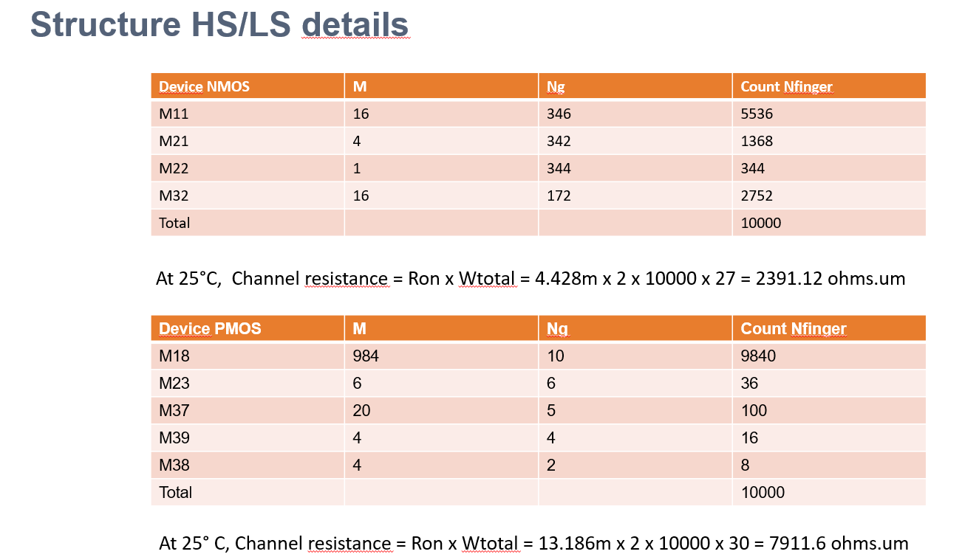

Slide 3
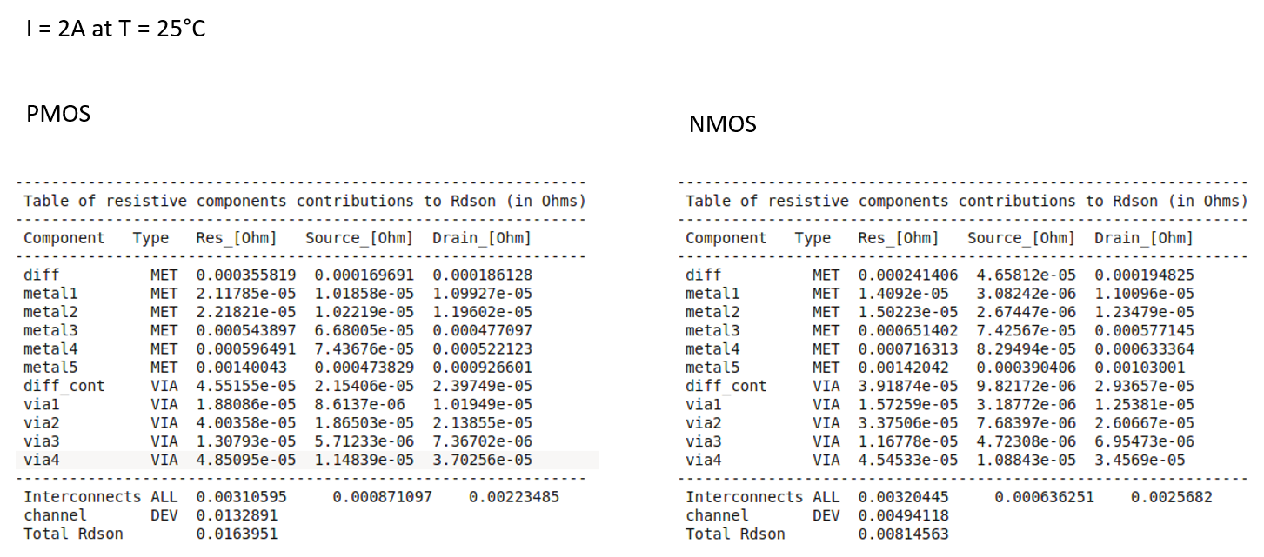

Slide 4
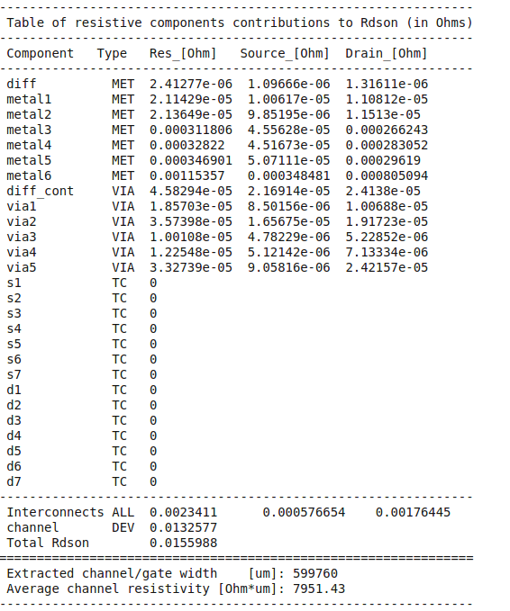
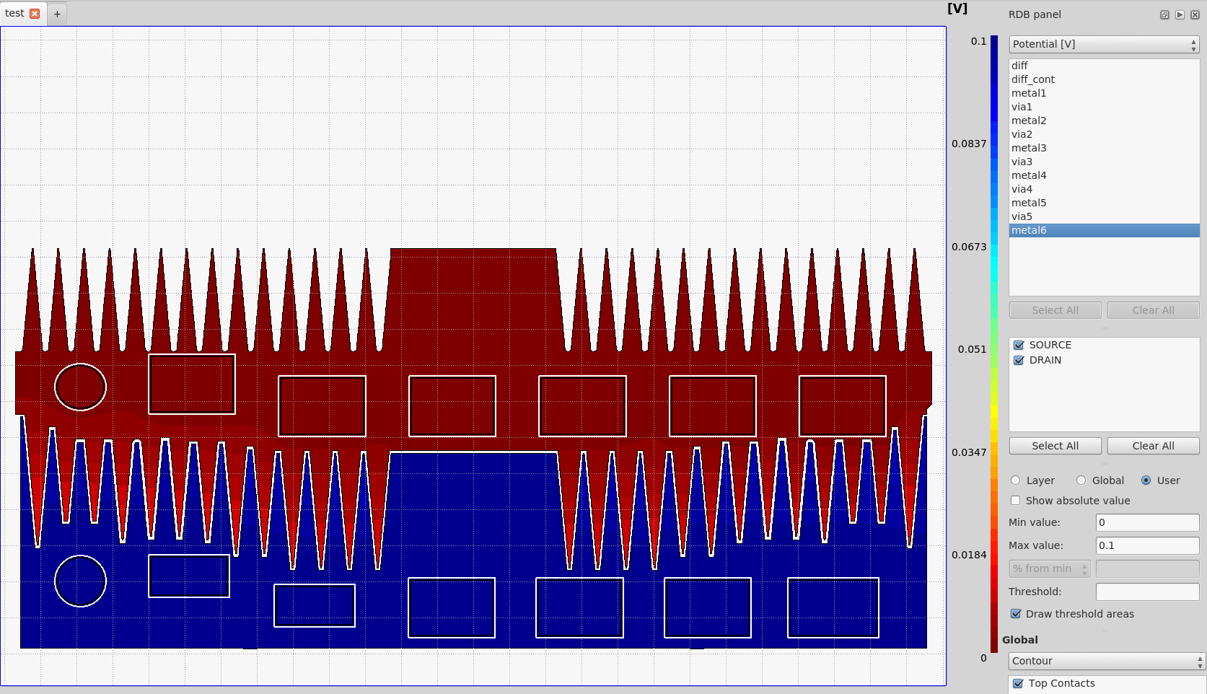
NCV91621 : Power module
HSS ( PMOS)
Expected: WTotalPmos = Ng x Wdevice x Nb_Pmos = 10000 x 30 x 2 = 600000
599760 / 30 = 19992 in fact, 8 gates are missing ( 4 per devices)

Slide 5
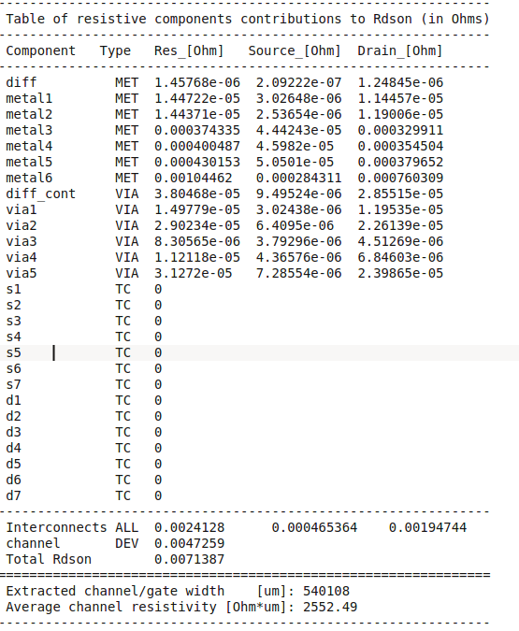
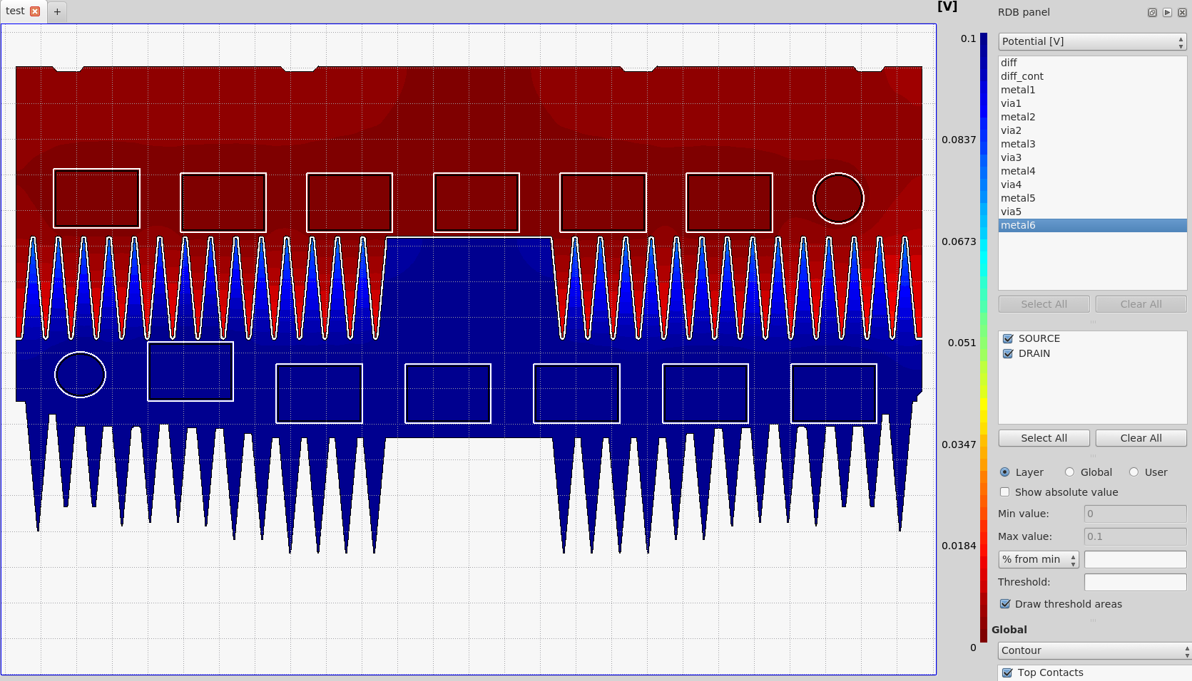
NCV91621 : Power module
LSS ( NMOS)
Expected: WTotalNmos = Ng x Wdevice x Nb_Pmos = 10000 x 27 x 2 = 540000
540108 / 27 = 20004 we have 4 extra gates ( 2 per devices)

Slide 6
To run R3D , enter the following command in console :
> r3d xxxx.cfg
Output file (xxxx.log) is created and saves the results of the run.

Slide 7
To run simulation, R3D requires differents kind of files :
  GDS file containing layout
  Configuration file which contains a series of R3D commands specifying simulations condition and options ( *.cfg)
  Rule file : describe layer connectivity and device recognition statements (1)
  Stack layer file : resistivity of metal, via resistance (2)
  Process file description : stack of layers : dielectric or metal, layers thickness (3)

Slide 8
Config file
# specify GDSII file name
input layout.gds
# specify rule file
rulefile techno.rule
# specifiy mapping and techno file
techfile stack_layer process
# Specify lowest and uppermost metal layers
r3d_start_layer metal1
r3d_end_layer metal6
# specify device specific channel resistance [Ohm*um] ( total Wgate)
r3d_device_resistance 5000.0
# number of nodes for discretization of transistor along gate width
r3d_mesh_for_device size=1.0
# discretizations of metals and vias
r3d_mesh_for_via dx=1 dy=1
# mesh for top contact discretization
r3d_mesh_for_top_contacts 40
#
r3d_mesh_for_cont size=5.0
# Define contacts (wirebond or bump )
r3d_top_contact v=0.0 xc=0 yc=73 dx=20 dy=20 r=0 source name=s circular node=src
r3d_top_contact v=0.1 xc=0 yc=-70 dx=20 dy=20 r=0 drain name=d circular node=drn
# Set the total current through the device
r3d_total_current 4.0
# create output file used by r3ddraw
r3d_dat_file 2
# enables calculation of individual contributions from all resistive layers to the total resistance of the device (Rdson + interconnect)
r3d_rdson_table
# direct solver
r3d_solver 2
# via grouping ( reduce the geometrical complexity of the layout)
viagr 1

Slide 9
Stack layers
process r3d_onc18gen2
deposition
*-----------------------------------------------
* No Type p/n Name Thickn. Epsilon
*-----------------------------------------------
step 1 substrate field 0.57 3.9
step 2 metal diff 0.12
*step 3 dielectric p fox 0.0 3.9
*step 4 dielectric p gox 0.005 3.9
step 5 metal poly 0.25
*step 6 dielectric n oxspr
*step 7 dielectric n nitspr
*step 8 dielectric n liner
step 9 dielectric p ox1 0.71 3.9
step 10 metal metal1 0.56
step 11 dielectric p ox2 0.88 3.9
step 12 metal metal2 0.56
step 13 dielectric p ox3 0.88 3.9
step 14 metal metal3 0.56
step 15 dielectric p ox4 0.88 3.9
step 16 metal metal4 0.56
step 17 dielectric p ox5 0.88 3.9
step 18 metal metal5 0.56
step 19 dielectric p ox6 0.88 3.9
step 20 metal metal6 3.07
step 21 dielectric p ox6 ??? ???
*-----------------------------------------------
enddeposition
endprocess

Slide 10
Process file
pro_layer=diff ext_layer=sd sheet_res=15;
pro_layer=poly ext_layer=poly sheet_res=6.5 TC1=0.0037;
pro_layer=metal1 ext_layer=met1 sheet_res=0.078 TC1=0.0036;
pro_layer=metal2 ext_layer=met2 sheet_res=0.078 TC1=0.0036;
pro_layer=metal3 ext_layer=met3 sheet_res=0.078 TC1=0.0036;
pro_layer=metal4 ext_layer=met4 sheet_res=0.078 TC1=0.0036;
pro_layer=metal5 ext_layer=met5 sheet_res=0.078 TC1=0.0036;
pro_layer=metal6 ext_layer=met6 sheet_res=0.010 TC1=0.0036;
ext_cont=diff_cont res=15 unit_area=0.0484;
ext_cont=poly_cont res=9 unit_area=0.0484;
ext_cont=via1 res=5 unit_area=0.0676;
ext_cont=via2 res=5.4 unit_area=0.0676;
ext_cont=via3 res=5.4 unit_area=0.0676;
ext_cont=via4 res=5.4 unit_area=0.0676;
ext_cont=via5 res=2.6 unit_area=0.1296;

Slide 11
Layer mapping
LAYER aa 102
LAYER cont 5
LAYER met1 6
LAYER met2 18
LAYER met3 39
LAYER met4 48
LAYER met5 56
LAYER met6 79
LAYER poly 4
LAYER via1 17
LAYER via2 19
LAYER via3 47
LAYER via4 55
LAYER via5 60
bulk = extent
gate_poly = poly and aa
sd = aa not poly
poly_cont = poly and cont
diff_cont = aa and cont
connect met6 met5 by via5
connect met5 met4 by via4
connect met4 met3 by via3
connect met3 met2 by via2
connect met2 met1 by via1
connect met1 sd by diff_cont
connect met1 poly by poly_cont
connect bulk bulk
DEVICE MN(nmos) gate_poly poly(g) sd(s) sd(d) bulk(b) []

Slide 12
r3d_start_layer & r3d_stop_layer : defines the name of the lowest and uppermost metal layer included in the simulation
r3d_start_layer metal1
r3d_end_layer metal6
Poly layer does not typically carry current, so mesh of the POLY layer is not useful. This saves RAM and simulation time.
r3d_mesh_for_device: specifies the discretization ( fracturing) of transistor along the channel width
r3d_mesh_for_device 50 : Each individual device channel is divided into 50 elements.
r3d_mesh_for_device count=50 : Each individual device channel is divided into 50 elements.
r3d_mesh_for_device size=10.0 Each individual device channel is divided into channel widths of 10.0 μm.
r3d_mesh_for_top_contacts : Discretization of the area on and around top contact
Using this command will ensure that large metal plates are meshed sufficiently where top contacts are placed on them.
r3d_mesh_for_top_contacts 20 -> A mesh of 20 equidistant spacings in both x and y directions are placed across each top contact.

Slide 13
r3d_mesh_for_via : Discretization of via
r3d_mesh_for_via 100 200 Each via layer is additionally discretized by a uniform mesh of 100 intervals along X axis and 200
intervals along Y axis.
r3d_mesh_for_via dx=5.0 dy=5.0 Each via layer is additionally discretized by a uniform mesh with a step size of 5.0 μm
along X axis and along Y axis.
r3d_channel : specifies a model for the device instanceswhich matrix solver is used
r3d_channel r=5000 rd = 0.03 rs = 0.05
r : resisivity of the channel [ohm x Wtotal in µm ]
rd or rs : serie drain / serie source resistance (Ohm per one micron of gate width)
r3d_solver : specifies which matrix solver is used
Syntax : r3d_solver 0 / 1 / 2
0: if the memory size is limited, iterative mode still be preferable
2: Direct solver is faster than an iterative

Slide 14
viagr : enables grouping if vias to reduce the geometrical complexity of the layout
0 : via grouping is disabled
1: via grouping is enabled
Via grouping is performed in order to reduce the number of vertical resistive elements corresponding to vias and contacts, ideally without loss of accuracy in the simulations. Vias and contacts forming large arrays are grouped into polygons that are discretized using a mesh. Simulating a large layout with large number of via arrays with parameter 0 (zero) may fail due to a large matrix size.
r3d_top_contact : specifies the top contact (wirebond, bump …)
r3d_top_contact v=0.1 xc=1040 yc=1180 dx=50 dy=50 r=0 drain name=d circular node=drn
r3d_top_contact v=0.0 xc=1040 yc=352 dx=50 dy=50 r=0 source name=s circular node=src
xc & yc : center of contact and dx & dy are width and height of the area
r3d_top_contact v=0.1 x1=265 y1=1114 x2=1882 y2=1257 r=0 drain name=d polygon node=drn layer=metal6
r3d_top_contact v=0.0 x1=265 y1=605 x2=1882 y2=748 r=0 source name=s polygon node=src layer=metal6
x1, y1,y2 ,y2 : lower left and upper right corners of the area

Slide 15
r3d_total_current : specifies the total current througt the device
r3d_total_current 4.0
Analysis of current density (electromigration) by viewing results of processing current density pltos in R3DDRAW
Em rules files may be defined to set current densisty limits of backend layers ( EM rules)
include emrules

Slide 16
Viewer
R3DDRAW

Slide 17
https://bbs.eetop.cn/thread-625278-1-1.html
https://pdfs.semanticscholar.org/d9c4/18fcc3443e7332bea8da067bbf394abe7551.pdf

