Slide 1
Self Appraisal Guidelines
October 2011

Slide 2

Individual Goals
  Project goals
    Ownership & Commitments
    Timely Execution
    Use of Best Practices
    Design for Manufacturing
  IP/Reuse goals
    Reuse & IP alignment
    Innovation & Documentation
    Design Method Improvements
  Behavioral goals
    Business focus
    Breakthrough thinking
    Continuous development
    Accountability
    Collaboration
  These goals must be aligned with:
  Business division objectives and strategies
  Job scope (Design leader, Analog or Digital Designer, Verification …)
  Grade Role & Responsibilities
  Development or Improvement Plans
  The goals must be:
  Specific
  Measurable
  Achievable
  Time Bound
  => Goal template document

Slide 3
Performance rating definitions

Slide 4

Nine-box Rating Descriptions 1/2
high
Distribution
Guidelines
Total = 0-20%
Total = 0-100%
Total = 0-20%
IDP Required
TP
TP2
TP1
1
(0-3%)
2
(0-10%)
3
(0-20%)
Top Performer
Consistently exceeds expectations
In top 20% of your performers
Consistently exceeds goals, budget, schedule
Consistently exceeds expectations
In top 20% of your performers
Consistently exceeds goals, budget, schedule
Consistently exceeds expectations
In top 20% of your performers
Consistently exceeds goals, budget, schedule
Total = 0-20%
GP2
GP1
GP
4
(0-10%)
5
(0-100%)
6
(0-20%)
Good Performer
Meets, sometimes exceeds expectations
Meets, sometimes exceeds goals, budget, schedule
Meets, sometimes exceeds expectations
Meets, sometimes exceeds goals, budget, schedule
Meets, sometimes exceeds expectations
Meets, sometimes exceeds goals, budget, schedule
Performance
Total = 60-100%
(0-10%)
BE2
Action Plan
Required*
7
(0-20%)
8
BE1
(0-20%)
9
BE
(0-5%)
Below
Expectations
In bottom 20% of your performers
New to role
Does not always meet goals, budget, schedule
In bottom 20% of your performers
Does not always meet goals, budget, schedule
In bottom 20% of your performers
Does not always meet goals, budget, schedule
Total = 0-20%
low
Advancement Potential within 2-3 years

Slide 5
Nine-Box Matrix Descriptions 2/2
Rating 4-5 1 HIGHEST POTENTIAL Consistently over delivers on expectations and is currently ready for new challenges. Immediately promotable. | Rating 4-5 2 HIGH MOBILITY Consistently over delivers on performance. Has potential to expand beyond current responsibilities across the business or up one level in 12-18 months. | Rating 3-4 3 VERY COMPETENT, NOT PROMOTABLE Consistently over delivers in current role but does not have interest and/or ability to move to an expanded role.
Rating 3-4 4 NEEDS DEVELOPMENT High potential with room to grown in current assignment Rating 3 INCREASED PROFICIENCY Requires increased proficiency or time in current role. | Rating 3 5 SOLID PERFORMER Good performer and may have potential to do more. Possibly needs development in current role, and in areas that will improve current performance and prepare individual for future assignments. | Rating 3 6 COMPETENT Does the work and is effective in current position. Promotional opportunity is not likely or necessary.
Rating 2 or No Rating 7 POTENTIAL TO EXPAND IN CURRENT ROLE New to job or assignment (3-6 months) and is learning the job. Has potential for broader assignments. Performance may be more accurately measured after longer period of time. | Rating 1 or 2 8 POSSIBLY WRONG POSITION Is not delivering on expected results. Immediate improvement in performance is necessary. Needs to be actively managed. | Rating 1 9 REDIRECT Not an effective performer. May not be capable of growing with the job or company. Individuals need to be actively managed, repositioned, or outplaced.
Performance
Rating 2
Potential
Notes:
2008 guideline (for new in role employee) for ratings of a 2 in box 7 means eligible for bonus but not merit increase in the US

Slide 6
ON Semiconductor Values
Integrity
  We say what we mean and are accountable for delivering our commitments on time.
  We address issues in an objective, fact based and constructive fashion without fear of reprisal.
  When a decision has been made we all execute to support it.
  We comply with all legal requirements and hold ourselves to the highest standards of ethical conduct.
Respect
  We treat each other with dignity and respect.
  We share information and encourage divergent viewpoints in an open and honest environment.
  We draw out the best in each other recognizing that diversity of backgrounds and experience are key strengths.
  We all win when we support each other by placing the success of the Company above individual interests.
Initiative
  We take informed risks while making data based decisions.
  If a problem exists we are individually responsible to see it through to rapid resolution.
  We value people who demonstrate a positive, “can-do” attitude, while collaborating to win.
  We work smart and with a sense of urgency.
Return

Slide 7
Potential: definition
Potential is the assessment of a person’s ability to handle an expanded role in the future based on past performance
  It is not your intrinsic potential
  It is an evaluation of your potential based on the performance and behavior demonstrated the year of evaluation
  A high potential employee is someone with the ability, engagement and aspiration to rise and to succeed in more senior critical positions
Performance does not equal potential:
  Current performance is a necessary condition for potential, but does not guarantee success at the next level
  Statistics for illustration:
    only 7% of high potential employees are not high performers
    Only 30% of high performers are demonstrating high potential
Notes:
9-box with some suggested % guidelines; back-up slides have more descriptions of each box

Slide 8
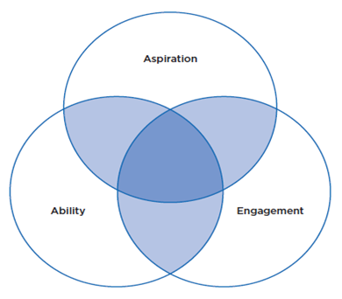


Elements of Potential
  A high potential employee is someone with the ability, engagement and aspiration to rise and to succeed in more senior critical positions
new responsibilities

Slide 9
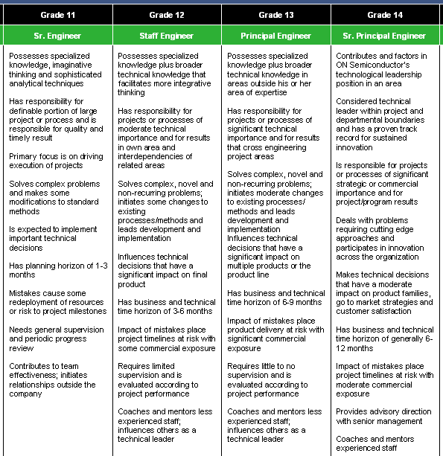

Grade Role & Responsibility
Tech Expertise
Responsibility
Breakthrough
Thinking
Business Impact
Autonomy &
Maturity
Develop Others

