Slide 1
ASIC DESIGN FLOW
Submitted To:- Submitted By:- Manju K. Chattopadhyay Purvi Medawala
14MTES11

Slide 2
TABLE OF CONTENTS
Introduction
ASIC Design Flow
Specification
RTL Coding
Test Bench & Simulation
Synthesis
Pre-layout Timing Analysis
APR
Back Annotation
Post-layout Timing Analysis
Logic Verification
Tapeout

Slide 3
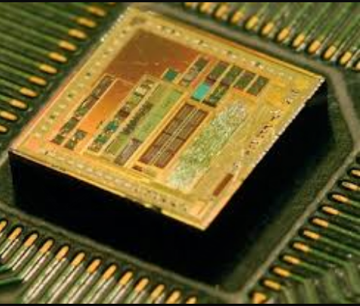
What is ASIC ?
Application Specific Integrated Circuit
Build by connecting existing circuit blocks in new ways
High speed, Lesser area & power consumption, more time to market

Slide 4
ASIC DESIGN FLOW

Slide 5

SPECIFICATION
Features and functionalities of ASIC are defined
Chip planning is performed
Architecture and microarchitecture are derived

Slide 6

RTL CODING
Microarchitecture converted into synthesizable RTL code containing logic functionalities
Graphical Tools like Summit Design’s or Mentor Graphics are used
Sometimes code is written manually

Slide 7
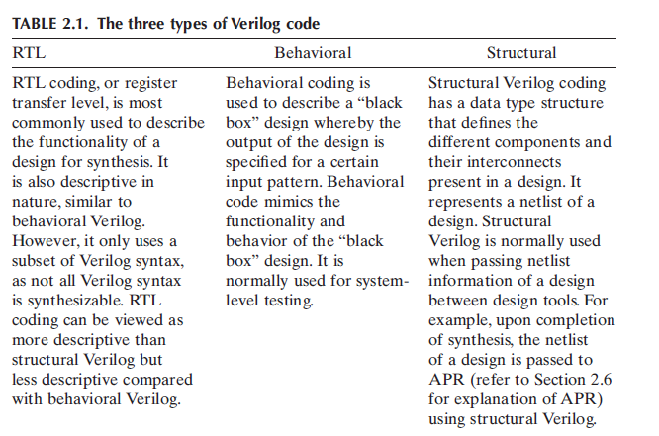
RTL CODING cont..

Slide 8
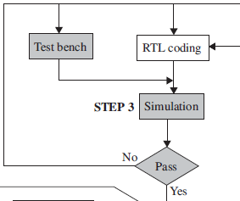
TEST BENCH AND SIMULATION
Test bench created to simulate RTL code using HDL simulators
Cadence’s Verilog XL, Mentor Graphic’s Modelsim are used
Finally logically correct RTL code obtained

Slide 9
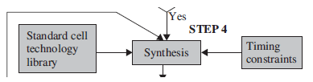
SYNTHESIS
RTL code converted into optimized logic gate level representation
Synthesis tools like Synopsys’s Design Compiler & Cadence’s Ambit used
“technology library” file & “constraints file” used

Slide 10
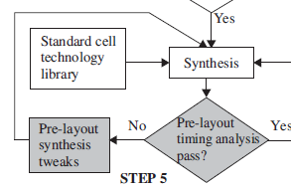
PRE-LAYOUT TIMING ANALYSIS
synthesized database along with timing information from the synthesis process used to perform a Static Timing Analysis
Tweaking (making small changes) has to be done to correct any timing issues

Slide 11
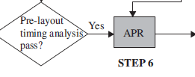
AUTOMATIC PLACE AND ROUTE (APR)
Layout is produced
synthesized database together with timing information from synthesis is used to place the logic gates
Designs have timing critical path

Slide 12

BACK ANNOTATION
process where extraction for RC parasitics are made from the layout.
path delay is calculated from these RC parasitics
Back annotation is the step that bridges synthesis and physical layout

Slide 13
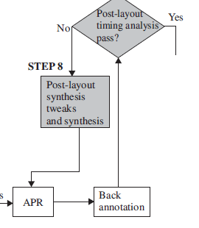
POST-LAYOUT TIMING ANALYSIS
allows real timing violations such as hold and setup to be detected
net interconnect delay information is fed into the timing analysis and any setup violation is fixed

Slide 14
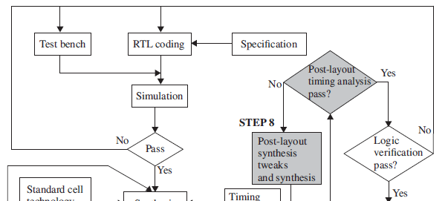
LOGIC VERIFICATION
the final check to ensure the design is correct functionally after additional timing information from layout
Design is re-simulated using test benches with timing information from layout
If there are failures, fix it by moving back to step 2 or step 8

Slide 15
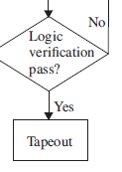
TAPEOUT
When design passes logical verification, its ready for fabrication
The tapeout design is in the form of GDSII file, which will be accepted by the foundry

Slide 16
REFRENCES
Verilog Coding for Logic Synthesis, edited by Weng Fook Lee, John Wiley and Sons, Inc.
CMOS Digital Integrated Circuits , Analysis and Design by Sung-Mo Kang & Yusuf Leblebici, TMH

Slide 17
ANY QUESTIONS ????

Slide 18
THANK YOU !
☺ ☺

