Slide 1
Design for Testability
Test & reliability

Slide 2
Murphy’s laws
“If you don’t test it, it won’t work!” (Guaranteed)

Slide 3
Inroduction:
The purpose of this document is to present the role of the test in the development cycle of a product.
General concept
Implementation in digital flow with ATPG

Slide 4
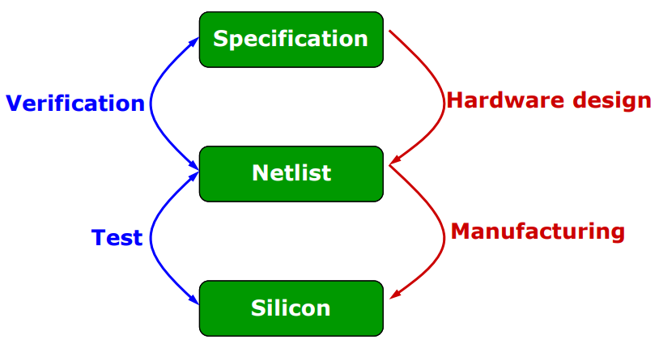
Test vs verification
≠

Slide 5
Test concept
The fabrication process is imperfect and introduce manufacturing defects
cause malfunction of the device
Improve yield and reject undesirable parts
2 types of yield loss : random effects or process variations

Slide 6
Defect
A defect is the unintended difference between the implemented hardware and its intended design 
Defects occur either during manufacture or during the use of devices

Slide 7
Defects in fabrication
Decreasing feature size (reduce device dimention, technology scale shrink ) increases probability of defects during manufacturing process
These defects come from many sources :
Defects in the base silicon.
Oxide breakdown (crystal defects)
Optical deformation (photolithography)
Dust or contamination in the fab or on wafer.
Dust on mask.
Misalignment. Over-etch or under-etch.
…….

Slide 8
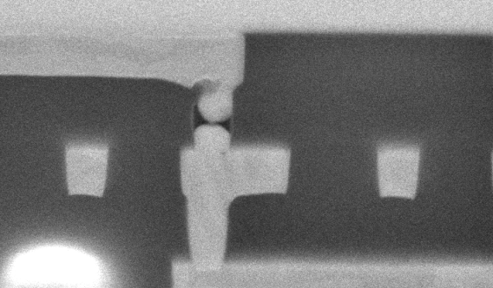
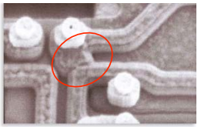
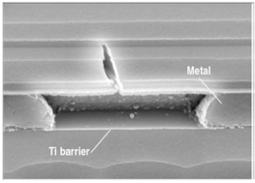
Defects examples

Slide 9
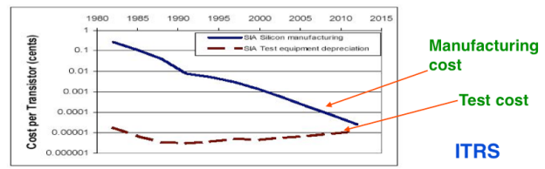
Importance of the test
Yield of any chip is < 100% , no process is perfect !
The role of testing is to detect whether something went wrong
Effectiveness of testing is most important for quality products
Today, test cost as more 60% of the total manufacturing cost

Slide 10
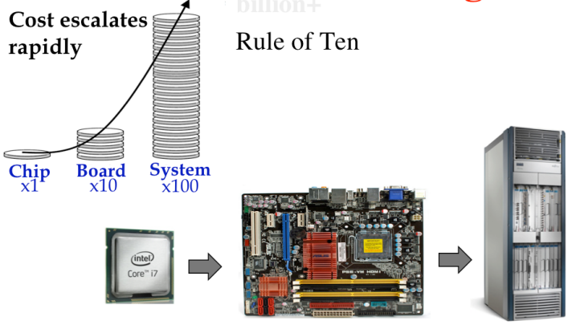
Motivation of testing
Intel bug (1994): 1M units shipped, recall cost $450M

Slide 11
Benefits of testing
Quality and economy are two major benefits of testing, these two attributes are greatly dependent and can not be defined without the other 
Quality means satisfying the user’s needs at a minimum cost 
Needto weed out all bad products before delevery to customers 
Understanding the principles of manufacturing and test is essential for design a quality product

Slide 12
Manufacturing
Testers (ATE) are very expensive
Time is money
Minimize time on tester
Careful selection of test, choose the most appropriate tests

Slide 13
How to test digital blocks ?
Input Patterns
Output Response
-1011
11-00
-0-1-
01--0
0-101
Circuit under
Test
(CUT)
1-001
0011-
-1101
1001-
01-11
Stored
Correct
Response
Comparator
Test result
The stimuli are called test patterns or test vectors

Slide 14
Testability
Two important concept are higlhy associated woth testability:
• Controllability : ease of observing a node by watching external output pins of the chip
• Observability : ease of forcing a node to 0 or 1 by driving input pins of the chip

Slide 15
Focus to digital test
Aim: observe and control logic stucture
Combinational logic is usually easy to observe and control
It’s difficult to test sequential circuit behave
Idea: Modify sequential circuitery of the design
This technique is called scan design and is a part of the DFT methodology

Slide 16
Design for test (DFT)
Design the circuit to increase observability and controllability
If each register could be observed and controlled, test problem reduces to testing combinational logic between registers.
Better yet, logic blocks could enter test mode where they generate test patterns and report the results automatically.

Slide 17
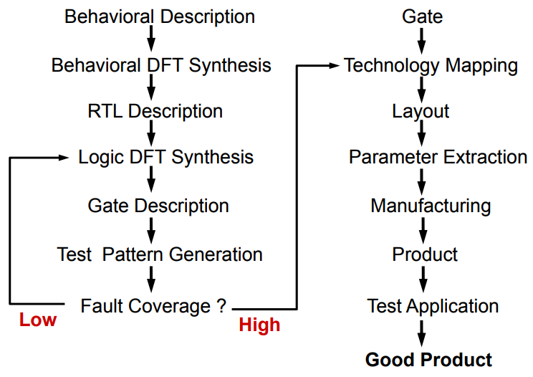
DFT implementation

Slide 18
Test pattern generation
• Manufacturing test ideally would check every node in the circuit to prove it is not stuck.
• Apply the smallest sequence of test vectors necessary to prove each node is not stuck.
• Good observability and controllability reduces number of test vectors required for manufacturing test.
– Reduces the cost of testing
– Motivates design-for-test

Slide 19
Lexique : Defect, Fault, and Error
Defect : 
- A defect is the unintended difference between the implemented hardware and its intended design 
Fault :
- A representation of a defect at the abstracted function level 
Error : 
- A wrong output signal produced by a defective system 
An error is caused by a Fault or a design error
Defect --> Fault ---> Error ---> Failure

Slide 20

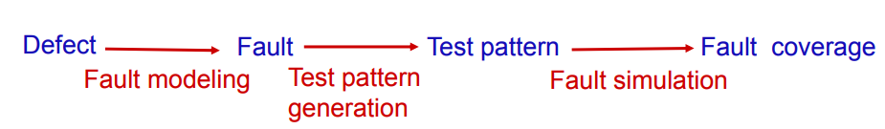

Slide 21
Fault models
Fault models considered in this document:
  Stuck-at fault (gate level)
  Bridging fault
  Path-delay / Transition fault
  IDDQ fault
A delay or transition fault alters the signal propagation delay
along the faulty line As a result, signals can arrive at the outputs of
the circuit before or after the time expected.
Bridge
Faults
IDDQ
Transition
Stuckat
Most frequent faults

Slide 22
Fault model example
Inputs and outputs can either be “stuck-at” a high (Vdd) or low (Ground)
A
B
Y
Pattern | A | B | Y | Faults Detected
1 | 0 | 0 | 0 | A: SA1 (#2) B: SA1 (#4) Y: SA1 (#6)
2 | 0 | 1 | 0 | A: SA1 (#2) B: SA0 (#3)
3 | 1 | 0 | 0 | A: SA0 (#1) B: SA1 (#4) Y: SA1 (#6)
4 | 1 | 1 | 1 | A: SA0 (#1) B: SA0 (#3) Y: SA0 (#5)
Fault Number | Fault Description
#1 | Input A is (shorted to Gnd): SA0
#2 | Input A is (shorted to Vdd): SA1
#3 | Input B is (shorted to Gnd): SA0
#4 | Input B is shorted to Vdd) : SA1
#5 | Output Y is (shorted to Gnd): SA0
#6 | Output Y is (shorted to Vdd) : SA1

Slide 23
Stuck at faults
Permanent or static faults
a short is formed by connecting points not intended to be connected; signal stuck to VDD or GND
a open results from the breaking of a connection.

Slide 24
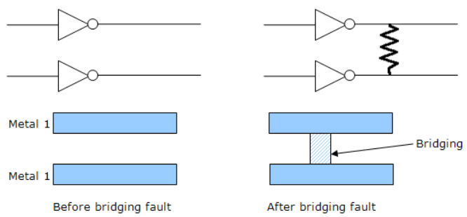
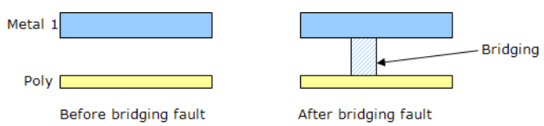
Bridging faults (1)
The bridging fault model tests for resistive shorts between two normally unconnected in wires, which could be caused by a piece of metal from the sputtering process
Bridging faults can be intra-layer and inter-layer c

Slide 25
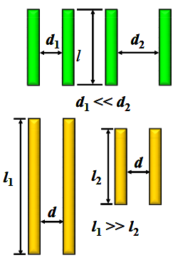
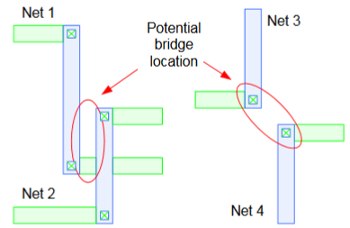
Bridging faults (2) : interconnect defects
Two or more adjacent wire are shorter together
EDA tool extract capacitive coupling based bridge pairs from physical design (frindge capacitance)
Higher capacitance indicating the higher probability of bridge occurence
Onsemi script analyze output database to identifiy the potential bridge
The designer can filter the results to select or ignore nodes that are suceptible to create a bridge.
The new netlist is given to ATPG tool to generate the
bridge detection patterns used by ATE
High probability
of bridging faults

Slide 26
Bridging faults (3) : layout analysis
Detects bridging pair nets:
examining the physical database for parallel or close proximity wires

Slide 27
Transistion faults
Delay transistion: increase the input to output delay of one logic gate (slow to rise or to fall)
Delay path : propagation delay of the path exceeds the clock interval
(timing violation)

Slide 28
IDDQ faults (1)
Measure supply current in quiescent state (not switching and inputs are statics)
Leakage and bias current value expected is less than 10uA
Advantage:
- IDDQ test can detect (catch) bridge that are not detectable or other
faults that are not found by saf vectors
Inconvenience :
- Compared to scan chain test, Iddq test is time consuming (slow)
- Leakage current closer to quiescent current for deep submicron

Slide 29
IDDQ faults (2)
Normal IDDQ: 1nA
Abnormal : > 10µA
VDD
IDD
inputs
outputs
circuit
VSS

Slide 30
Concept
IC design techniques that add testability features to a hardware product design.
Design techniques that make test generation, test application and test evaluation cost-effective.
The added features make it easier to develop and apply manufacturing tests to the designed hardware. The purpose of manufacturing tests is to validate that the product hardware contains no manufacturing defects that could adversely affect the product's correct functioning

Slide 31
Ideal test & real tests
Ideal tests detect all defects produced in the manufacturing process 
It is difficult to generate tests that detect every possible fault in the chip due to high design complexity
Very large numbers and varieties of possible defects need to be tested 
Difficult to generate tests for some real defects

Slide 32
Main idea:
Obtain controllability & observability of FFs
Add a test mode to the circuits
- All FFs functionally form one or more shift registers
- Inputs and output of these registers are made into
PIs & POs
- All FFs can be set to any desired state (by shifting in)
- All states of FFs can be observed (by shifting out)
- All FFs can be set/observed in “#FFs longest register
” *CLK

Slide 33
Scan path design
Basic Problem
– Test generation for sequential circuits is difficult.
Objective
– Make all the flip flops directly controllable and observable.
What do we gain?
– Combinational circuit test generation can be used.
– A few additional tests to test the flip-flops (shift register).

Slide 34
Scan is the most popular DFT technique:
- Rule-based design
- Automated DFT hardware insertion
- Combinational ATPG
Advantages:
Design automation
High fault coverage; helpful in diagnosis
Hierarchical – scan-testable modules are easily
combined into large scan-testable systems
Moderate area (~10%) and speed (~5%) overheads
Disadvantages:
Large test data volume and long test time
Basically a slow speed

Slide 35
Fault Coverage
Fault coverage = percentage of faults detected by set of test vectors
For a given set of input test pattens
At least one mismatch -> fault is detected
No mismatches -> fault is not detected
D = detected faults
U = undetected faults
T=Total faults = D + U
Fault coverage = D / T

Slide 36
Fault detecion
Requires
Observation to catch an error (from the fault)
Control to apply stimuli that creates an error as a result of fault

Slide 37
Wrapper ?
Interface between digital block and rest of chip
Make access to cell and isolate it from rest of the circuit
Test wrapper is the logic added around topdig to provide test access to the embedded core
Normal mode :
Test mode

Slide 38
Functional vs Structural testing
Functional testing verifies that a circuit fulfils the desired spec.
Functional testing not feasible for exhaustive tests.
  Example: 32-bit adder requires 2⁶⁵ ≈ 3.7*10¹⁹ test vectors
Structural test focuses rather on the circuit structure and can cover manufacturing defects that otherwise may not have been detected by functional testing.
  Power or ground shorts
  Open interconnect on the die (caused by dust particles)
  Short circuited source or drain on the transistor, (caused by metal spike through)
  Exhaustive test is impossible or unpractical

Slide 39
Scan design overview
Internal scan (or scan design) is the internal modification of your design’s circuitry to increase its testability.
Goal of scan : make a difficult to test sequential circuit behave (during the testing process) like an easier to test combinational circuit
Replacing sequential cells (FF) with scannable scan cells and then stitching the scan cells together into scan registers, or scan chains. You can then use these serially-connected scan cells to shift data in and out when the design is in scan mode.

Slide 40
Sequential -> combinational
Problem: ATPG works for combinational logic while most ICs are sequential
Solution: Provide a test mode in which flip flops can be accessed directly
- Replace flip flop (FF) with scan flip flop (SFF): extra multiplexer on data input
- Connect SFFs to form one or more scan chains
- Connect multiplexer control signal to scan enable
Flip-flop
Data in
0
Flip-flop
D
Q
Q
Scan in
1
clk
clk
Scan Mode

Slide 41
SCAN chain : unactive
All the flops are connected in form of a chain, as a shift register
Combinational logic
D
0
FF
D
0
FF
D
0
FF
Q
Q
Q
SI
1
SI
1
SI
1
clk
clk
clk
SE
SE
SE
Normal mode SE = 0

Slide 42
SCAN chain : active
Combinational logic
D
0
FF
D
0
FF
D
0
FF
Q
Q
D
Q
SI
1
SI
1
SI
1
clk
clk
clk
SE
SE
SE
Scan mode SE = 1

Slide 43
Scan process
Scan chain operation involves 3 stages: Scan-in, Scan-capture and Scan-out
- Shifting in and loading all the flip-flops with an input vector. During scan- in, the data flows from the output of one flop to the scan-input of the next flop not unlike a shift register
- Once the pattern is loaded, one clock pulse (capture) is applied to excite the combinatorial logic block (evaluation) and the output is captured .
- The data is then shifted out and the signature is compared with the expected signature
During response shift-out, next pattern can be
concurrently shifted in.
Shift-In
Capture
Shift-Out
time

Slide 44
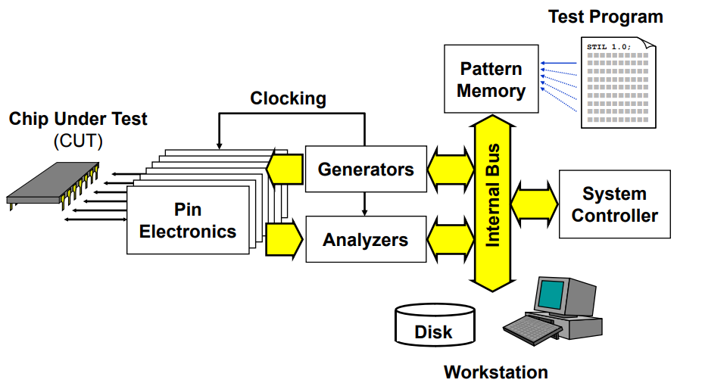
Internal structure of ATE

Slide 45
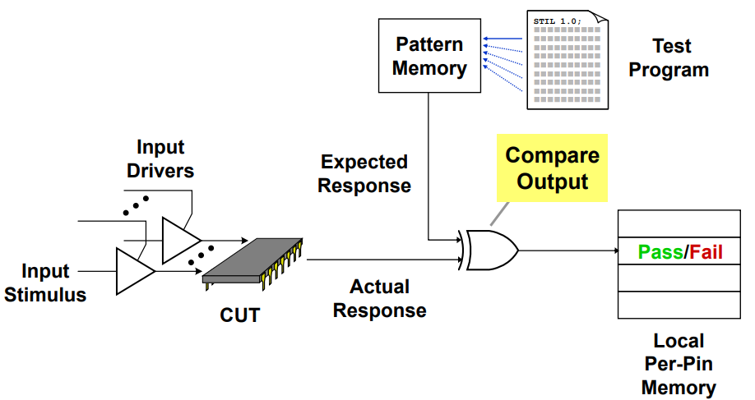
ATE Test operation

Slide 46
Test pattern generation
Automated tool that consists of creating test sequences (stimuli ) to verify the proper functioning of a digital circuit.
Detection of defects introduced by the manufacturing
The test sequence generators verify that each of the nodes of the circuit will be observable to develop a sequence of tests whose routing through the circuit activates all its nodes and makes it possible to propagate the faults up to the output pins of the component.

Slide 47
ATPG essentials
Netlist
ATPG algorithms use fault models to
generate patterns and to give a fault
coverage result & fault classes list
A fault model is a digital representation of a
real manufacturing/silicon defect
- Fault model matches with one category of
silicon defect only
- It is the abstract of reality (not 100%)
Defects not covered by a fault model could
escape to test
Fault coverage 100 % ≠ 0 ppm
ATPG
Algorithms
User
ATPG
engine
Fault
models
ATPG Tool
Patterns

Slide 48
ATPG overview
Sets of 1 and 0 placed in each inputs pins during the manufacturing test process to determine if the chip is functioning properly
When the test pattern is applied, the tester determines if the circuit is free from manufacturing defects by comparing the fault-free output—which is also contained in the test pattern—with the actual output measured by the ATE
If no test vectorexists for a fault, the fault is said untestable

Slide 49
ATPG process
2 Main steps:
Generating patterns
Performing fault simulation to determine which faults the patterns detect

Slide 50
What is STIL files ?
Standard Test Interface Language : international format
Test vectors generated by the ATPG tool and used by the tester.
We find the stimulus file that introduces the faults and the response files that will be compared

Slide 51
ITC = Interconnect Test coverage
Also know as loopback
Cells test placed inside analog cells (xor)

Slide 52
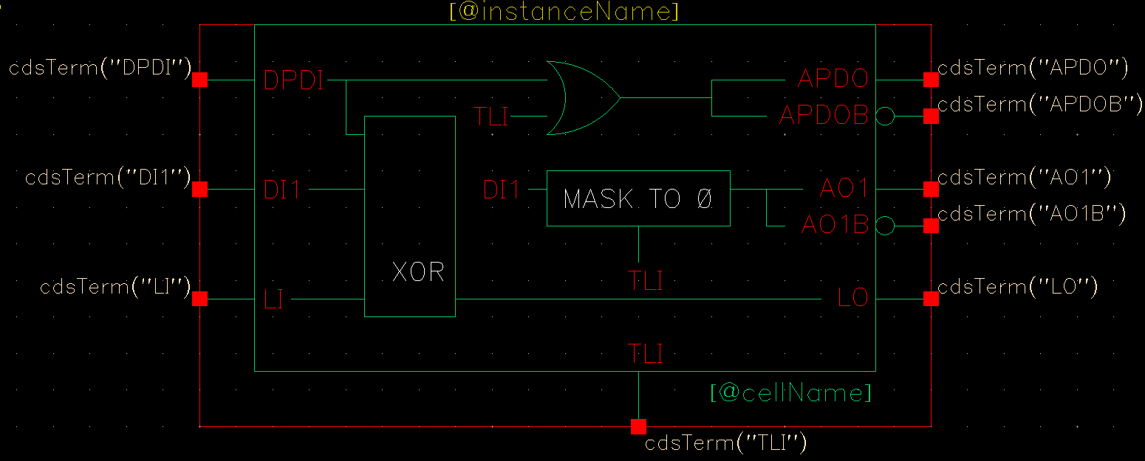
ITC cells
ITC = interconnect test coverage or loop back
Used to test the digital cells found in analog blocks
Loopback cells must be placed inside these blocks
In Automotive flow, it a requirement to check stuck at and birdge failures on wire between digital and analog
Increase coverage

Slide 53
ITC implementation
Digital
cmd
Analog
in
ITC
out

Slide 54
Typical flow:
Implement DFT
Generate test patterns (ATPG)
Verify fault coverage of patterns trought fault simulation

Slide 55
wrapper: surrounding hardware with test logic block
A normal mode where the core terminal is driven by the host chip.
An external test mode where the wrapper element observes the core input terminal for interconnect test.
An internal test mode where the wrapper element controls the state of the core input terminal for testing the logic inside the core.

Slide 56
What is Tessent ?
Tessent suite is set of DFT tools from Mentor Graphics
It’s a design-for-test environment within which you can perform all the tasks required to insert DFT hardware, generate manufacturing test patterns, and post-silicon tasks such as diagnosis and yield analysis
Tessent provides a graphical user interface (GUI), DFTVisualizer, that allows you to edit and introspect designs, and adjust object attributes

Slide 57
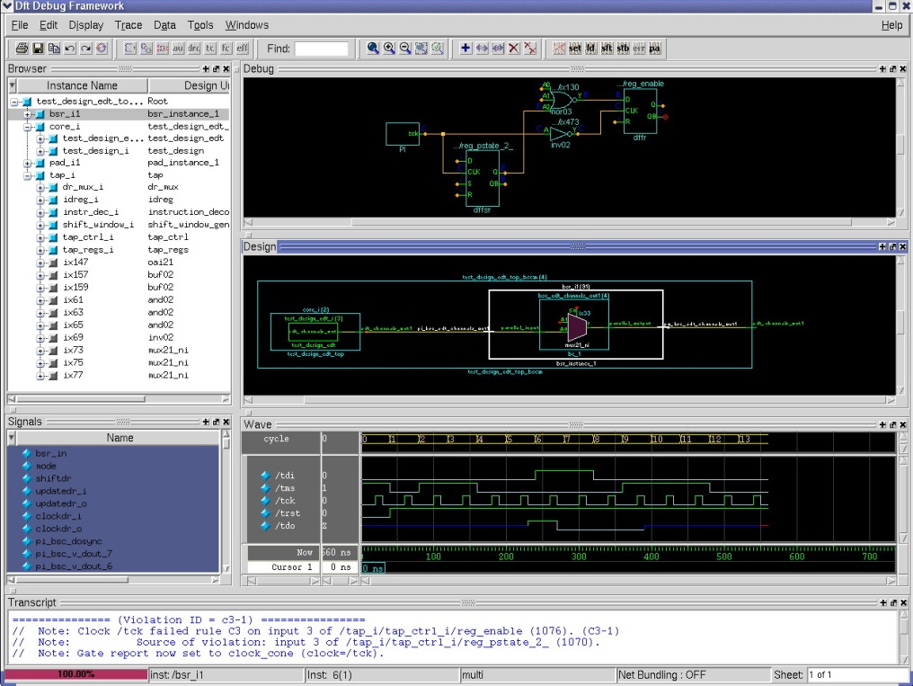
DFT VISUALIZER
DFT debug environment in Tessent
Tool to visally investigate the causes of DRC low converage
Intuitive and effective GUI to reduce DFT debug effort
Eases design navigation & exploration
Helps to debug DFT related issues
  DRC violations
  Low coverage
  Test procedures

Slide 58
Tetramax from Synposys ….

Slide 59
ATPG – digital blocks

Slide 60
ATPG digital flow features
For each project, a set of patterns must be generated.
In digital environment a set of scripts stored in templates allows to:
  Generate vectors in STIL format compatible with tester
  Generate testbench and vectors in Verilog format
  Simulate Verilog vectors with timings back annotation
  Provide cadence cells with auto-check embedded vectors for top cell simulation
  Estimate realistic stuck-at fault test coverage

Slide 61
Directory structures & files templates
Several files (do file, lib files, contraints sdf, parameters) are needed to perform pattern generation and for testbenchs simulations
mkblock.csh script creates a dedicated directory under DIG_BLOCKS/<digital_block name>/tool_data/tessent
Symbolink :

Slide 62
Directory template
  /tessent
  tessent_patt_saf.do : tessent dofile to generate stuck at fault vectors
    tessent_patt_sbf.do : tessent dofile to generate static bridge fault vectors
    tessent_patt_tft.do : tessent dofile to generate transient fault vectors
    tessent_patt_iddq.do : tessent dofile to generate IDDQ vectors
    tessent_cov.do : tessent dofile to estimate coverage
    tessent_testproc.do : tessent procedures file used by dofiles
    param_file : tessent options for .stil format
    run_patt.sh : tessent command for pattern generation
    run_cov.sh : tessent command for coverage estimation
    atpg_wrapper.v : wrapper around digital block= netlist for vectors generation
    generate_patterns.sh : script to generate patterns and create files for top cell simulation
    simulate_patterns.sh : script simulating all generated patterns in worst & best conditions
    /vectors : directory to store vectors and re-simulate them
      scan_map.txt : text file template for scan pins mapping
      header.txt : text file template for .stil header compatible with eagle tester
    /reports : directory containing tessent reports
    /top_cell_sim : directory to store deliverables for top cell simulation
To be completed by Designer

Slide 63
ATPG Patterns generation 1
In tessent directory, use generate_patterns.sh script that includes several sub command:
Launch tessent trought run_patt.sh to generate vectors and test benchs
Call gen_stil_4_eagle.pl to make STIL vectors compatible with eagle tester
Call generate_top_vectors.pl to write cadence test benches for top cell simulations.
Usage: sh generate_patterns.sh cellname block1 block2 …. blockN
Example: sh generate_patterns.sh DigTop scv78565_dig switcher_dig

Slide 64
Faults models
tessent -shell \
-dofile tessent_patt_saf.do \
-logfile tessent_patt_saf.log -replace
# Transition fault
tessent -shell \
-dofile tessent_patt_tft.do \
-logfile tessent_patt_tft.log -replace
# Static bridging fault
tessent -shell \
-dofile tessent_patt_sbf.do \
-logfile tessen_pattt_sbf.log -replace
# IDDQ
tessent -shell \
-dofile tessent_patt_iddq.do \
-logfile tessent_patt_iddq.log -replace
./run_patt.sh

Slide 65
ATPG Patterns generation 2
    Here is the list of files outputted by Tessent through run_patt.sh script:
  under tessent/
    tessent_patt.log -> drc rules report
  under reports/
    <block_name>_scan_chains.rpt -> lists registers in chains from output to input
    <block_name>_drc_C6.rpt -> report of C6 violations, flops to be masked
    <block_name>_wrapper_faults_au.rpt -> provides list of untestable faults
    <block_name>_wrapper_coverage.rpt -> provides coverage information
    Note: use run_cov.sh to get real coverage

Slide 66
ATPG Patterns generation 3
  under vectors/
    <block_name>_chain.v
    <block_name>_chain.v.0.vec -> set of Verilog data + auto check testbench
    <block_name>_chain.v.cfg for shift in / shift out vector (scan check integrity)
    <block_name>_chain.v.po_name
    <block_name>_serial.v
    <block_name>_serial.v.0.vec -> set of Verilog data + auto check testbench
    <block_name>_serial.v.cfg for first 10 vectors (shift and capture)
    <block_name>_serial.v.po.name
    <block_name>_serial_full.v
    <block_name>_serial_full.v.0.vec -> set of Verilog data + auto check testbench
    <block_name>_serial.v.cfg for all vectors (shift and capture)
    <block_name>_serial_full.v.po.name
    <block_name>_parallel.v
    <block_name>_parallel.v.0.vec -> set of Verilog data + auto check testbench
    <block_name>_parallel.v.cfg for all vectors (capture only) for debug purpose
    <block_name>_parallel.v.po.name
    <block_name>_parallel.v.chain.name
    <block_name>.stil -> all vectors in stil format

Slide 67
ATPG Patterns generation 4 : STIL post processing
To be fully compatible with eagle test program, the header of stil file generated by Tessent must be modified.
Inputs must be masked and outputs receive hi-Z during the first tester cycle.
scan_map.txt (in vectors/ directory) must be manually updated with top cell scan pin names and number of chains in the design:
Example scv78565: nb_chain =1
scan_clk = scan_clk
scan_rstb = scan_rstb
scan_en = scan_en
scan_in1 = scan_in
scan_out1 = scan_out
header.txt (in vectors/ directory):
  Must be changed only if multiple scan chains to add other scan_in/scan_out pins.
  Scan pins will be replaced by their top cell names by gen_stil_4_eagle.pl script.

Slide 68
ATPG Patterns generation 5
The generate_patterns.sh script calling generate_top_vectors.pl inside top_cell_sim/ directory to modify the testbench files generated by Tessent in vectors/ directory :
      usage: perl $TOOLS_SCRIPT/scan/generate_top_vectors.pl
      -vec <block_name>_chain.v | serial.v | parallel.v
      -map scan_map.txt
      -delay < in us>
      -block b1 –block b2 …. block N
What the script does:
Modify Tessent testbench file :
  - Remove atpg_wrapper instantiation and create scan pins inputs and outputs
  - Change relative to absolute paths for called files, insert delay scan process execution from <delay> us
  - Replace atpg_wrapper_inst by digital hierarchical path in top cell test bench
  - Rename modules in atpg_shift_vectors atpg_capture_vectors or atpg_parallel_vectors according to type
  - Copy other files from vectors/ directory
  - Create testbenches in top_cell_sim/ for re-simulation including .trn logging

Slide 69
ATPG Patterns generation 6
Here are the files generated:
under vectors/
  <block_name>_chain.v
  <block_name>_chain.v.0.vec
  <block_name>_chain.v.cfg
  <block_name>_chain.v.po_name
  <block_name>_serial.v
  <block_name>_serial.v.0.vec
  <block_name>_serial.v.cfg
  <block_name>_serial.v.po.name
  <block_name>_parallel.v
  <block_name>_parallel.v.0.vec
  <block_name>_parallel.v.cfg
  <block_name>_parallel.v.po.name
  <block_name>_parallel.v.chain.name
under topcell_sim/
  atpg_ <block_name>_ shift_vectors.v
  <block_name>_chain.v.0.vec
  <block_name>_chain.v.cfg
  <block_name>_chain.v.po_name
  tb_scan_shift.v
  atpg_ <block_name>_ capture_vectors.v
  <block_name>_serial.v.0.vec
  <block_name>_serial.v.cfg
  <block_name>_serial.v.po.name
  tb_scan_capture.v
  atpg_ <block_name>_ parallel_vectors.v
  <block_name>_parallel.v.0.vec
  <block_name>_parallel.v.cfg
  <block_name>_parallel.v.po.name
  <block_name>_parallel.v.chain.name
  tb_scan_parallel.v
New modules atpg_<block_name>_[shift | capture | parallel]_vectors can be imported in cadence as functional views through verilogin.
Other files (.0.vec, .cfg, .po.name , .chain.name) will be directly accessed by people in charge of top cell simulation.

Slide 70
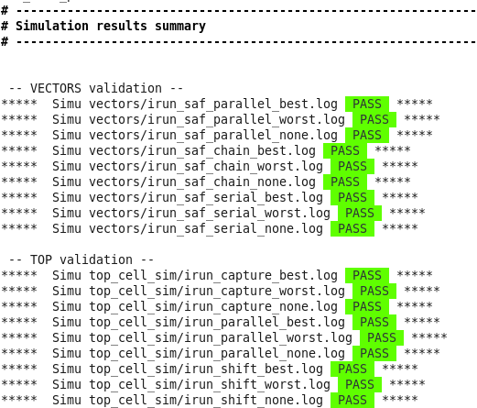

Slide 71
ATPG with ITC loop back

Slide 72
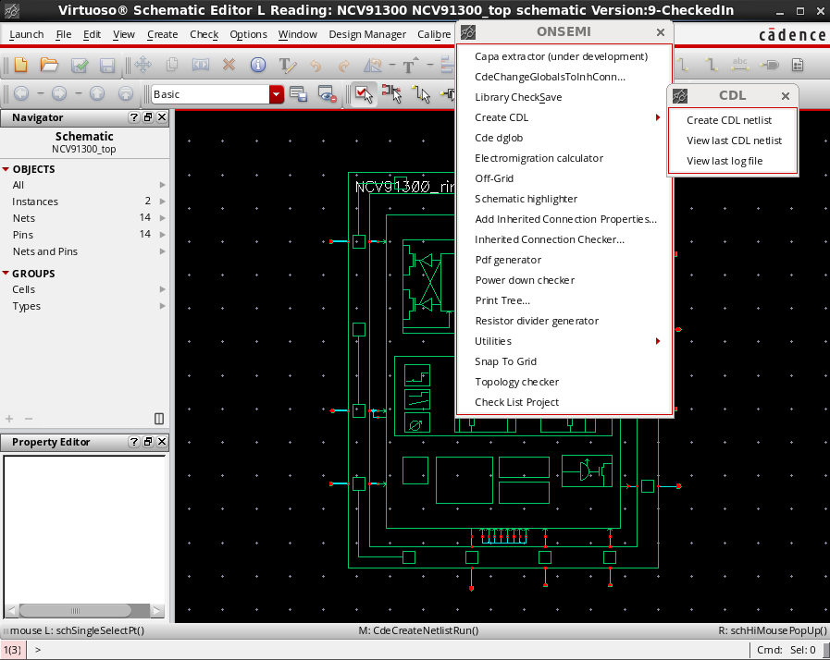
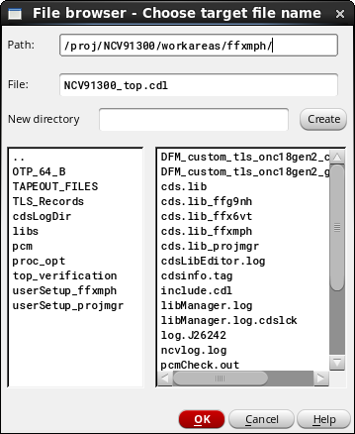
Netlist of the design: step 1
Generate CDL netlist of the Topcell

Slide 73
Apply patch : step 2
In itc directory:
Apply patch.pl to CDL netlist to create a modified netlist.cdl
This script identify digital libraries and cells (TLS works with multiple dig blocks and Brno use only one)

Slide 74
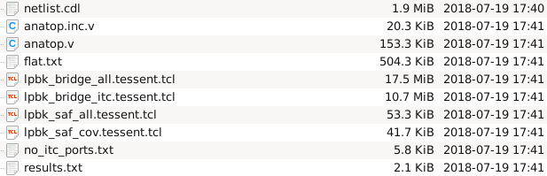
Interconnectes extraction: step3
We need to extract the connectivity (interconnects) between the ITC cells placed inside analogs macro blocks and the topdig cell
./cdl_itc.pl -cmd
Before going to the next step, check the files no_itc_port.txt and results.txt to make sure the consistency of the nets will be tested.
results.txt : List of warning
no_itc_port.txt : List of nets that will not be tested , may be forgottent ?
Output files

Slide 75
lpbk_saf_all_tessent.tcl : faults descriptions
Ipbk_saf_cov_tessent.tcl

Slide 76
Replace instance name: step4
Build excuded_ports.txt file
Grep command contains regular expression to change

Slide 77
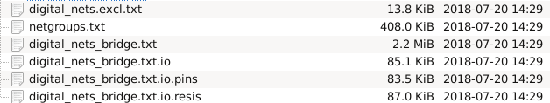
Extract bidge pairs from calibre DB

Slide 78

Tetramax faults list generation

Slide 79
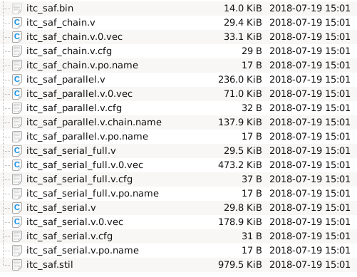
ATPG generation
Step 1:Execute Tessent cmd to launch vectors generation in Tessent directory
Created file inside/vectors

Slide 80
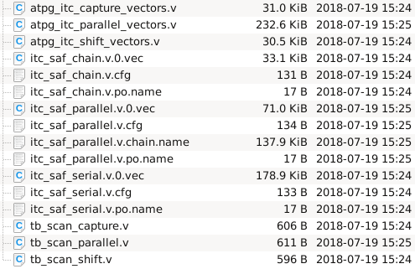
Step 2: Execute generate_top_vectors.pl to modify vectors generated by Tessent and stored in /vectors
/top_cell_sim

Slide 81
Step3 : It’s necessary to simulate generated vectors (to check generation) before to send it to test team.

Slide 82
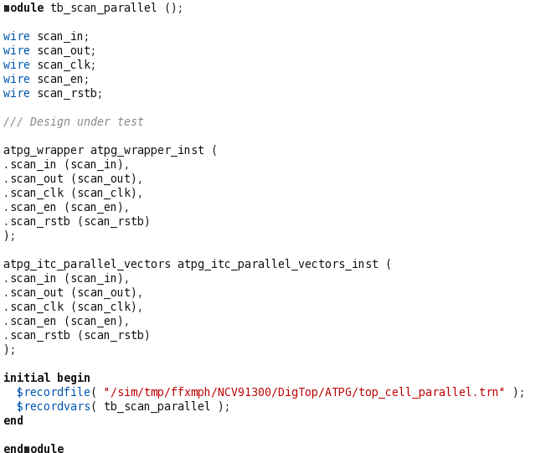
we will create an ATPG box that can be used by the verification team to simulate the behavior of the scan on the topcell.

Slide 83
scan_in
tb_scan_xxx.v
scan_clk
scan_rstb
scan_en
atpg_vectors.v
atpg_wrapper.v
scan_out

Slide 84
ATPG_wrapper from ITC
scan_in
atpg_wrapper.v
scan_clk
scan_rstb
scan_en
Hard coded
Switcher_dig.v
Top_dig.v
Analog_top.v
scan_out

Slide 85
What is ATPG ?
Automatic Test pattern generation tools are used at the end of the design process to generate a set of vectors that will be test the device
It’s to check manufacturing error
Generates efficient scan patterns that can be used to find manufacturing defects in the real silicon. It also produces a fault coverage report that tells you how good your test it, and which nets are and are not covered by the test pattern.

Slide 86
ATPG alogorithms will go trought each net of the design and apply fault model to come up with a test that will « catch » each potential error

Slide 87
The goal of DFT is to define a failure analysis process that will provide efficent and accurate results
Extra hardware are added in design to impove testability
Observability and controlability

Slide 88
Summary
Scan design is a methodology used for Design For Test (DFT) to add testability features to a hardware design.
Scan design makes Automatic Test Pattern Generation (ATPG) easier to implement as logic depth is constrained.
There is always a trade-off. Full scan design typically adds 10%-15% more area.
100% fault coverage may be impossible due to undetectable faults
Your goal should be to achieve the highest coverage of defects as possible. Because high test coverage directly correlates to the quality of the parts shipped
Think about testing from the beginning of Design

Slide 89
Bibliography
Digital Systems Testing and Testable Design IEEE press
Testing of Digital Systems , Cambridge
VLSI Test principles and architectures
The Morgan Kaufmann Series in Systems on Silicon
Essentiials of electronic testing , Bushnell - Agrawal
An Introduction to logic circuit Testing , Parag K.Lala , Morgan & Claypol

