Slide 1
Design for Testability
Scan - ATPG
Patrice Delpy – 2017

Slide 2
Inroduction:
The purpose of this document is to present the role of the test in the development cycle of a product.
- General concept
- Implementation in digital flow with ATPG

Slide 3
Murphy’s laws
“If you don’t test it, it won’t work!” (Guaranteed)

Slide 4
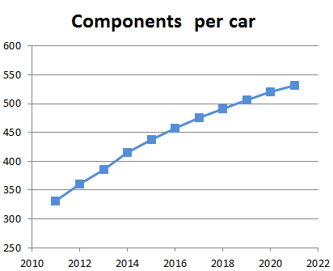
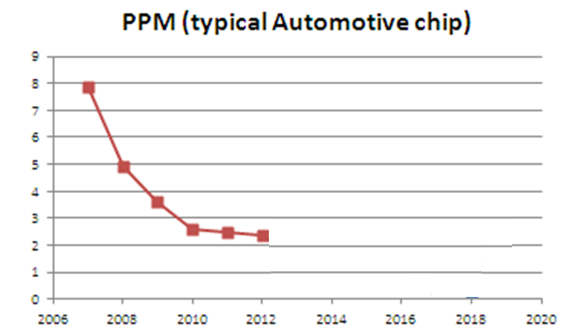
Challenge:
Quality is fondamental for automotive circuits
Zero defects
?

Slide 5
How to guarantee quality ?
The test ensures the quality of the products
It’s an integral part of the design cycle and its main role is to detect defective parts after their manufacture,
A well structured method for testing needs to be followed to ensure high yield and proper detection of faulty chips after manufacturing. Design for testability (DFT) is a matured domain now, and thus needs to be followed by all the designers

Slide 6
Test versus verification
Specification
Hardware design
Verification
≠
Netlist
Manufacturing
Test
Silicon

Slide 7
Test concept
The fabrication process is imperfect and introduce manufacturing defects
cause malfunction of the device
Improve yield and reject undesirable parts
2 types of yield loss : random effects or process variations
Test catch defectives parts

Slide 8
Defect
A defect is the unintended difference between the implemented hardware and its intended design
Defects occur either during manufacture or during the use of devices

Slide 9
Defects in fabrication
Decreasing feature size (reduce device dimention, technology scale shrink ) increases probability of defects during manufacturing process
These defects come from many sources :
Defects in the base silicon.
Oxide breakdown (crystal defects)
Optical deformation (photolithography)
Dust or contamination in the fab or on wafer.
Dust on mask.
Misalignment. Over-etch or under-etch.
…….

Slide 10
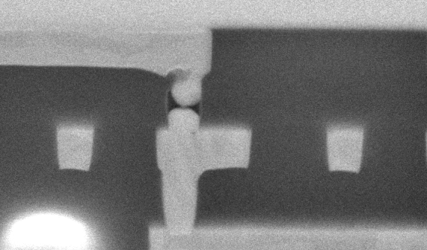
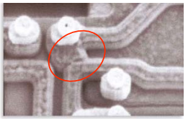
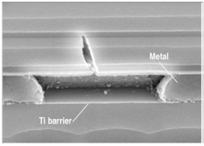
Defects illustrations

Slide 11
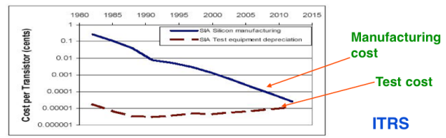
Importance of the test
Yield of any chip is < 100% , no process is perfect !
The role of testing is to detect whether something went wrong
Effectiveness of testing is most important for quality products
Today, test cost as more 60% of the total manufacturing cost

Slide 12
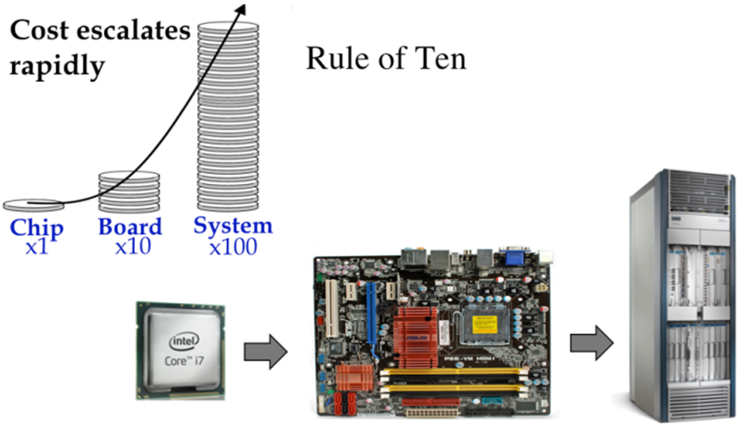
Motivation of testing
Identify a defective component as soon as possible,
before it is distributed, assembly in board and
integrated in system
If it’s doesn’t detected, the costs and penalty are very
importants
Intel bug (1994): 1M units shipped, recall cost $450M

Slide 13
Benefits of testing
Quality and economy are two major benefits of testing, these two attributes are greatly dependent and can not be defined without the other 
Quality means satisfying the user’s needs at a minimum cost 
Need to weed out all bad products before delevery to customers 
Understanding the principles of manufacturing and test is essential for design a quality product

Slide 14
Manufacturing
Testers (ATE) are very expensive
Time is money
Minimize time on tester
Careful selection of test, choose the most appropriate tests

Slide 15
Testability
Two important concept are higlhy associated woth testability:
• Controllability : ease of observing a node by watching external output pins of the chip
• Observability : ease of forcing a node to 0 or 1 by driving input pins of the chip

Slide 16
Focus to digital test
Aim: observe and control logic stucture
Combinational logic is usually easy to observe and control
It’s difficult to test sequential circuit behave
Idea: Modify sequential circuitery of the design
This technique is called scan design and is a part of the DFT methodology

Slide 17
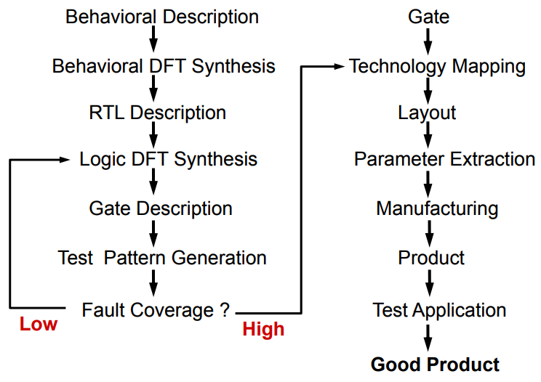
DFT implementation

Slide 18
Fault models

Slide 19
Terminology: Defect, Fault, and Error (1)
Defect :
- A defect is the unintended difference between the implemented hardware and its intended design 
Fault :
- A representation of a defect at the abstracted function level 
Error : 
- A wrong output signal produced by a defective system 
An error is caused by a Fault or a design error
Defect --> Fault ---> Error ---> Failure

Slide 20

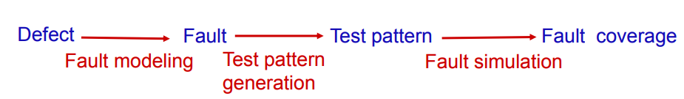
Terminology: Defect, Fault, and Error (2)

Slide 21
Fault models
Fault models considered in this document:
Stuck-at fault (gate level)
Bridging fault
Path-delay / Transition fault
IDDQ fault
A delay or transition fault alters the signal propagation delay
along the faulty line As a result, signals can arrive at the outputs of
the circuit before or after the time expected.
Bridge
Faults
IDDQ
Transition
Stuckat
Most frequent faults

Slide 22
Fault model : example
Inputs and outputs can either be “stuck-at” a high (Vdd) or low (Ground)
A
B
Y
Pattern | A | B | Y | Faults Detected
1 | 0 | 0 | 0 | A: SA1 (#2) B: SA1 (#4) Y: SA1 (#6)
2 | 0 | 1 | 0 | A: SA1 (#2) B: SA0 (#3)
3 | 1 | 0 | 0 | A: SA0 (#1) B: SA1 (#4) Y: SA1 (#6)
4 | 1 | 1 | 1 | A: SA0 (#1) B: SA0 (#3) Y: SA0 (#5)
Fault Number | Fault Description
#1 | Input A is (shorted to Gnd): SA0
#2 | Input A is (shorted to Vdd): SA1
#3 | Input B is (shorted to Gnd): SA0
#4 | Input B is shorted to Vdd) : SA1
#5 | Output Y is (shorted to Gnd): SA0
#6 | Output Y is (shorted to Vdd) : SA1

Slide 23
Defects representation
Functionnal
defects
opens or shorts
At speed
defects
stuck on
Stuck open
Bridge
IDDQ
defects

Slide 24
Stuck at faults
Permanent or static faults
a short is formed by connecting points not intended to be connected; signal stuck to VDD or GND
a open results from the breaking of a connection.

Slide 25
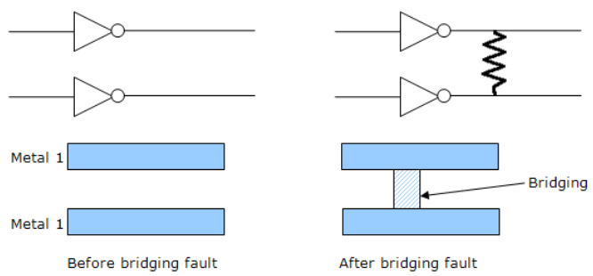
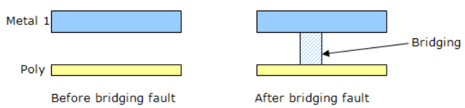
Bridging faults (1)
The bridging fault model tests for resistive shorts between two normally unconnected in wires, which could be caused by a piece of metal from the sputtering process
Bridging faults can be intra-layer and inter-layer c

Slide 26
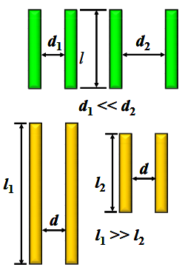
Bridging faults (2) : interconnect defects
Two or more adjacent wire are shorter together
EDA tool extract capacitive coupling based bridge pairs from physical design (frindge capacitance)
Higher capacitance indicating the higher probability of bridge occurence
Onsemi script analyze output database to identifiy the potential bridge
The designer can filter the results to select or ignore nodes that are suceptible to create a bridge.
The new netlist is given to ATPG tool to generate the
bridge detection patterns used by ATE
High probability
of bridging faults

Slide 27
Bridging faults (3) : layout analysis
Detects bridging pair nets:
examining the physical database for parallel or close proximity wires

Slide 28
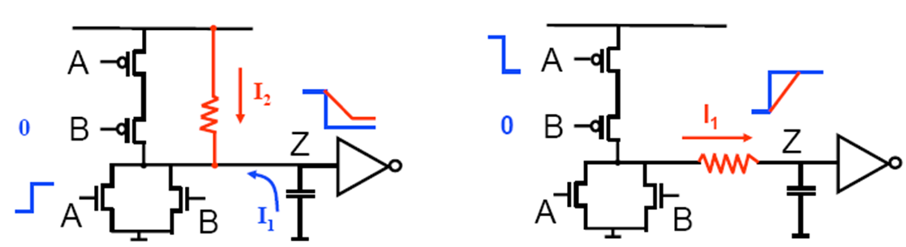
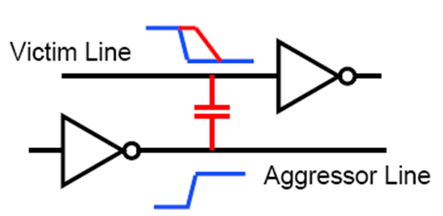
Transistion faults
Certain manufacturing defects do not change the logic function but can cause timing issues,
Delay transistion: increase the input to output delay of one logic gate (slow to rise or to fall)
Delay path : propagation delay of the path exceeds the clock interval
(timing violation)
Resistive bridges
Resistive opens

Slide 29
IDDQ faults (1)
Measure supply current in quiescent state (not switching and inputs are statics)
Leakage and bias current value expected is less than 10uA
Advantage:
- IDDQ test can detect (catch) bridge that are not detectable or other
faults that are not found by saf vectors
Inconvenience :
- Compared to scan chain test, Iddq test is time consuming (slow)
- Leakage current closer to quiescent current for deep submicron

Slide 30
IDDQ faults (2)
Normal IDDQ: 1nA
Abnormal : > 10µA
VDD
IDD
inputs
outputs
circuit
VSS

Slide 31
Fault Coverage
Fault coverage = percentage of faults detected by set of test vectors
For a given set of input test pattens
At least one mismatch -> fault is detected
No mismatches -> fault is not detected
D = detected faults
U = undetected faults
T=Total faults = D + U
Fault coverage = D / T

Slide 32
DFT - SCAN CHAIN

Slide 33
Scan path design
Scan is the most popular DFT technique:
- Rule-based design
- Automated DFT hardware insertion
- Combinational ATPG
Advantages:
Design automation
High fault coverage; helpful in diagnosis
Hierarchical – scan-testable modules are easily
combined into large scan-testable systems
Disadvantages:
Large test data volume and long test time
Moderate area (~10%) and speed (~5%) overheads

Slide 34
Functional vs Structural testing
Functional testing verifies that a circuit fulfils the spec
Functional testing not feasible for exhaustive tests.
Example: 32-bit adder requires 2⁶⁵ ≈ 3.7*10¹⁹ test vectors (so big ,,,)
Structural test focuses rather on the circuit structure and can cover manufacturing defects that otherwise may not have been detected by functional testing.
Power or ground shorts
Open interconnect on the die (caused by dust particles)
Short circuited source or drain on the transistor, (caused by metal spike through)
Exhaustive test is impossible (more complex and time consuming)

Slide 35
Scan design overview
Internal scan (or scan design) is the internal modification of your design’s circuitry to increase its testability.
Extra hardware
Goal of scan : make a difficult to test sequential circuit behave (during the testing process) like an easier to test combinational circuit
Replacing sequential cells (FF) with scannable scan cells and then stitching the scan cells together into scan registers, or scan chains. You can then use these serially-connected scan cells to shift data in and out when the design is in scan mode.

Slide 36
Sequential -> combinational
Problem: ATPG works for combinational logic while most ICs are sequential
Solution: Provide a test mode in which flip flops can be accessed directly
- Replace flip flop (FF) with scan flip flop (SFF): extra multiplexer on data input
- Connect FF to form one or more scan chains
- Connect multiplexer control signal to scan enable
Flip-flop
Data in
0
Flip-flop
D
Q
Q
Scan in
1
clk
clk
Scan Mode

Slide 37
SCAN chain : unactive, normal mode
All the flops are connected in form of a chain, as a shift register
Combinational logic
D
0
FF
D
0
FF
D
0
FF
Q
Q
Q
SI
1
SI
1
SI
1
clk
clk
clk
SE
SE
SE
Normal mode SE = 0

Slide 38
SCAN chain : active, scan mode
Combinational logic
D
0
FF
D
0
FF
D
0
FF
Q
Q
D
Q
SI
1
SI
1
SI
1
clk
clk
clk
SE
SE
SE
Scan mode SE = 1

Slide 39
Scan process
Scan chain operation involves 3 stages: Scan-in, Scan-capture and Scan-out
- Shifting in and loading all the flip-flops with an input vector. During scan- in, the data flows from the output of one flop to the scan-input of the next flop not unlike a shift register
- Once the pattern is loaded, one clock pulse (capture) is applied to excite the combinatorial logic block (evaluation) and the output is captured .
- The data is then shifted out and the signature is compared with the expected signature
During response shift-out, next pattern can be
concurrently shifted in.
Shift-In
Capture
Shift-Out
time

Slide 40
ATPG - concept

Slide 41
ATPG essentials
Netlist
ATPG algorithms use fault models to
generate patterns and to give a fault
coverage result & fault classes list
A fault model is a digital representation of a
real manufacturing/silicon defect
- Fault model matches with one category of
silicon defect only
- It is the abstract of reality (not 100%)
Defects not covered by a fault model could
escape to test
Fault coverage 100 % ≠ 0 ppm
ATPG
Algorithms
User
ATPG
engine
Fault
models
ATPG Tool
Patterns

Slide 42
ATPG overview
Sets of 1 and 0 placed in each inputs pins during the manufacturing test process to determine if the chip is functioning properly
When the test pattern is applied, the tester determines if the circuit is free from manufacturing defects by comparing the fault-free output—which is also contained in the test pattern—with the actual output measured by the ATE
If no test vectorexists for a fault, the fault is said untestable

Slide 43
Understand ATGP
ATPG tool uses deterministic test pattern generation when it creates a test pattern intended to detect a given fault.
Procedure
pick a fault from the fault list
create a pattern to detect the fault
fault simulate the pattern
check to make sure the pattern detects the fault

Slide 44
How to test digital blocks ?
Input Patterns
Output Response
Flow:
- Implement DFT
- Generate test patterns
- Verify fault coverage of patterns trought fault simulation
-1011
11-00
-0-1-
01--0
0-101
Circuit under
Test
(CUT)
1-001
0011-
-1101
1001-
01-11
Stored
Correct
Response
Comparator
Test result
The stimuli are called test patterns or test vectors

Slide 45
Fault detection process
Process is called : path sensitization
Faults detection works by comparing the response of a known-good version of the circuit with the actual circuit, for a given stimulus set. A fault exists if there is any difference in the responses.
ATPG tool construct a vector which apply to input and tries to propagate the fault effect to output,
When successful, the tool create a stimulus set (or test pattern) to detect the fault,

Slide 46
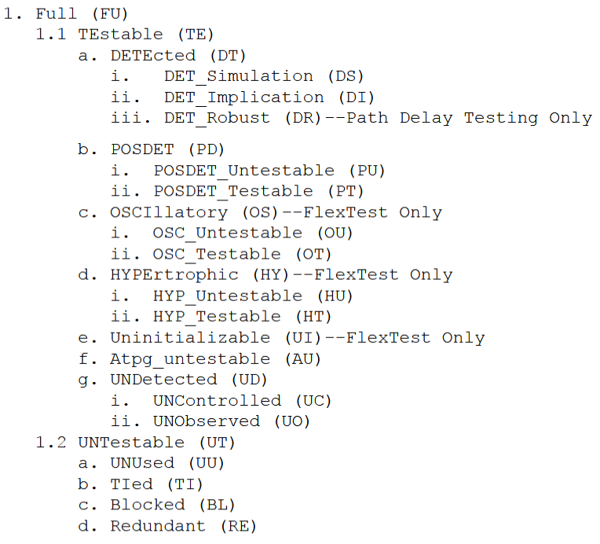
Fault classes
ATPG tool categorize faults into fault classes, based on how the faults were detected or why they could not be detected.

Slide 47
What is STIL files ?
Standard Test Interface Language : international format
Language to define the test vectors applied to the device under test (DUT). Describe bits sequences
This stimulus file introduces the faults, it’s input datas of scan chain

Slide 48
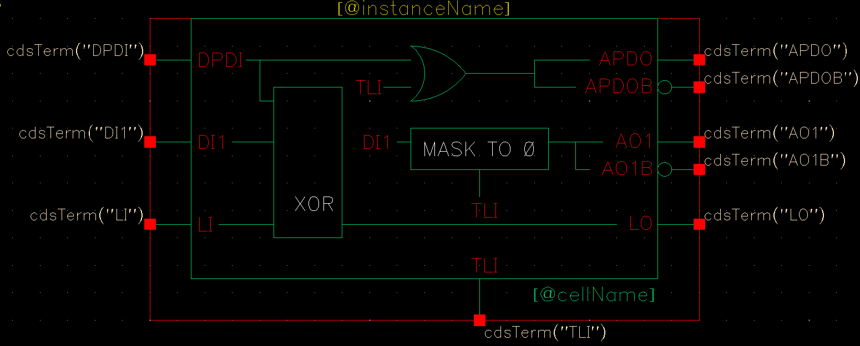
ITC cells
ITC = interconnect test coverage or loop back (include XOR)
Used to test the digital cells found in analog blocks
Loopback cells must be placed inside these blocks
In Automotive flow, it’s a requirement to check connections beetwen digtop and digital functions implemented in analog cells
Increase test coverage

Slide 49
ITC implementation
Digital
cmd
Analog
in
ITC
out

Slide 50
Wrapper concept
wrapper: surrounding hardware with test logic block
A normal mode where the core terminal is driven by the host chip.
An external test mode where the wrapper element observes the core input terminal for interconnect test.
An internal test mode where the wrapper element controls the state of the core input terminal for testing the logic inside the core.
Interface between digital block and rest of chip
Make access to cell and isolate it from rest of the circuit
Test wrapper is the logic added around topdig to provide test access to the embedded core
Normal mode :
Test mode

Slide 51
What is Tessent ?
Tessent suite is set of DFT tools from Mentor Graphics
It’s a design-for-test environment within which you can perform all the tasks required to insert DFT hardware, generate manufacturing test patterns, and post-silicon tasks such as diagnosis and yield analysis
Tessent provides a graphical user interface (GUI), DFTVisualizer, that allows you to edit and introspect designs, and adjust object attributes

Slide 52
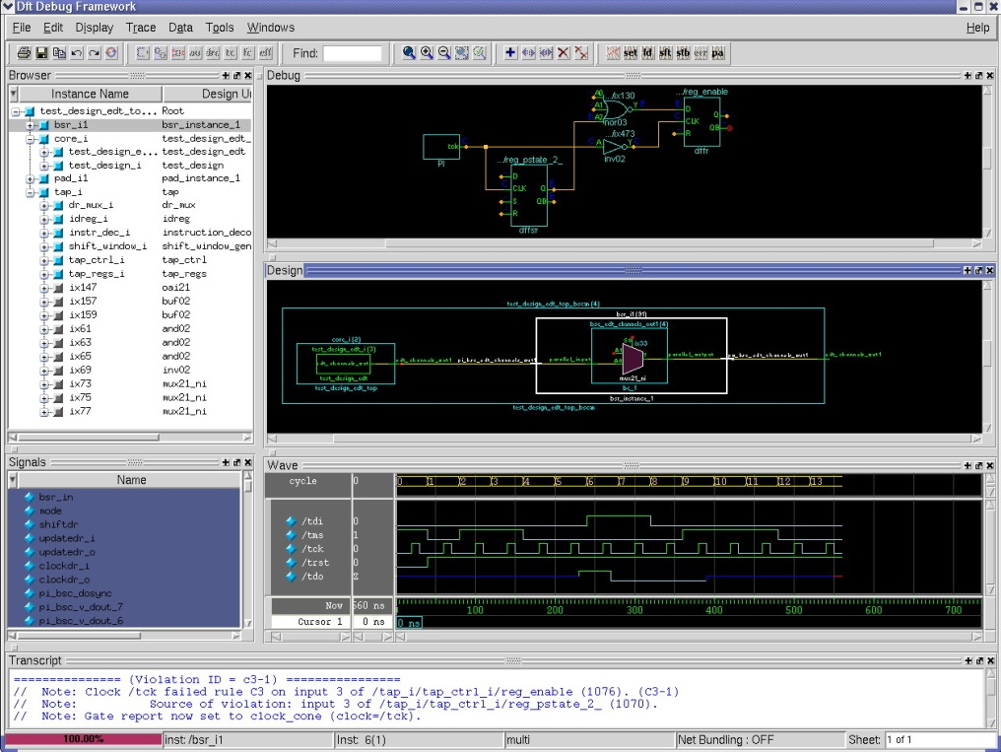
DFT VISUALIZER
DFT debug environment in Tessent
Tool to visally investigate the causes of DRC low converage
Intuitive and effective GUI to reduce DFT debug effort
Eases design navigation & exploration
Helps to debug DFT related issues
DRC violations
Low coverage
Test procedures

Slide 53
Tetramax from Synposys ….

Slide 54
ATPG – implementation

Slide 55
ATPG digital flow features
For each project, a set of patterns must be generated.
In digital environment a set of scripts stored in templates allows to:
Generate vectors in STIL format compatible with tester
Generate testbench and vectors in Verilog format
Simulate Verilog vectors with timings back annotation
Provide cadence cells with auto-check embedded vectors for top cell simulation
Estimate realistic stuck-at fault test coverage

Slide 56
Directory structures & files templates
Several files (do file, lib files, contraints sdf, parameters) are needed to perform pattern generation and for testbenchs simulations
mkblock.csh script creates a dedicated directory under DIG_BLOCKS/<digital_block name>/tool_data/tessent
Symbolink :

Slide 57
Directory template
/tessent
tessent_patt_saf.do : tessent dofile to generate stuck at fault vectors
tessent_patt_sbf.do : tessent dofile to generate static bridge fault vectors
tessent_patt_tft.do : tessent dofile to generate transient fault vectors
tessent_patt_iddq.do : tessent dofile to generate IDDQ vectors
tessent_cov.do : tessent dofile to estimate coverage
tessent_testproc.do : tessent procedures file used by dofiles
param_file : tessent options for .stil format
run_patt.sh : tessent command for pattern generation
run_cov.sh : tessent command for coverage estimation
atpg_wrapper.v : wrapper around digital block= netlist for vectors generation
generate_patterns.sh : script to generate patterns and create files for top cell simulation
simulate_patterns.sh : script simulating all generated patterns in worst & best conditions
/vectors : directory to store vectors and re-simulate them
scan_map.txt : text file template for scan pins mapping
header.txt : text file template for .stil header compatible with eagle tester
/reports : directory containing tessent reports
/top_cell_sim : directory to store deliverables for top cell simulation
To be completed by Designer

Slide 58
ATPG Patterns generation 1
In tessent directory, use generate_patterns.sh script that includes several sub command:
Launch tessent trought run_patt.sh to generate vectors and test benchs
Call gen_stil_4_eagle.pl to make STIL vectors compatible with eagle tester
Call generate_top_vectors.pl to write cadence test benches for top cell simulations.
Usage: sh generate_patterns.sh cellname block1 block2 …. blockN
Example: sh generate_patterns.sh DigTop scv78565_dig switcher_dig

Slide 59
Faults models
tessent -shell \
-dofile tessent_patt_saf.do \
-logfile tessent_patt_saf.log -replace
# Transition fault
tessent -shell \
-dofile tessent_patt_tft.do \
-logfile tessent_patt_tft.log -replace
# Static bridging fault
tessent -shell \
-dofile tessent_patt_sbf.do \
-logfile tessen_pattt_sbf.log -replace
# IDDQ
tessent -shell \
-dofile tessent_patt_iddq.do \
-logfile tessent_patt_iddq.log -replace
./run_patt.sh

Slide 60
ATPG Patterns generation 2
Here is the list of files outputted by Tessent through run_patt.sh script:
under tessent/
tessent_patt.log -> drc rules report
under reports/
<block_name>_scan_chains.rpt -> lists registers in chains from output to input
<block_name>_drc_C6.rpt -> report of C6 violations, flops to be masked
<block_name>_wrapper_faults_au.rpt -> provides list of untestable faults
<block_name>_wrapper_coverage.rpt -> provides coverage information
Note: use run_cov.sh to get real coverage

Slide 61
ATPG Patterns generation 3
under vectors/
<block_name>_chain.v
<block_name>_chain.v.0.vec -> set of Verilog data + auto check testbench
<block_name>_chain.v.cfg for shift in / shift out vector (scan check integrity)
<block_name>_chain.v.po_name
<block_name>_serial.v
<block_name>_serial.v.0.vec -> set of Verilog data + auto check testbench
<block_name>_serial.v.cfg for first 10 vectors (shift and capture)
<block_name>_serial.v.po.name
<block_name>_serial_full.v
<block_name>_serial_full.v.0.vec -> set of Verilog data + auto check testbench
<block_name>_serial.v.cfg for all vectors (shift and capture)
<block_name>_serial_full.v.po.name
<block_name>_parallel.v
<block_name>_parallel.v.0.vec -> set of Verilog data + auto check testbench
<block_name>_parallel.v.cfg for all vectors (capture only) for debug purpose
<block_name>_parallel.v.po.name
<block_name>_parallel.v.chain.name
<block_name>.stil -> all vectors in stil format

Slide 62
ATPG Patterns generation 4 : STIL post processing
To be fully compatible with eagle test program, the header of stil file generated by Tessent must be modified.
Inputs must be masked and outputs receive hi-Z during the first tester cycle.
scan_map.txt (in vectors/ directory) must be manually updated with top cell scan pin names and number of chains in the design:
Example scv78565: nb_chain =1
scan_clk = scan_clk
scan_rstb = scan_rstb
scan_en = scan_en
scan_in1 = scan_in
scan_out1 = scan_out
header.txt (in vectors/ directory):
Must be changed only if multiple scan chains to add other scan_in/scan_out pins.
Scan pins will be replaced by their top cell names by gen_stil_4_eagle.pl script.

Slide 63
ATPG Patterns generation 5
The generate_patterns.sh script calling generate_top_vectors.pl inside top_cell_sim/ directory to modify the testbench files generated by Tessent in vectors/ directory :
usage: perl $TOOLS_SCRIPT/scan/generate_top_vectors.pl
-vec <block_name>_chain.v | serial.v | parallel.v
-map scan_map.txt
-delay < in us>
-block b1 –block b2 …. block N
What the script does:
Modify Tessent testbench file :
- Remove atpg_wrapper instantiation and create scan pins inputs and outputs
- Change relative to absolute paths for called files, insert delay scan process execution from <delay> us
- Replace atpg_wrapper_inst by digital hierarchical path in top cell test bench
- Rename modules in atpg_shift_vectors atpg_capture_vectors or atpg_parallel_vectors according to type
- Copy other files from vectors/ directory
- Create testbenches in top_cell_sim/ for re-simulation including .trn logging

Slide 64
ATPG Patterns generation 6
Here are the files generated:
under vectors/
<block_name>_chain.v
<block_name>_chain.v.0.vec
<block_name>_chain.v.cfg
<block_name>_chain.v.po_name
<block_name>_serial.v
<block_name>_serial.v.0.vec
<block_name>_serial.v.cfg
<block_name>_serial.v.po.name
<block_name>_parallel.v
<block_name>_parallel.v.0.vec
<block_name>_parallel.v.cfg
<block_name>_parallel.v.po.name
<block_name>_parallel.v.chain.name
under topcell_sim/
atpg_ <block_name>_ shift_vectors.v
<block_name>_chain.v.0.vec
<block_name>_chain.v.cfg
<block_name>_chain.v.po_name
tb_scan_shift.v
atpg_ <block_name>_ capture_vectors.v
<block_name>_serial.v.0.vec
<block_name>_serial.v.cfg
<block_name>_serial.v.po.name
tb_scan_capture.v
atpg_ <block_name>_ parallel_vectors.v
<block_name>_parallel.v.0.vec
<block_name>_parallel.v.cfg
<block_name>_parallel.v.po.name
<block_name>_parallel.v.chain.name
tb_scan_parallel.v
New modules atpg_<block_name>_[shift | capture | parallel]_vectors can be imported in cadence as functional views through verilogin.
Other files (.0.vec, .cfg, .po.name , .chain.name) will be directly accessed by people in charge of top cell simulation.

Slide 65
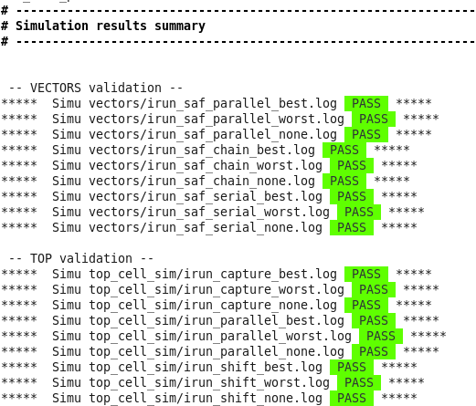
Simulation results

Slide 66
ATPG with ITC loop back

Slide 67
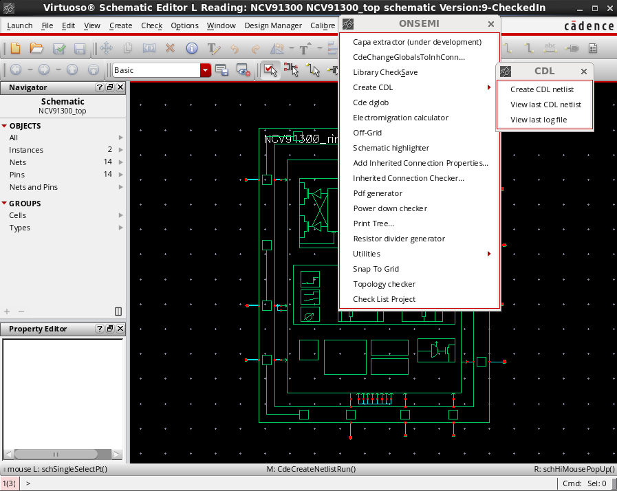
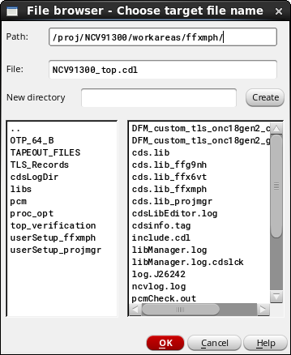
Netlist of the design: step 1
Generate CDL netlist of the Topcell

Slide 68
Apply patch : step 2
In itc directory:
Apply patch.pl to CDL netlist to create a modified netlist.cdl
This script identify digital libraries and cells (TLS works with multiple dig blocks and Brno use only one)

Slide 69
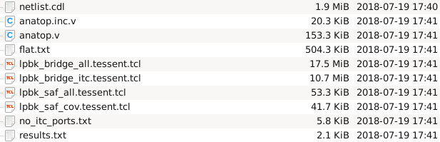
Interconnectes extraction: step3
We need to extract the connectivity (interconnects) between the ITC cells placed inside analogs macro blocks and the topdig cell
./cdl_itc.pl -cmd
Before going to the next step, check the files no_itc_port.txt and results.txt to make sure the consistency of the nets will be tested.
results.txt : List of warning
no_itc_port.txt : List of nets that will not be tested , may be forgottent ?
Output files

Slide 70
lpbk_saf_all_tessent.tcl : faults descriptions
Ipbk_saf_cov_tessent.tcl

Slide 71
Replace instance name: step4
Build excuded_ports.txt file
Grep command contains regular expression to change

Slide 72
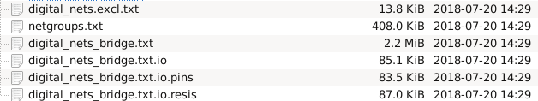

Slide 73
Bridge extraction and ATPG
The mentor provide an innovative tool with LADB
- Need to extract from layout or DEF
- Need to take critical area into account
Extract bridge pairs

Slide 74
What is critical area ?
The area in which the center of a spot defect must fall to cause the bridge
Total critical area (TCA) is the sum of all individual CAs weighted by the probability of occurrence of that spot size

Slide 75
(source Mentor Graphics)
The extraction of the bridge faults can be influenced by various settings that refer to the defect probability and the critical area calculation.
The critical area is calculated based on the relation between the size and density of particles that may cause a bridge fault, and the bridge probability that depends, among others, on the distance between two adjacent shapes.

Slide 76
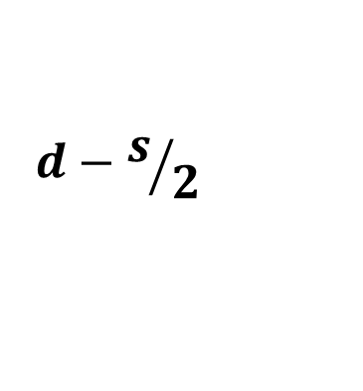


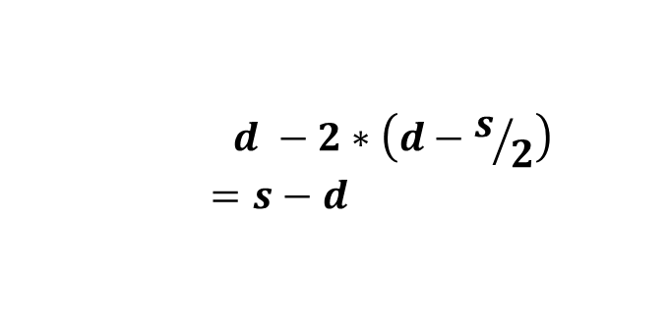
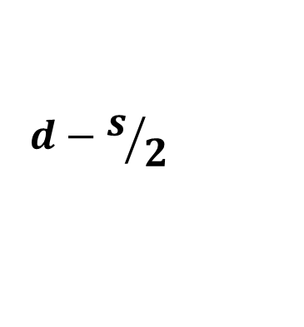
Simple case
critical area = $l ∗(s−d)$
l
$$d−s/2$$
d
$$d −2∗\left(d−s/2\right)$$
$$=s−d$$
$$d−s/2$$

Slide 77

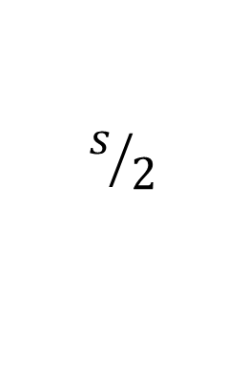
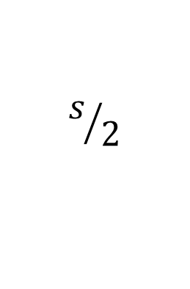
Add end effect
l
$$s/2$$
$$s/2$$
d
length is now $l+s$
critical area = $(l+s)(s−d)$

Slide 78
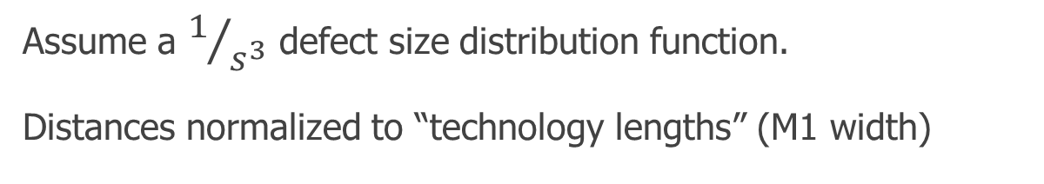
side to side Bridge example
V1
M2
M2
Net A
M2
V1
M1
3.0
tl
1.5
tl
Net B
M1
M2
V1
10.0 tl
6.0 tl
∫
s_{max}
3 * dist_{min}² * (s + length) * (s - dist)
s³
ds
s_{min}
Assume a $1/{s^{3}}$ defect size distribution function.
Distances normalized to “technology lengths” (M1 width)

Slide 79
Critical area flow
LADB
Creation
Bridge
Extraction
Pattern
Generation
.DEF
Reports
LADB
UDFM
.LEF
.STIL

Slide 80

Tetramax faults list generation ????

Slide 81
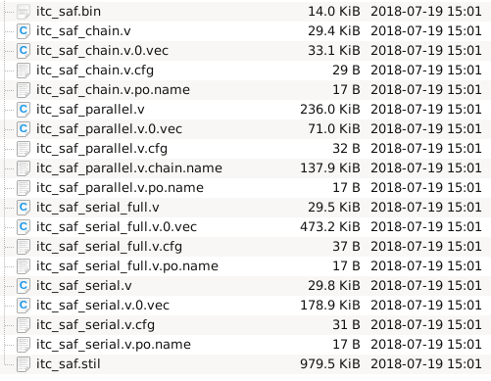
ATPG generation
Step 1:Execute Tessent cmd to launch vectors generation in Tessent directory
Created file inside/vectors

Slide 82
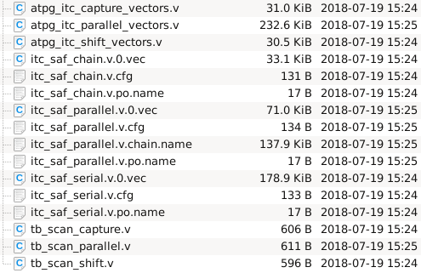
Step 2: Execute generate_top_vectors.pl to modify vectors generated by Tessent and stored in /vectors
/top_cell_sim

Slide 83
Step3 : It’s necessary to simulate generated vectors (to check generation) before to send it to test team.

Slide 84
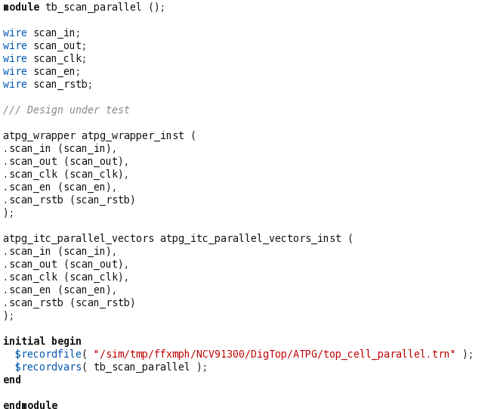
we will create an ATPG box that can be used by the verification team to simulate the behavior of the scan on the topcell.

Slide 85
scan_in
tb_scan_xxx.v
scan_clk
scan_rstb
scan_en
atpg_vectors.v
atpg_wrapper.v
scan_out

Slide 86
ATPG_wrapper from ITC
scan_in
atpg_wrapper.v
scan_clk
scan_rstb
scan_en
Hard coded
Switcher_dig.v
Top_dig.v
Analog_top.v
scan_out

Slide 87
Summary
Scan design is a methodology used for Design For Test (DFT) to add testability features to a hardware design.
Scan design makes Automatic Test Pattern Generation (ATPG) easier to implement as logic depth is constrained.
There is always a trade-off. Full scan design typically adds 10%-15% more area.
100% fault coverage may be impossible due to undetectable faults
Your goal should be to achieve the highest coverage of defects as possible. Because high test coverage directly correlates to the quality of the parts shipped
Think about testing from the beginning of Design

Slide 88
Bibliography
Digital Systems Testing and Testable Design IEEE press
Testing of Digital Systems , Cambridge
VLSI Test principles and architectures
The Morgan Kaufmann Series in Systems on Silicon
Essentiials of electronic testing , Bushnell - Agrawal
An Introduction to logic circuit Testing , Parag K.Lala , Morgan & Claypol
Electronic Design Automation: Synthesis, Verification, and Test

