Slide 1
Back end Digital Flow
Basics
Patrice Delpy 2018

Slide 2
Overview
Techno Files
(liberty, qrc techfile, ...)
Functional netlist
(.v, .sv)
Timing Constraints (sdc)
Formal Verification
(LEC)
Synthesis (Genus)
Timing
not met
netlist (.v) map on std cells
Signoff Verification
DRC and LVS checks
STA (Timing Check) with Tempus
Place and Route (Innovus)
Layout in OA / gds
Netlist in Verilog
Sdf file for post extraction simulations

Slide 3
Abstract view
These abstracts could be :
provided by the foundry or the IP provider
generated by the user with the virtuoso abstract generator
generated from the lef files provided by the foundry
oa2lef –lef my_IP.lef –lib my_IP_OA_library

Slide 4
Liberty files
Foreach cell of a library, these files describe:
The ports (input and output, power)
The type of cells : buffer, inverter, and gate, io pads , …
The operating condition
The power consumption (optional)
The timing modelling
These Liberty files are given by the foundry

Slide 5
Timing constaints (Sdc)
The sdc files (Synopsis Design Constraints) describe all the timing information between your design and the outside:
what are the clocks signals? What are the relation between clocks ?
what is the delay between the signals and the clock?
What is the input or output capacitance load ?
What are the timing exceptions ?
…..
By default, the time unit is the ns

Slide 6
Multi-Mode Multi-Corner view
Multi Mode :
The chip have different functional modes (different clock speed, enable bit configuration, …)
=> One or more constraint modes associated with sdc files for each mode
Multi Corner
There is different library set (process corner typical, slow, fast, …) and RC corners for timing analysis (propagation delay, SI analysis)
=> Each delay corners combine liberty (.lib) for the std cells and QRC techfiles for the nets
=> MMMC view file combines constraint modes and delay corners to define different scenarios (“Analysis View”)
These analysis views are used for setup analysis and the hold during STA

Slide 7
SDC files
Setup / Hold
Clock
Inputs
Outputs
Timing exceptions

Slide 8
Setup and hold timing (1)
The setup and hold timing checks are needed for proper propagation of data through the sequential cells. These checks verify that the data input is stable at the active clock edge.
Setup time = minimum time with data stable before clock edge
Hold time = minimum time with data stable after clock edge

Slide 9
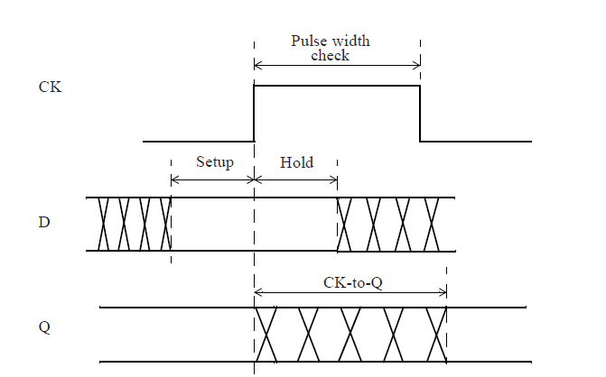
Setup and hold timing (2)

Slide 10
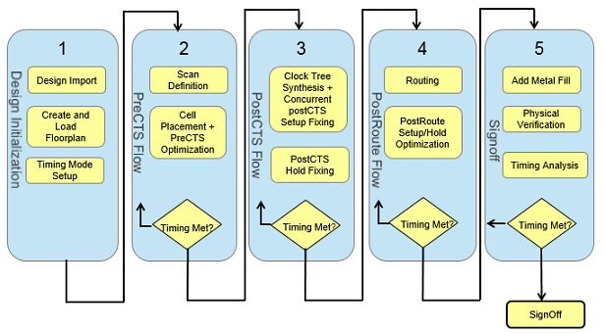
Summary of Innovus flow

Slide 11
More informations:
About sdc :
“Static Timing Analysis for Nanometer Designs : a Practical Approach”
from J . Bhasker and Rakesh Chadha

Slide 12
Place and route ?
Process of taking a structural file
(Verilog in our case) and making a physical view
from that description. It involves placing the cells on the chip, and routing the wiring connections
between those cells.

Slide 13
Digital Implementation System:
A Cadence tool for creation of digital
integrated circuits. This includes floor planning, power planning, test and place and route.

Slide 14
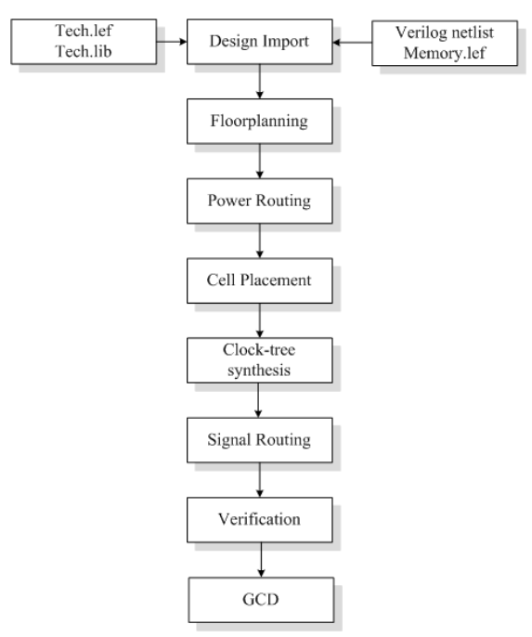
Innovus design flow

Slide 15
CTS: clock buffers will be added
Garantees that clock tree will be routed in the most effcient way and thereby clock skew will be reduced (best case 0)

Slide 16
Technology and design files
LEF: library exchange format

Slide 17

Warning !
The sdc files guide the digital tools during synthesis,
placement and routing to avoid setup or hold failure.
So be careful when you write them !
All path should be constrained to enable their analysis.
=> Unconstrained path can lead to “hidden” timing violations or “over design”

Slide 18
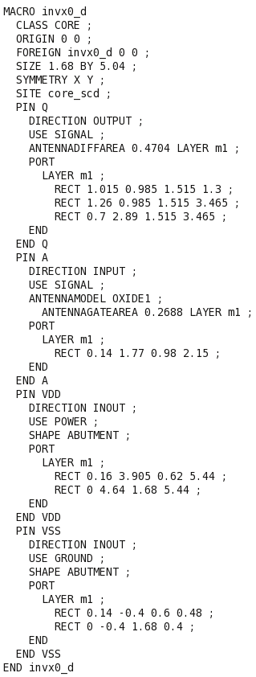
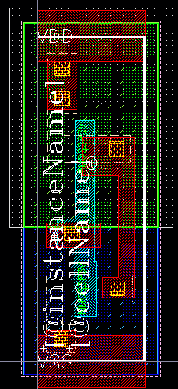
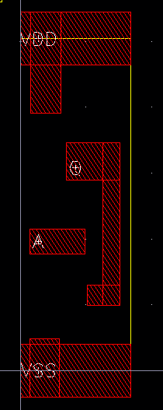
LEF Example : invx0
ASCII file
Layout
Abstract

Slide 19
LEF: Libray exchange format
An ASCII data format, used to describe a standard cell library includes the design rules for routing and the Abstract of the cells, no information about theinternal netlist of the cells
Technology: layer, design rules, via definitions, metal capacitance
type: Layer type can be routing, cut (contact), masterslice (poly, active), overlap.
width/pitch/spacing rules
direction
resistance and capacitance per unit square
antenna Factor
2. Site: Site extension
３．Macros: cell descriptions, cell dimensions, layout of pins and blockages, capacitances.

Slide 20
TLF : timing lib format
Ascii representation of the timing and power parameters accociated with any cell in technology
Timiing models to calculate
I/O delay path
Timing check value
Interconnect delays

Slide 21
Engenering change order (ECO) cells
ECOs usually are done after place and route.
It’s not necessary to regenerate all-masks. Only front end layers, is known as a “Metal Fix”
Spare cells without functionakity are added during design

Slide 22
Filler and tap cells
Must be inserted in empty areas in rows
Ensure well and diff mask continuity
Provide dummy poly for scaled technologies
Include moscap beetween VDD and GND
Called Decaps cells

Slide 23
Wells taps needed to ensure local body voltage
Eliminate latchup
Every 30um

Slide 24
Signal integrity (SI)
NanoRoute engine provides concurrent timing driven and SI driven routing.
Signal Integrity during routing is synonymous with Crosstalk
A switching signal may affect a neighboring net.
The switching net is called the Aggressor
The affected net is called the Victim

Slide 25
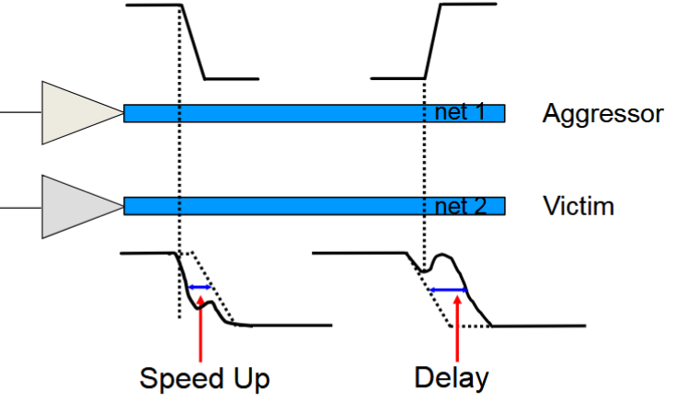
Two major effects:
Signal slow down
When the aggressor and victim switch in opposite directions.
Signal speed up
When the aggressor and victim switch in the same direction.

Slide 26
solutions
Limit length of parallel nets
Wire spreading
Shield special nets
Upsize driver or buffer

Slide 27
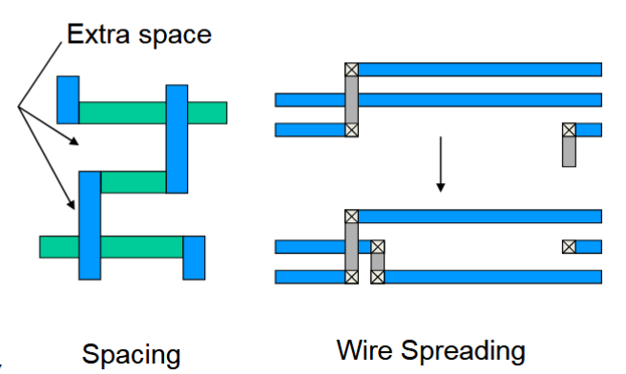
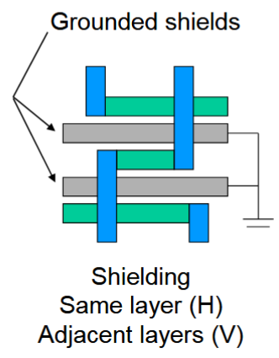
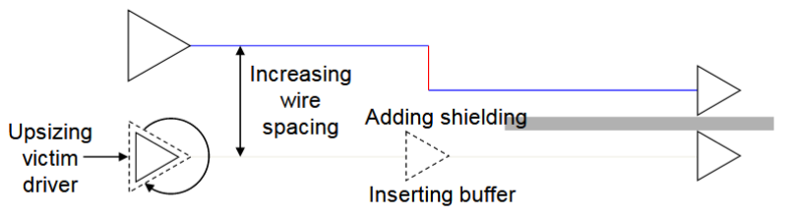

Slide 28
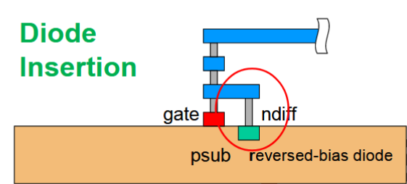
Antenna fixeing

Slide 29
Timing driving placement
Timing-driven placement tries to place critical path cells close together to reduce net RCs and to meet setup timing

Slide 30
ftp://ftp.dii.unisi.it/pub/users/vignoli/old/elettronicaiii/seminario_ing_affortunati_2000/des_flow.pdf a voir

Slide 31
What are the foundation flows ?
Utility for generating standard flow scirpts based on user input (via template)
Include latest options and command recommanded by Cadence expert, updates for each tool revision
Provides a quick reliable implementation flow
Start simple and add complexity if needed
Flexibility with customization
Goal: increasing designer productivity

Slide 32
Flow customization
plug in

Slide 33
Prepare Data
Library
Techno library (spacing, layers, vias …etc)
Timing library (*.lib)
Physical LEF library (*.lef)
Capacitance table (RC analysis) not necessary !
User data
Timing constaints (*.sdc) -> from synthesis
Gate level netlist -> from synthesis
Flooplan plan (*.def)
Clock tree specification
Scan chain information

Slide 34
What is signoff ?
The design will be released (sign-off) if all the following checking are passed: (golden)
DRC / LVS / DFM, electromigration, antenna
Gate Level Back-Annotated Simulation
Static Timing Analysis, signal integrity
Formal Verification

Slide 35
Gate Level Back-Annotated Simulation
The gate netlist is simulated using for each timing arc cells the value given by the SDF file.
Static Timing Analysis (STA)
The design back-annotated with the SDF is verified with a Static Timing Analyzer to find out all the critical paths (Worst Case operating conditions). An analysis is even performed in Best Case to find out all the hold violations.
Formal Verification
Because the Back End tool change the netlist (buffer clock, io buffer, optimization, Scan Insertion, etc ...) the “new” netlist has to be proved equivalent to that one released after synthesis

Slide 36
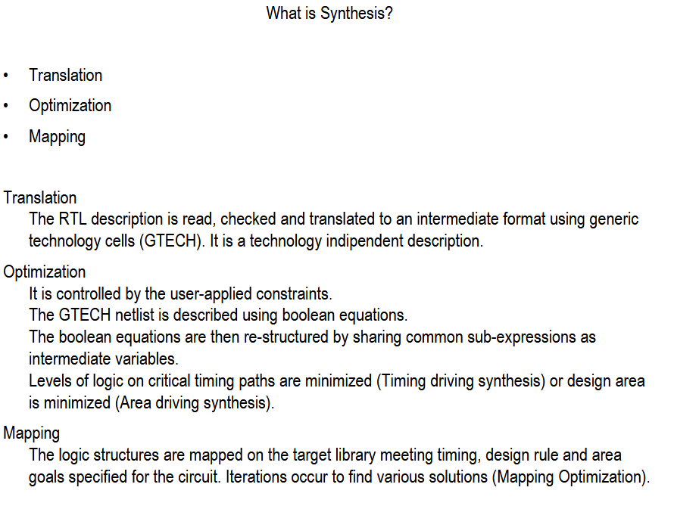
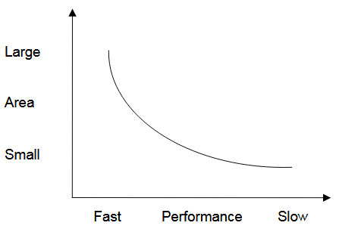
Logic synthesis
Synthesis is constraint driven

Slide 37
Placement
The aim of the placement is to place all the standard cells according to the user requirements (timing or congestion).
For a timing constraint placement, the placer will estimate the interconnect parasitic capacitance in order to calculate the cell and the interconnect delays. Then, the cell placement will be optimized so as to meet the constraints.
For a congestion based placement, the goal is to avoid an “unroutable” situation, even if timing is not satisfactory. In that case, it may be necessary to re-place locally some cells to space them out.

Slide 38
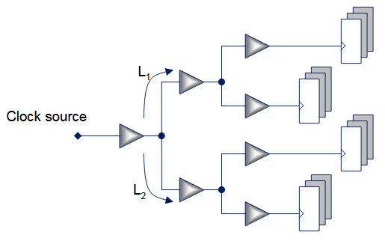
Clock Tree synthesis (CTS)
CTS builds a regular tree on the clock net, firstly to buffer the net and secondly to control the skew
The goal for the tool is to try to reach as closely as possible
L1 = L2 to balance the wire routing so as to get the same capacitance on each branch

Slide 39
Physical design stages (full custom layout)

Slide 40
Backend design tool (floorplan, place and route, power and clock distribution

Slide 41
http://www.eng.biu.ac.il/temanad/files/2017/03/02-Terminology-2012-13-A.pdf
http://www.eng.biu.ac.il/temanad/files/2017/02/Lecture-4-Standard-Cell-Libraries.pdf
http://www.ee.virginia.edu/~mrs8n/soc/SynthesisTutorials/sprflow.pdf
http://www.ee.ncu.edu.tw/~jfli/vlsidi/lecture/soc

Slide 42
http://www.eng.auburn.edu/~nelson/courses/elec5250_6250/slides/ASIC%20Layout_2%20%20Digital%20Implemenation.pdf

