Slide 1
Digital Flow
Verilog basics
Patrice Delpy 2017

Slide 2
Wire vs Register
Wire
Physical wire in the circuit
A wire does not store its value, it must be driven by
• connecting the wire to the output of a gate or module
• assigning a value to the wire in a continuous assignment
Can not use “wire” in left-hand side of assignment in procedural block
Register
Register represent abstract storage elements
Holds value until an new value is assigned to it
It is event driven
Can not use “reg” in left-hand side of continuous assignment

Slide 3
A variable belongs to one of two data types:
–Net
Must be continuously driven
Used to model connections between continuous assignments & instantiations
–Register
Retains the last value assigned to it
Often used to represent storage elements

Slide 4
Nets represent physical connections between hardware elements
Declared with the keyword wire (or default for ports)
Used to connect instantiated modules
Must be continuously driven with a value
Ex. wire b, c;
Registers represent storage elements
Not necessarily physical registers but synthesis tools often assume that
Registers do not need to be continuously driven
Registers will hold a value until it is overwritten
Ex.
reg reset;
initial
begin
reset = 1’b1;
#100 reset = 1’b0;
end

Slide 5
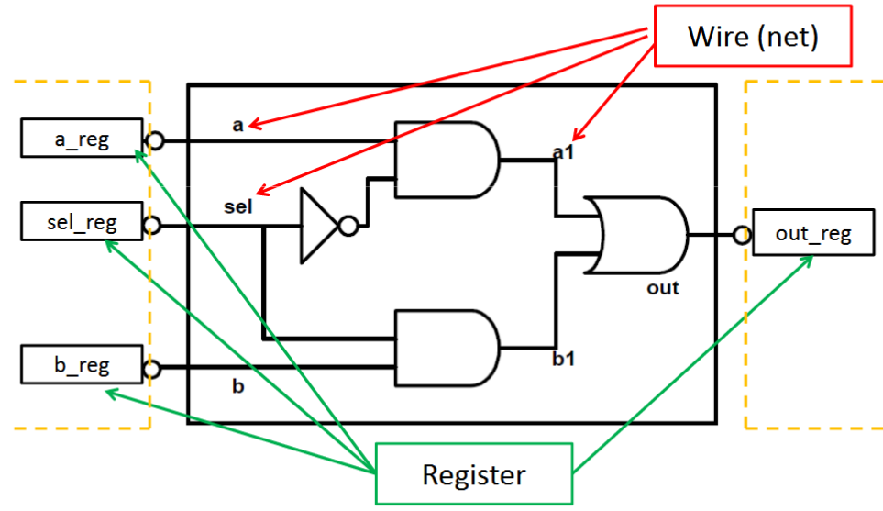

Slide 6
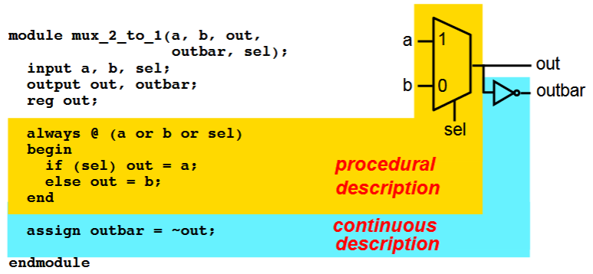

Slide 7
Procedural assignments update the value of
reg. The value will remain unchanged till another procedural assignment updates the variable.
This is the main difference with continuous assignments in which the right hand expression is constantly placed on the left-side

Slide 8
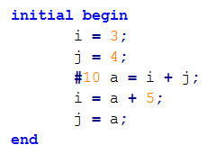
Blocking assignment (=)
Execute in the order they are specified
I = 12 and j = 7

Slide 9
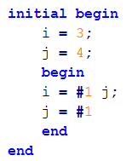
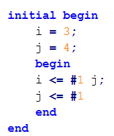
Non-blocking assignment (<=)
I = 4 and j = 4
I = 4 and j = 3

Slide 10
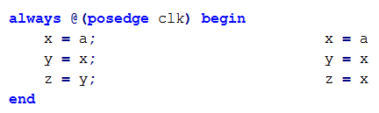
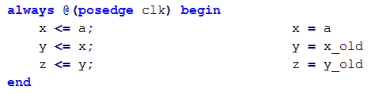
Blocking and Non-blocking Procedural Assignment
Blocking
Non-Blocking

Slide 11
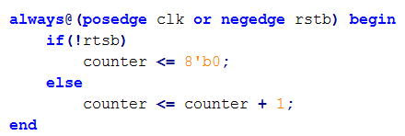
Usage policies (1):
Non blocking is only used in «always» block with clock signal (flip-flop description)

Slide 12
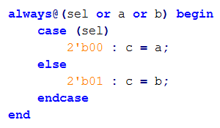
Usage policies (2):
Blocking is used in “Always” block without “clock”

Slide 13

Usage policies (3):
Blocking is used in continuous assignment

Slide 14
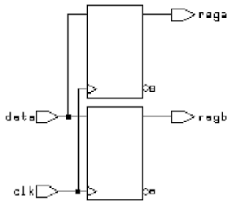


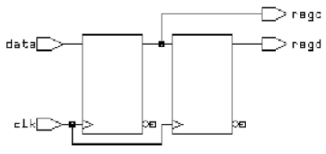
Blocking
Non-Blocking

Slide 15
Blocking assignment =
Regular assignment inside procedural block
Assignment takes place immediately
LHS must be a register
Nonblocking assignment <=
Compute RHS
Assignment takes place at end of block
LHS must be a register
always
begin
A = B;
B = A;
end
A = B, B= B
always
begin
A <= B;
B <= A;
end
swap A and B

Slide 16
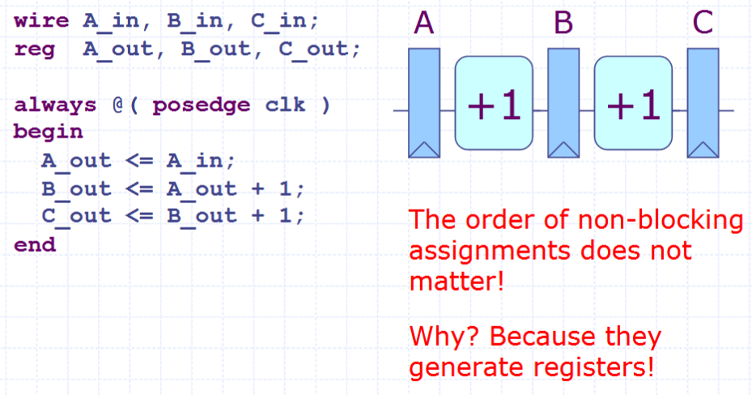
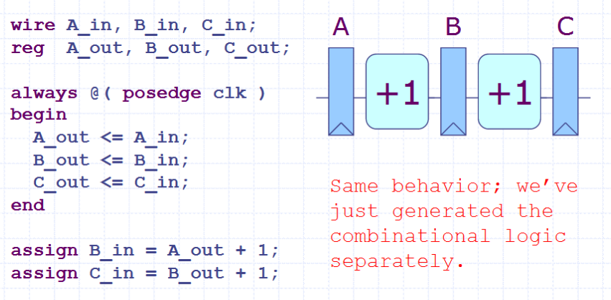
Autre possibilité

Slide 17
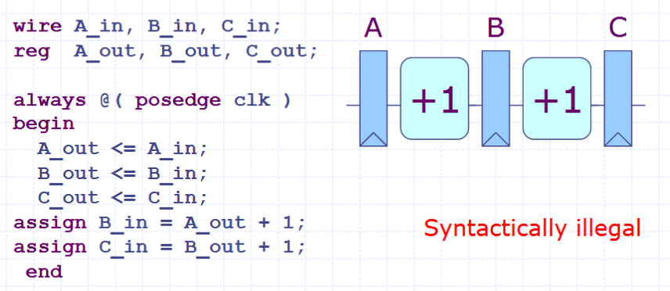

Slide 18
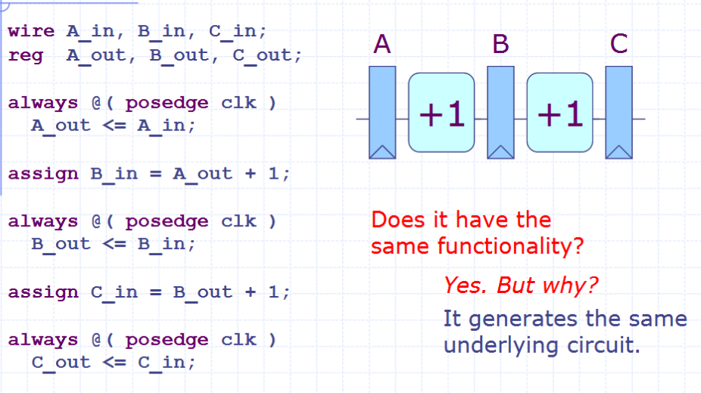

Slide 19
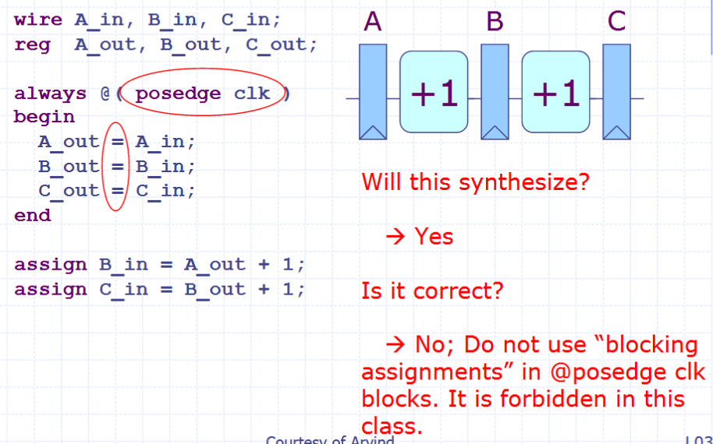

Slide 20
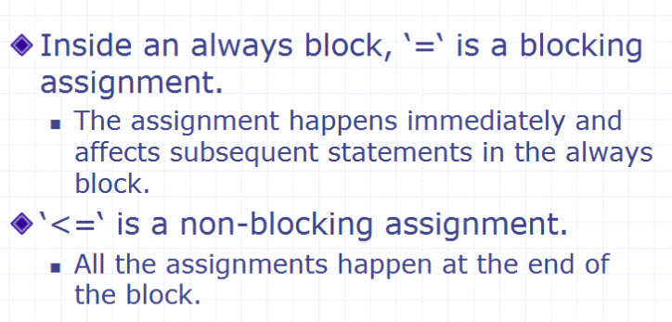

Slide 21
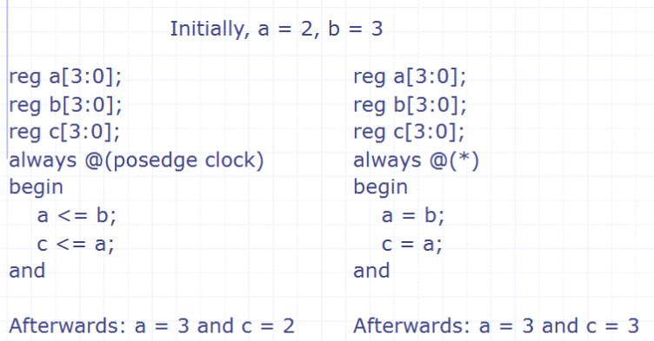

Slide 22
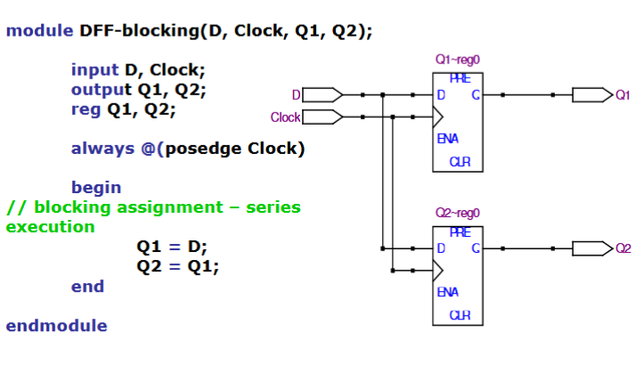

Slide 23
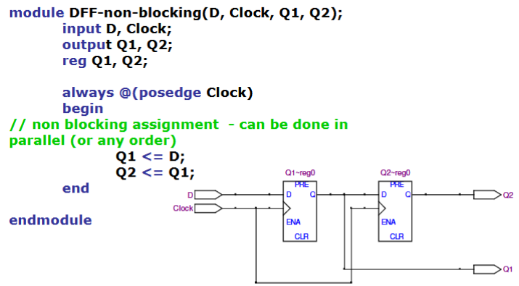

Slide 24
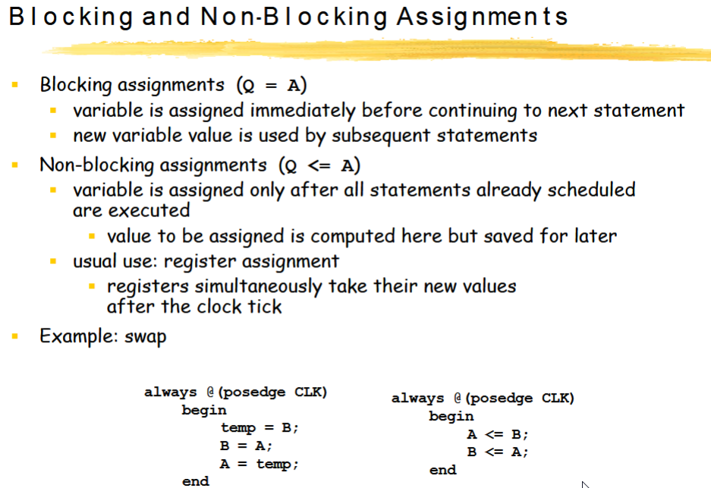

Slide 25
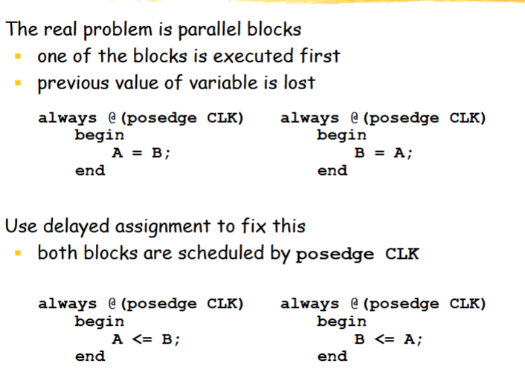

Slide 26
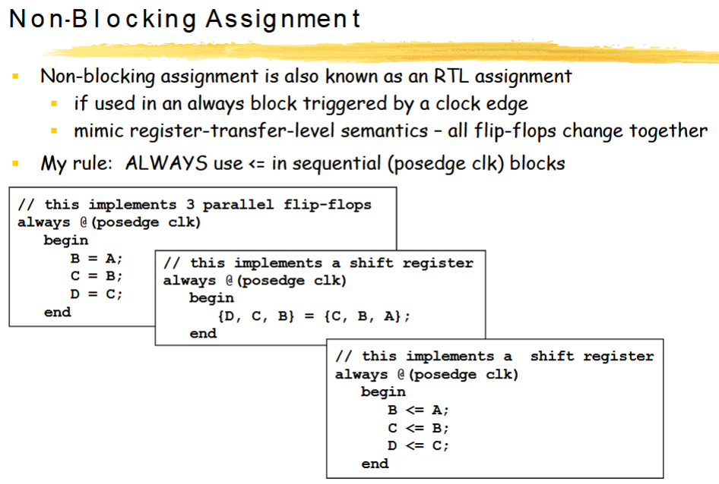

Slide 27
http://analog-design.net/Share/Ebook/micro/DIGITAL/DOC/1996-CUG-presentation_nonblocking_assigns.pdf

Slide 28
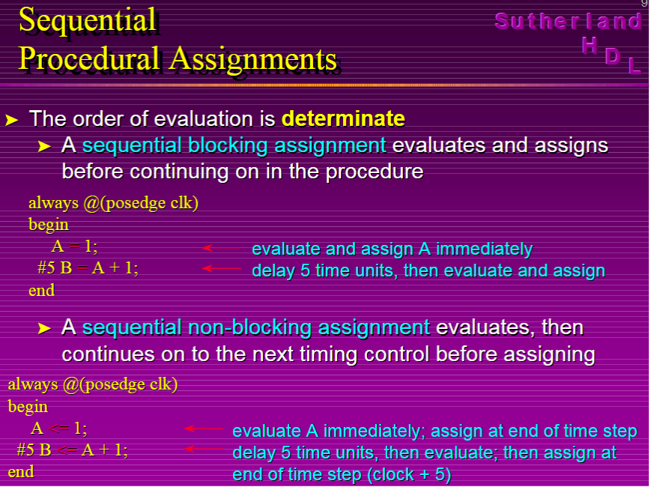

Slide 29
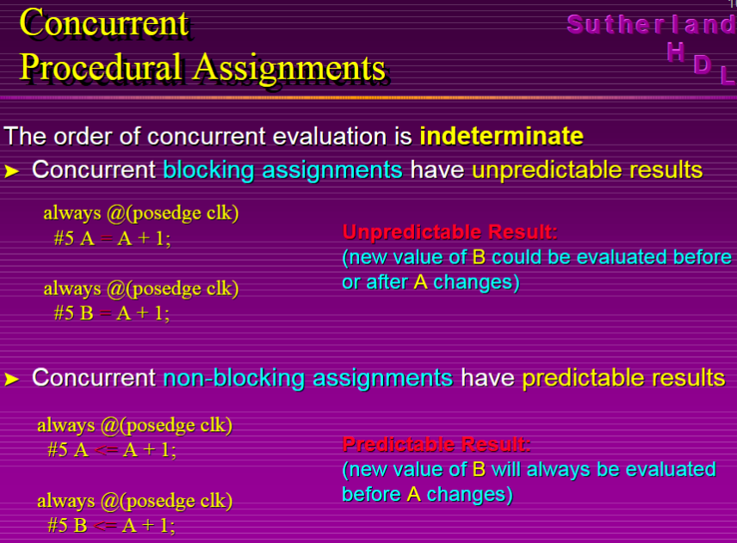

Slide 30
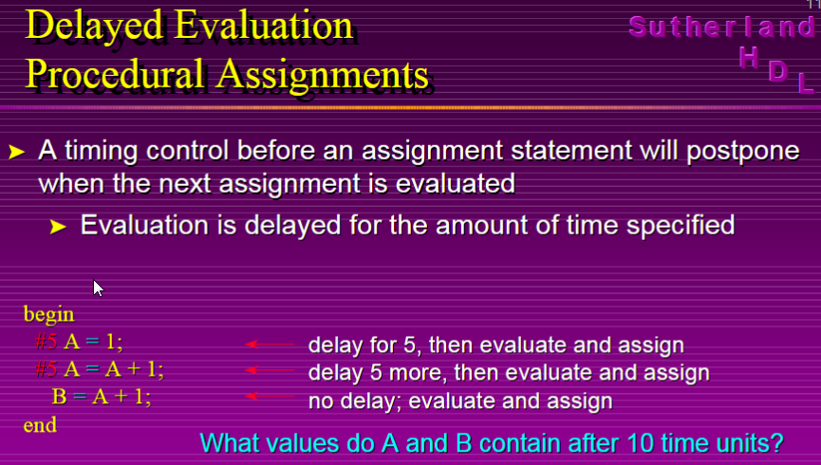

Slide 31
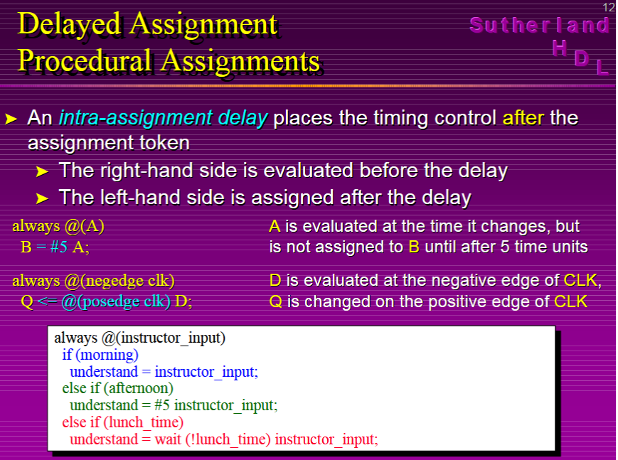

Slide 32
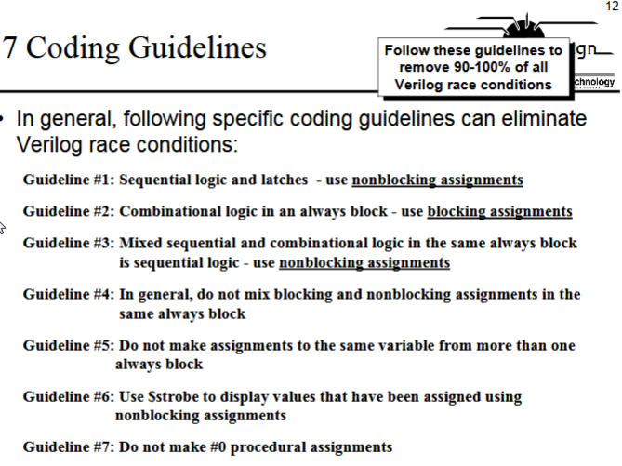

Slide 33
http://analog-design.net/Share/Ebook/micro/DIGITAL/DOC/verilog0000.pdf

Slide 34
assign => concurrent description
Always=> sequential description

Slide 35
Always blocks
- The block executes in an infinite loop
- By default, starts at time 0 (but this can be changed)
- Represents a concurrent hardware block
- Needs a delay
Blocking Assignments
- Represented with a = sign
- All blocking assignments are executed in sequence
Non-Blocking Assignments
- Represented with a <= sign
- All non-blocking assignments are executed in parallel
- Try not to mix with blocking assignments

Slide 36
Wire assignment: “continuous assignment”
Connect combinational logic block or other wire to wire input
Order of statements not important to Verilog, executed totally in parallel
But order of statements can be important to clarity of thought!
When right-hand-side changes, it immediately flows through to left
Designated by the keyword assign
wire c;
assign c = a | b;
wire c = a | b; // same thing

Slide 37
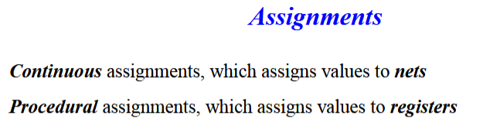

Slide 38
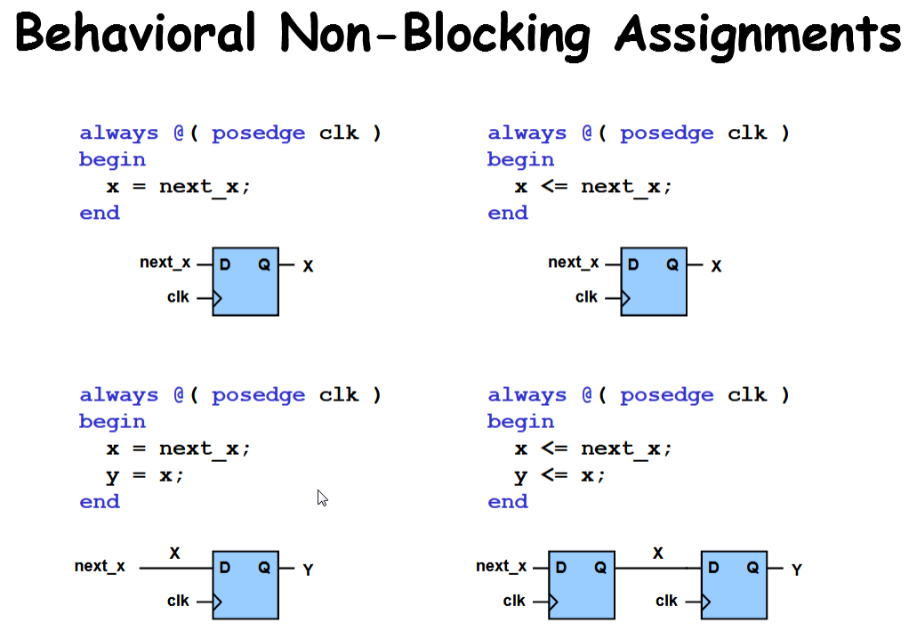

Slide 39
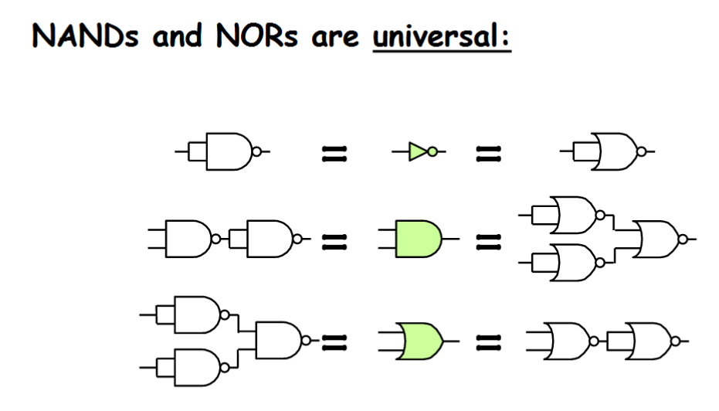

Slide 40
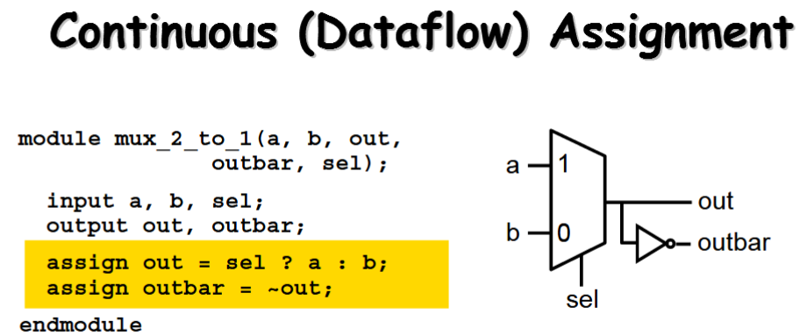

Slide 41
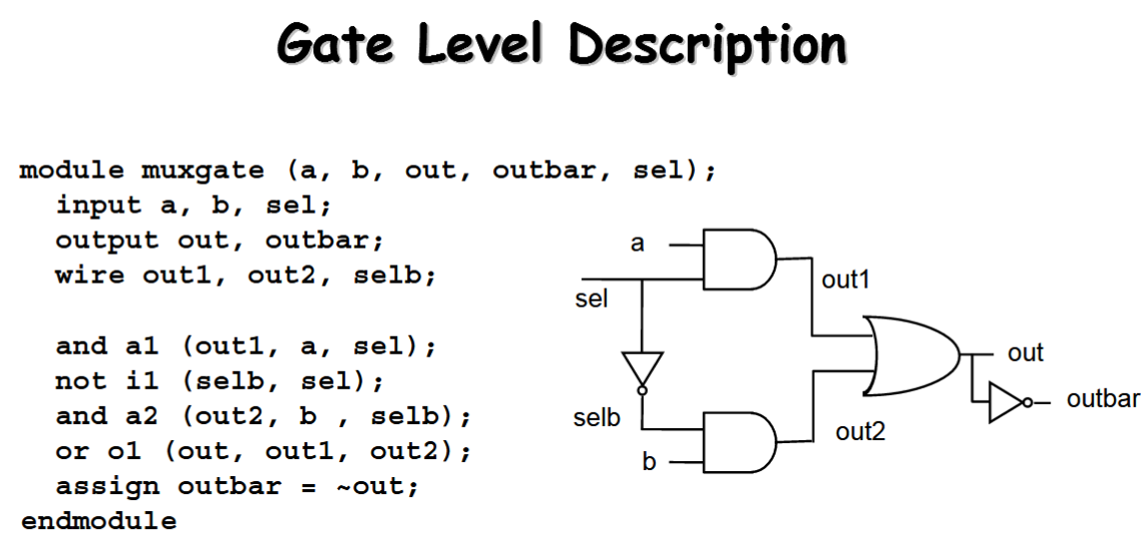

Slide 42
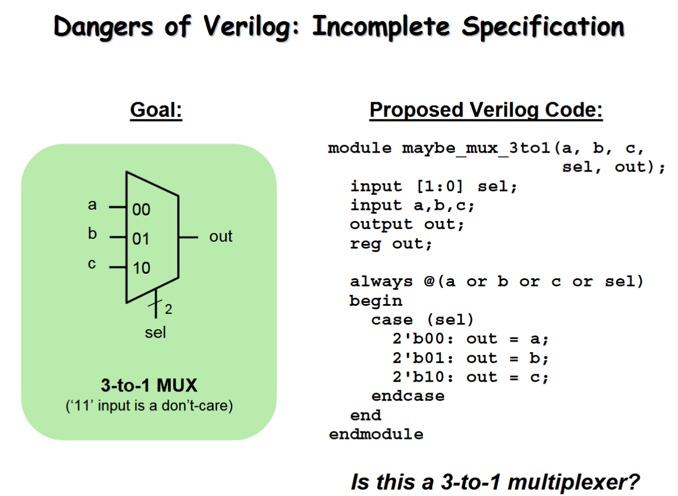

Slide 43
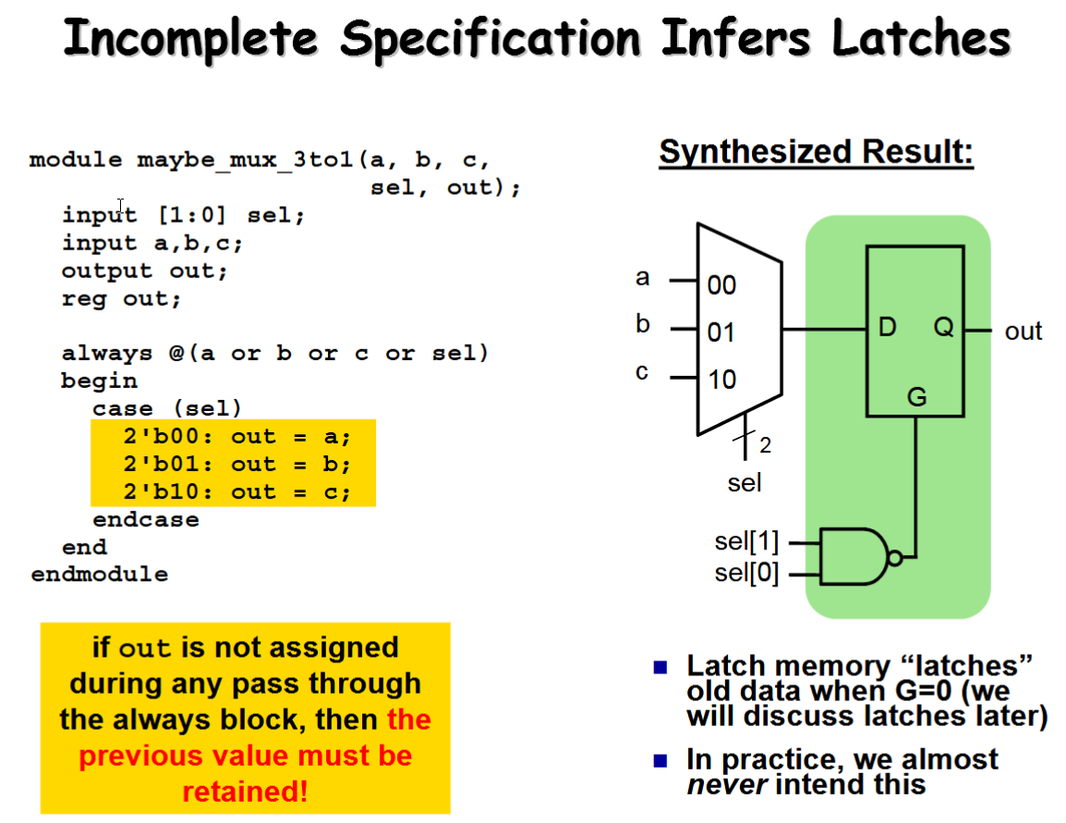

Slide 44
Interconnecting Modules

Modularity is essential to the success of large designs

A Verilog module may contain submodules that
are “wired together”

Slide 45
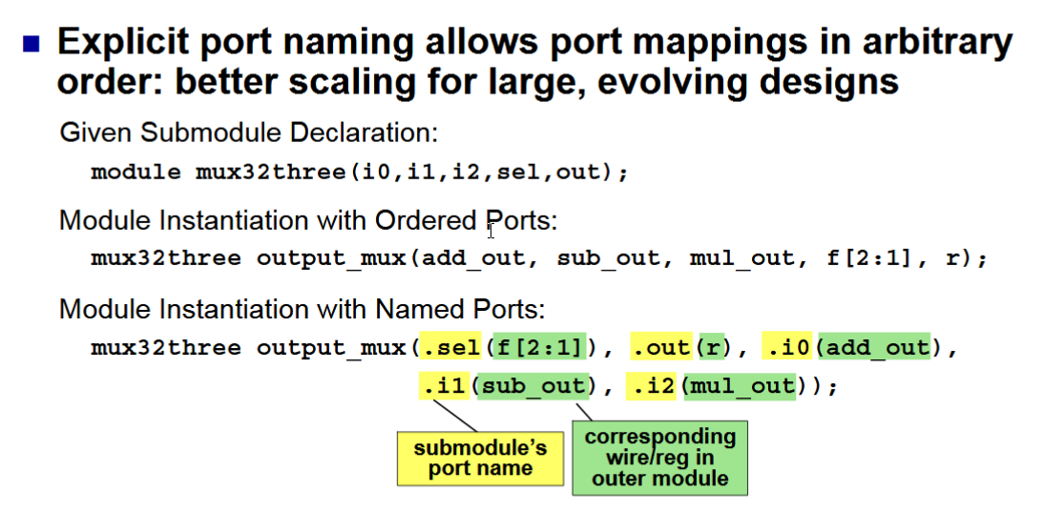

Slide 46
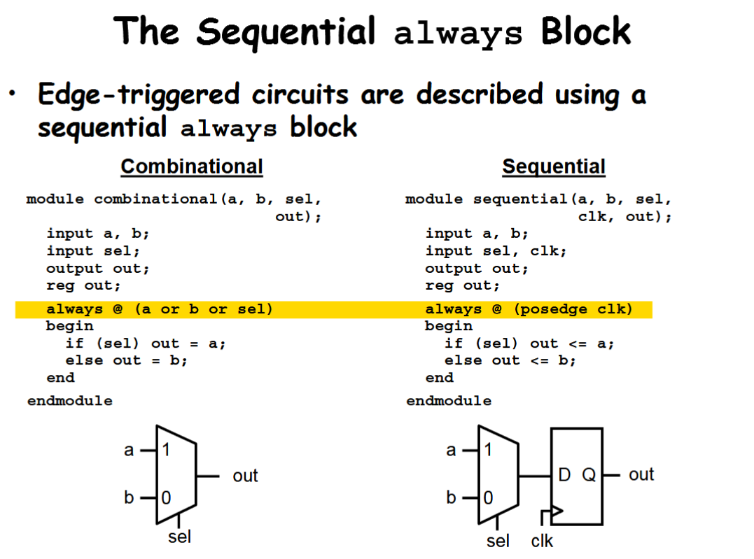

Slide 47
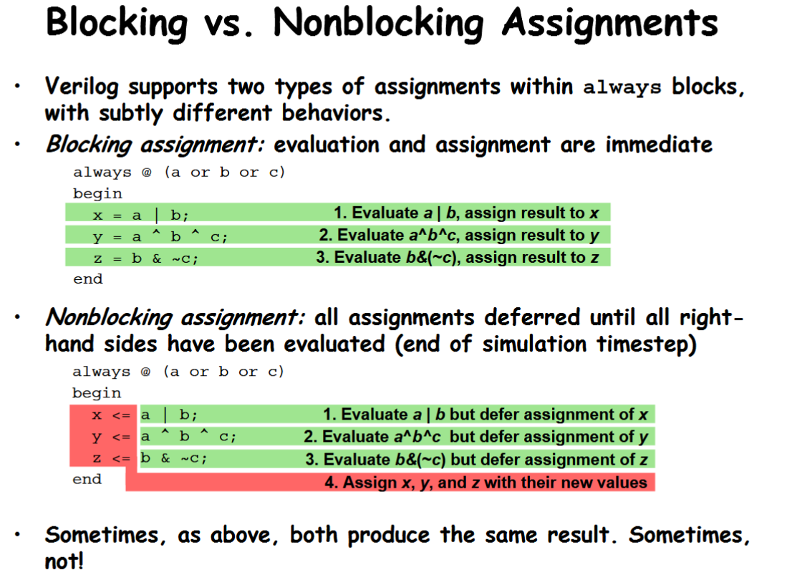

Slide 48
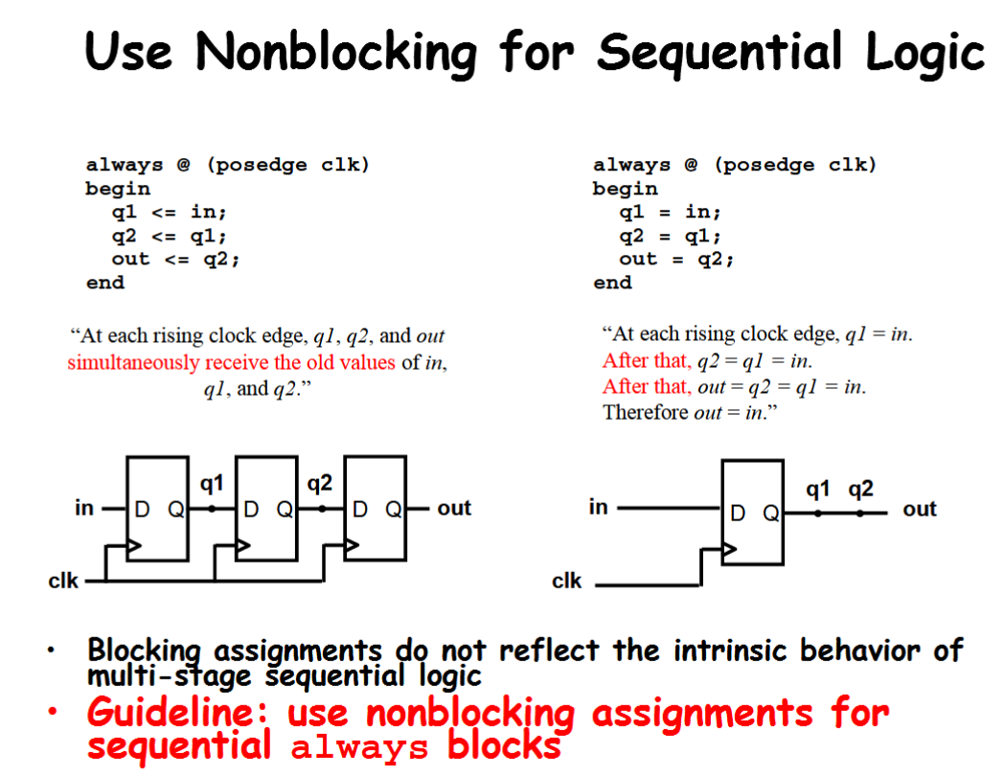

Slide 49
http://analog-design.net/Share/Ebook/micro/DIGITAL/DOC/Lab2SimulationsTut2014.pdf
Exemple verilog

Slide 50
A module is the principal design entity in Verilog
The first line of a module declaration specifies the name and port
list (arguments). The next few lines specifies the i/o type (
input
,
output
or
inout
, see Sect. 4.4. ) and width of each
port. The default port width is 1 bit.

Slide 51
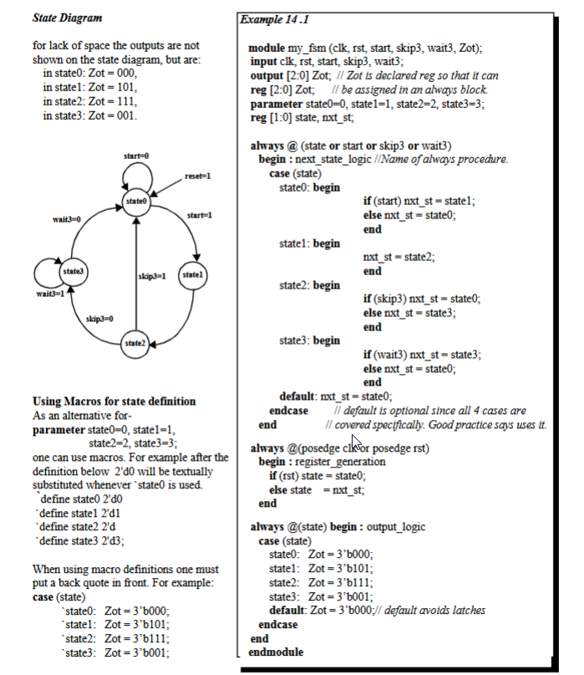

Slide 52
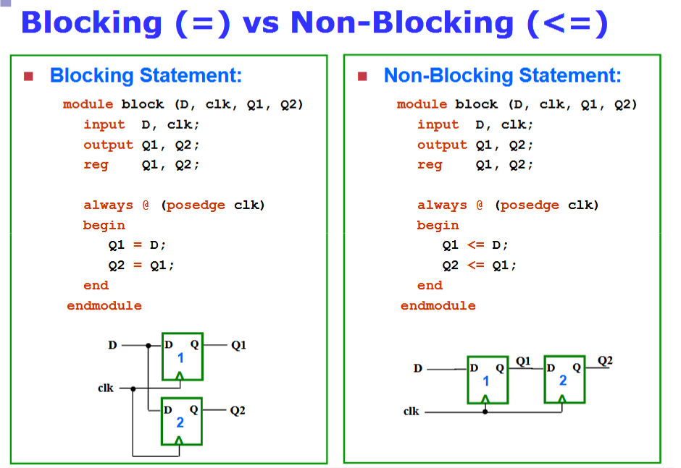

Slide 53
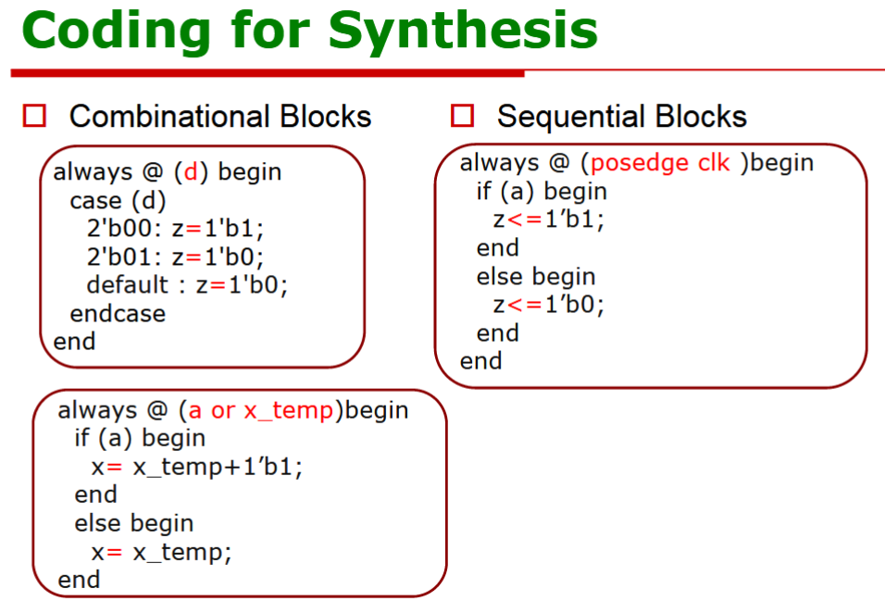

Slide 54
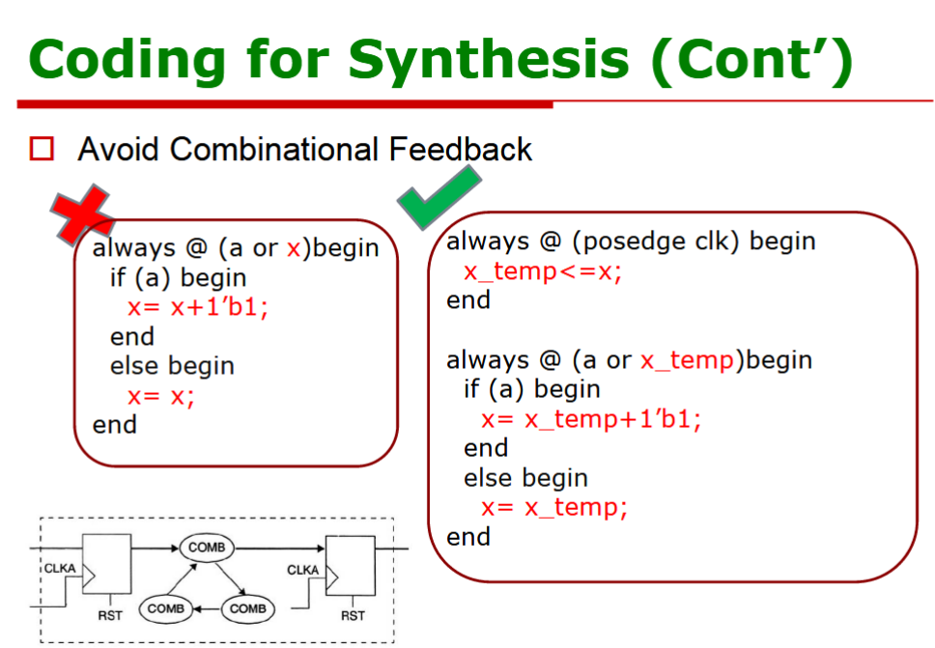

Slide 55
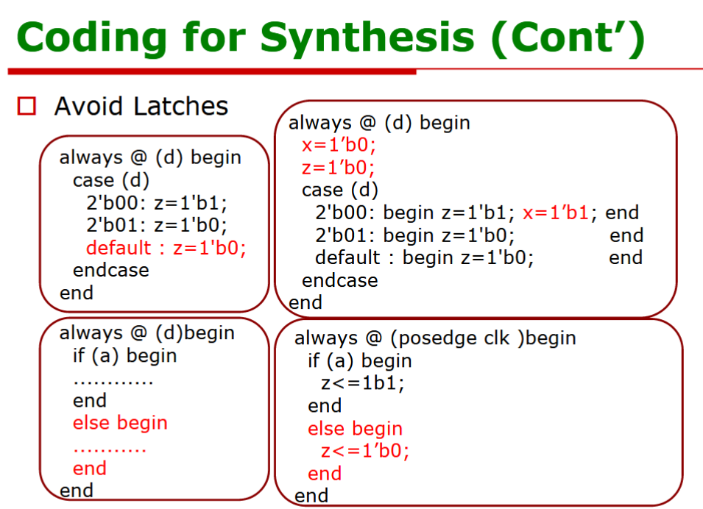

Slide 56
