Slide 1
Back end Digital Flow
Basics
Patrice Delpy 2018

Slide 2
TEST introduction
TEST of a circuit, what does that mean?
A task to know
If a manufactured circuit works well or not (functional or faulty)
If a circuit has faults or not
Why test a circuit?
To improve and guarantee its reliability (its quality): an indispensable condition for material for medicine, automotive, aviation, etc.
To ensure better production

Slide 3
We do not try to detect any design errors
We are not trying to identify the cause of the malfunction
We are talking about GO / NOGO test
The two main objectives are:
minimize the number of failed parts not detected
minimize the duration of the test (a few seconds at the most).

Slide 4
Time in money
Reduce the number of test vectors
Order the test vectors
Apply the tests first:
Which detect the most defects
Which detect the most likely faults
Having the smallest application time

Slide 5
Test patterns generation
The generation of test vectors consists in determining the stimuli to apply at the input of a circuit to highlight a potential fault.
The generation of test vectors can be performed at different levels of modeling:
- At the circuit description level
- Taking into account faults

Slide 6
Test vector generation methods
Exhaustive
Random
Structural

Slide 7
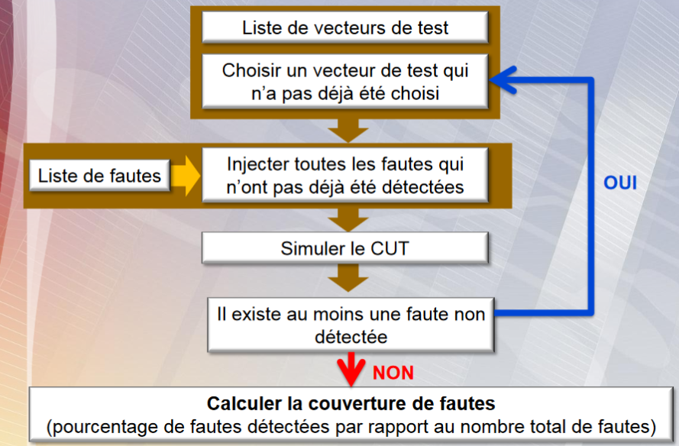
Faults simulation

Slide 8
Testability ? Design for Test techniques
Objective : facilitate controllability and observability of internet nodes,
Add circuitery (extra hardware) allowing circuit testable

Slide 9
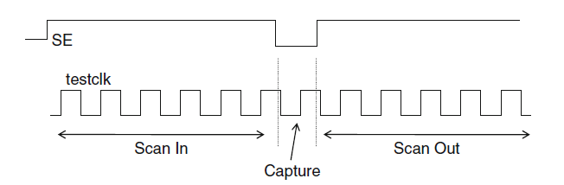

Slide 10
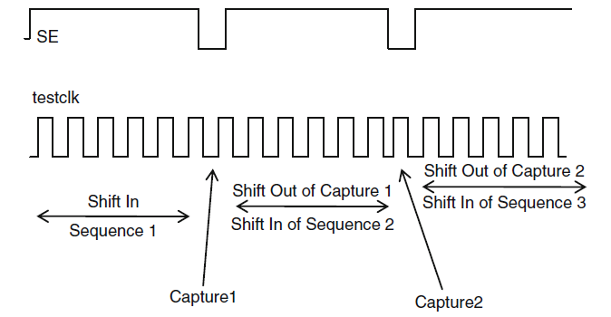

Slide 13
Liberty files
Foreach cell of a library, these files describe:
  The ports (input and output, power)
  The type of cells : buffer, inverter, and gate, io pads , …
  The operating condition
  The power consumption (optional)
  The timing modelling
These Liberty files are given by the foundry

Slide 14
Timing constaints (Sdc)
The sdc files (Synopsis Design Constraints) describe all the timing information between your design and the outside:
  what are the clocks signals? What are the relation between clocks ?
  what is the delay between the signals and the clock?
  What is the input or output capacitance load ?
  What are the timing exceptions ?
  …..
By default, the time unit is the ns

Slide 15
Multi-Mode Multi-Corner view
Multi Mode :
  The chip have different functional modes (different clock speed, enable bit configuration, …)
  => One or more constraint modes associated with sdc files for each mode
Multi Corner
  There is different library set (process corner typical, slow, fast, …) and RC corners for timing analysis (propagation delay, SI analysis)
  => Each delay corners combine liberty (.lib) for the std cells and QRC techfiles for the nets
=> MMMC view file combines constraint modes and delay corners to define different scenarios (“Analysis View”)
These analysis views are used for setup analysis and the hold during STA

Slide 16
SDC files
Setup / Hold
Clock
Inputs
Outputs
Timing exceptions

Slide 17
Setup and hold timing (1)
The setup and hold timing checks are needed for proper propagation of data through the sequential cells. These checks verify that the data input is stable at the active clock edge.
Setup time = minimum time with data stable before clock edge
Hold time = minimum time with data stable after clock edge

Slide 18
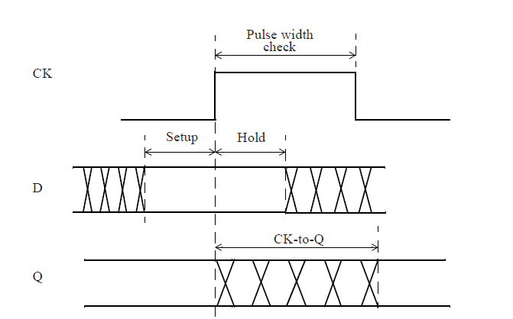
Setup and hold timing (2)

Slide 19
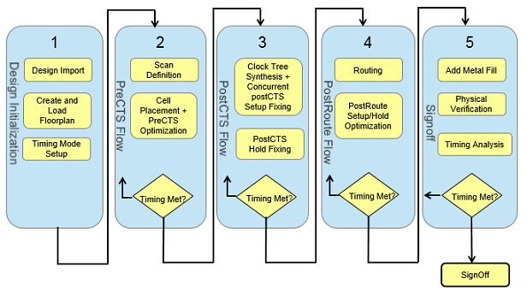
Summary of Innovus flow

Slide 20
More informations:
About sdc :
  “Static Timing Analysis for Nanometer Designs : a Practical Approach”
  from J . Bhasker and Rakesh Chadha

Slide 21
Place and route ?
Process of taking a structural file
(Verilog in our case) and making a physical view
from that description. It involves placing the cells on the chip, and routing the wiring connections
between those cells.

Slide 22
Digital Implementation System:
A Cadence tool for creation of digital
integrated circuits. This includes floor planning, power planning, test and place and route.

Slide 23
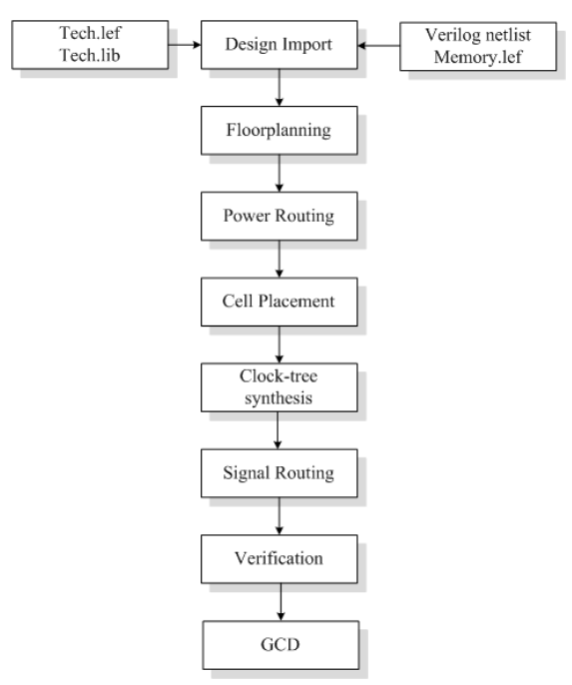
Innovus design flow

Slide 24
CTS: clock buffers will be added
Garantees that clock tree will be routed in the most effcient way and thereby clock skew will be reduced (best case 0)

Slide 25
Technology and design files
LEF: library exchange format

Slide 26

Warning !
The sdc files guide the digital tools during synthesis,
placement and routing to avoid setup or hold failure.
So be careful when you write them !
All path should be constrained to enable their analysis.
=> Unconstrained path can lead to “hidden” timing violations or “over design”

Slide 27
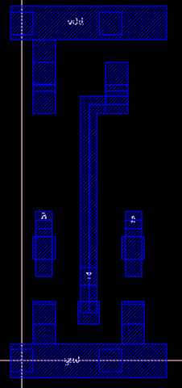
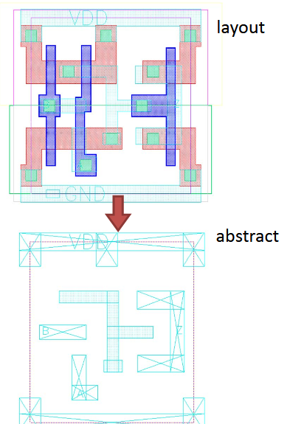

Slide 28
LEF: Libray exchange format
An ASCII data format, used to describe a standard cell library includes the design rules for routing and the Abstract of the cells, no information about theinternal netlist of the cells
Technology: layer, design rules, via definitions, metal capacitance
  type: Layer type can be routing, cut (contact), masterslice (poly, active), overlap.
  width/pitch/spacing rules
  direction
  resistance and capacitance per unit square
  antenna Factor
2. Site: Site extension
３．Macros: cell descriptions, cell dimensions, layout of pins and blockages, capacitances.

Slide 29
TLF : timing lib format
Ascii representation of the timing and power parameters accociated with any cell in technology
Timiing models to calculate
I/O delay path
Timing check value
Interconnect delays

Slide 30
Engenering change order (ECO) cells
ECOs usually are done after place and route.
It’s not necessary to regenerate all-masks. Only front end layers, is known as a “Metal Fix”
Spare cells without functionakity are added during design

Slide 31
Filler and tap cells
Must be inserted in empty areas in rows
Ensure well and diff mask continuity
Provide dummy poly for scaled technologies
Include moscap beetween VDD and GND
Called Decaps cells

Slide 32
Wells taps needed to ensure local body voltage
Eliminate latchup
Every 30um

Slide 33
Signal integrity (SI)
NanoRoute engine provides concurrent timing driven and SI driven routing.
Signal Integrity during routing is synonymous with Crosstalk
A switching signal may affect a neighboring net.
The switching net is called the Aggressor
The affected net is called the Victim

Slide 34
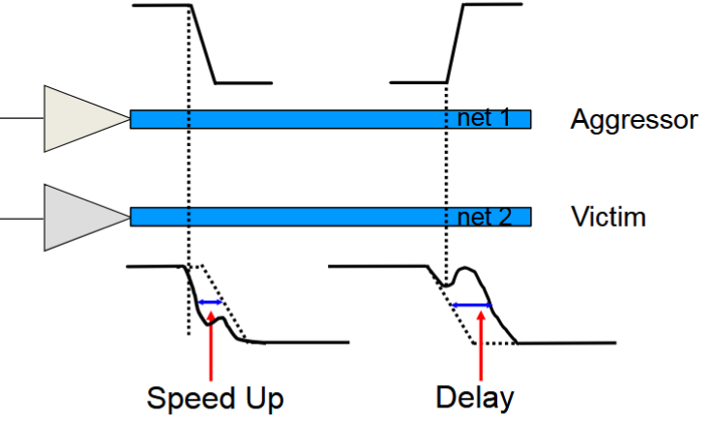
Two major effects:
Signal slow down
  When the aggressor and victim switch in opposite directions.
Signal speed up
  When the aggressor and victim switch in the same direction.

Slide 35
solutions
Limit length of parallel nets
Wire spreading
Shield special nets
Upsize driver or buffer

Slide 36
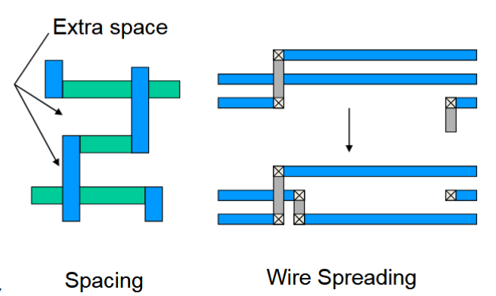
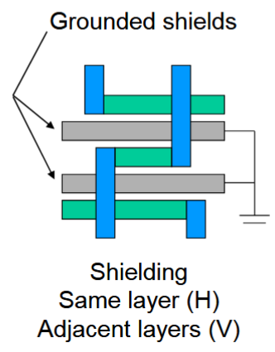
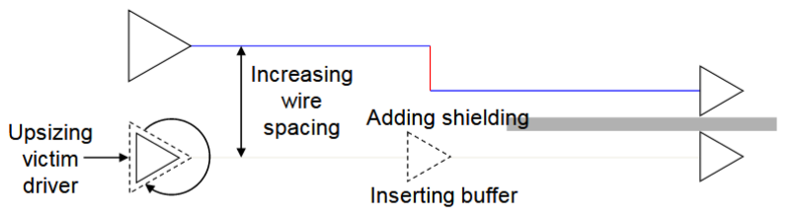

Slide 37
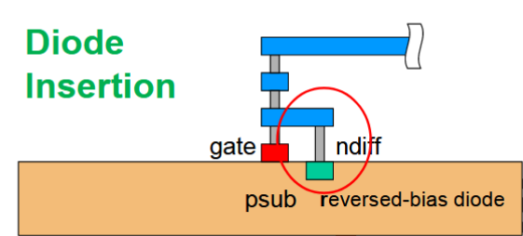
Antenna fixeing

Slide 38
Timing driving placement
Timing-driven placement tries to place critical path cells close together to reduce net RCs and to meet setup timing

Slide 39
ftp://ftp.dii.unisi.it/pub/users/vignoli/old/elettronicaiii/seminario_ing_affortunati_2000/des_flow.pdf a voir

Slide 40
http://www.eng.biu.ac.il/temanad/files/2017/03/02-Terminology-2012-13-A.pdf
http://www.eng.biu.ac.il/temanad/files/2017/02/Lecture-4-Standard-Cell-Libraries.pdf
http://www.ee.virginia.edu/~mrs8n/soc/SynthesisTutorials/sprflow.pdf
http://www.ee.ncu.edu.tw/~jfli/vlsidi/lecture/soc

