Slide 1
Current Mirror

Slide 2
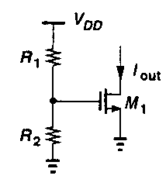

A MOS Transistor Biased by a Resistive Divider
Sensitivity to VDD, resistor variations, and temperature.

Slide 3
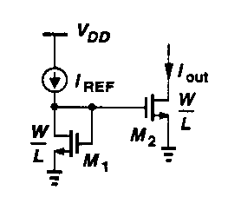
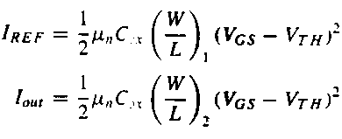

Basic Current Mirror
Same length MUST
be used for M1 and M2
A ratio of device dimensions.
No dependence on process
and temperature.

Slide 4
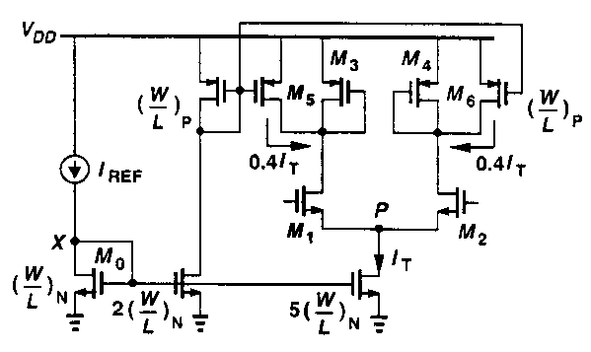
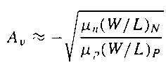
Current Mirror Used to Bias a Differential Amplifier
Reduce gm by reducing current rather than the aspect ratio.
Reduce I(M3) and I(M4).

Slide 5
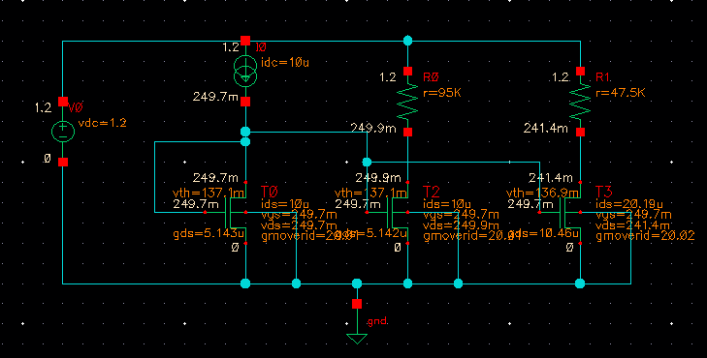
Example
W/L=10.95um/2um
W/L=21.9um/2um

Slide 6



Trade-Offs
Output resistance (1/gds)
CDS
W/L
Current

Slide 7
I_{OUT}=100 uA
L(um) | W(um) | GDS (uS) | CDS (fF)
2 | 109.63 | 51.82 | 100.39
800n | 47.4 | 56.5 | 17.13
180n | 17.02 | 92.9 | 1.079
120n | 13.33 | 147 | 0.411
For Same IOUT,
L↓→W↓→GDS↑(Ro↓) →CDS ↓
Drop in Ro is not desired.

Slide 8
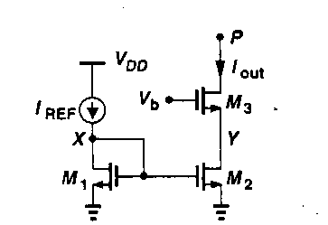
Use Cascode to Increase output Resistance
Rout is approximately g_{m3}r_{o3}r_{o2}
L1=L2, but L3 need not equal to L2.
Design Criteria: Choose V_{b} so that V_{Y} and V_{X}.

Slide 9
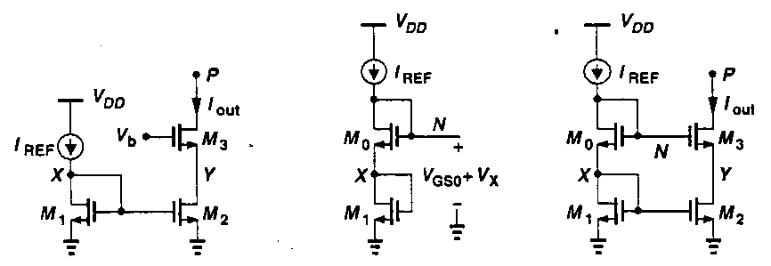
Cascode Current Source
Requirement: Choose Vb so that V_{X}=V_{Y}
V_{N}=V_{GS0}+V_{X}=V_{GS3}+V_{Y}
Therefore, V_{GS3}=V_{GS0}
Since I_{D1}=I_{D2}, (W/L)₃=(W/L)₀

Slide 10
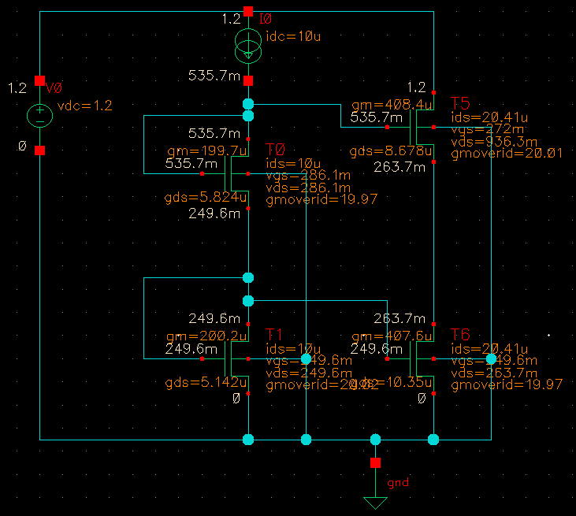
Cascode Current Mirror
(Close)
VDS1=249.6 mV
VDS6=263.7 mV
VDS5=0.675 V
VDS0=0.286 V
IDS5=20.41uA
IDS0=10 uA
gmovergds_5=47
gds6=10.35uS
Rout=4.5 MOhms
(Mismatch)

Slide 11
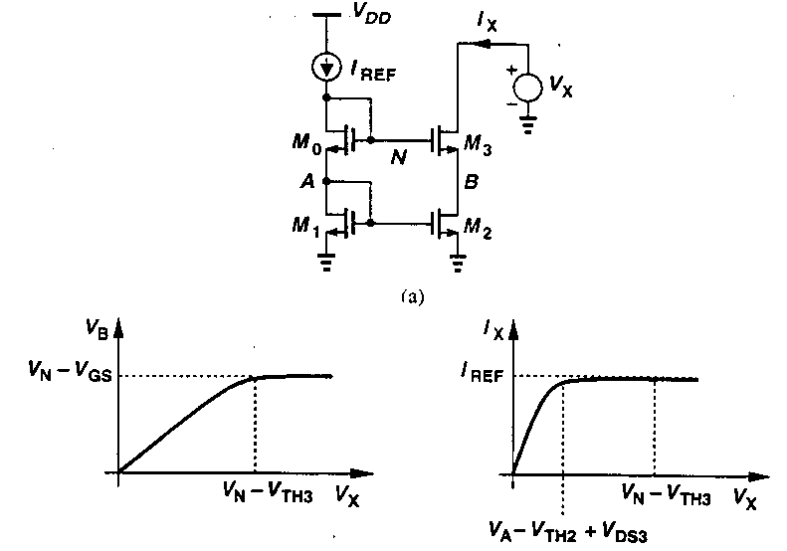
Sensitivity of IOUT due to VOUT
As VX decreases from VDD,
M3 enters the triode region first.
M2 enters the triode region

Slide 12
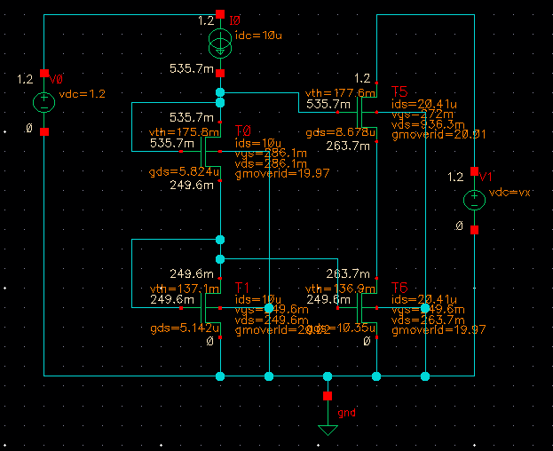
Sweep Output Voltage
VTH5=177.6 mV
VG5=535.7 mV
VG6=249.6 mV
VTH6=136.9 mV

Slide 13
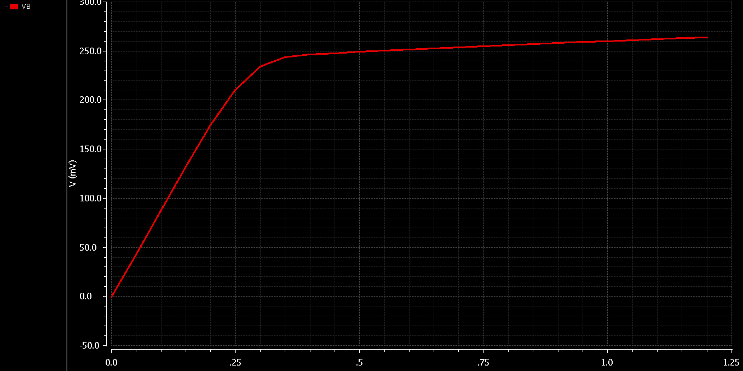
VB Versus VX
T5=Triode
T6=SAT
T5=SAT
T6=SAT
VG6=249.6 mV
VTH6=136.9 mV
VG6-VTH6=
249.6 mV-136.9 mV=112.7 mV
VB=112.7 mV →T6=Triode
VTH5=177.6 mV
VG5=535.7 mV
VG5-VTH5=535.7 mV-177.6 mV=358.1 mV

Slide 14
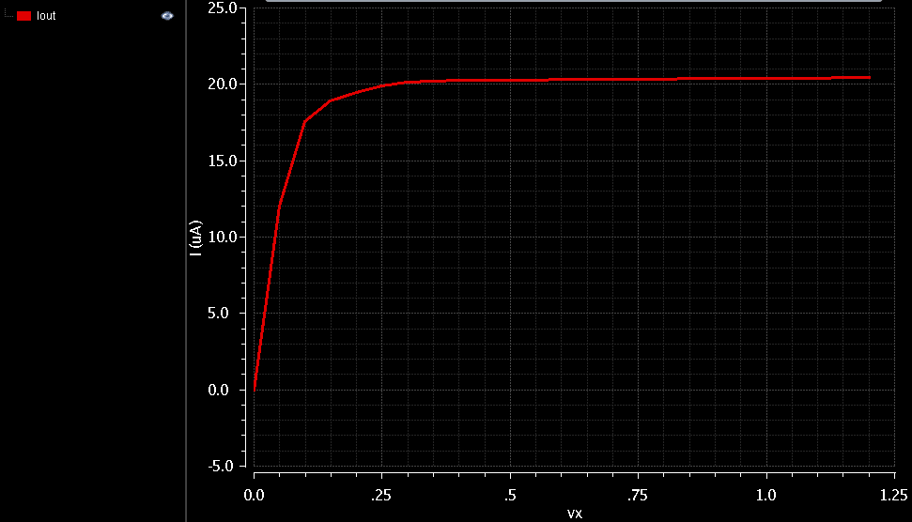
T5=Triode
T6=Triode
T5=Triode
T6=SAT
T5=SAT
T6=SAT

Slide 15
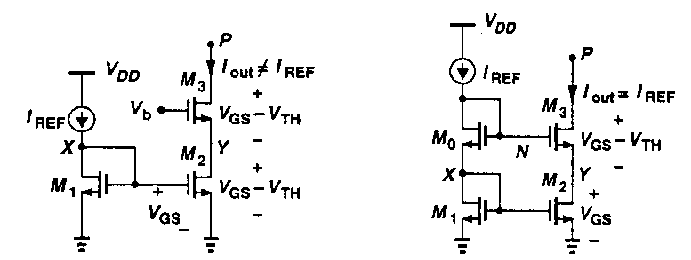
Accuracy and Voltage Headroom Trade-Off
Vb is chosen to allow minimum VP.
Problem: VX is not equal to VY
Iout is not equal to Iref.
Vb is chosen to allow VX=VY
VP is not minimum.
But Iout is equal to Iref.

Slide 16
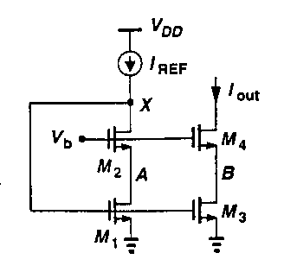
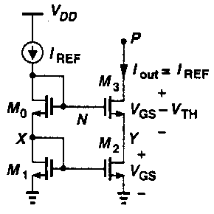
Design Criteria
Desirables:
  I_{OUT} should be I_{REF.} (i.e. V_{X}=V_{Y})
  V_{out} should be minimized. (i.e. V_{OD2}+V_{OD3})
V_{OUT}=V_{OD3}+V_{OD4}
V_{A}=V_{B}→I_{OUT}=mI_{REF}

Slide 17
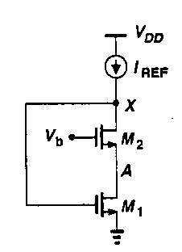


Low Voltage Cascode
To keep M2 in saturation: V_{x}>V_{b}-V_{th}→V_{x}+V_{th2}>V_{b}
To keep M1 in saturation: V_{A}>V_{x}-V_{th1}
Since V_{A}=V_{b}-V_{GS2}, V_{b}>V_{x}-V_{th1}+V_{GS2}
Design criteria for M2

Slide 18
Vb Requirement
Vb=VOD3+VGS4 to produce a minimum output
Voltage of VOD3 and VOD4.
By design, VGS4=VGS2, VA=VB
Vb=V_{OD2}+V_{TH2}+V_{OD1}.

Slide 19
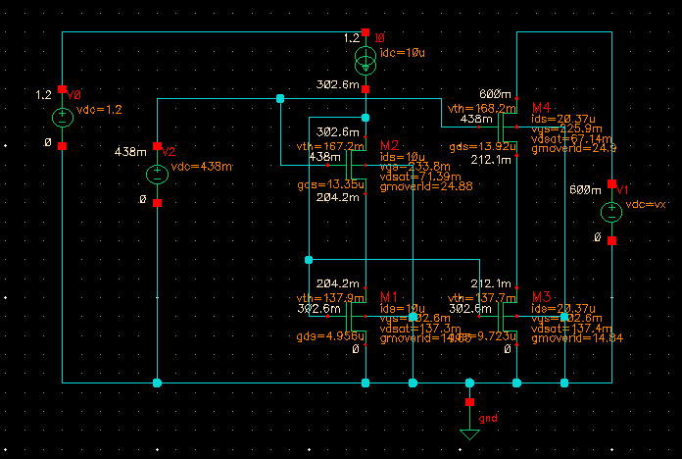
Minimum Vout

Slide 20
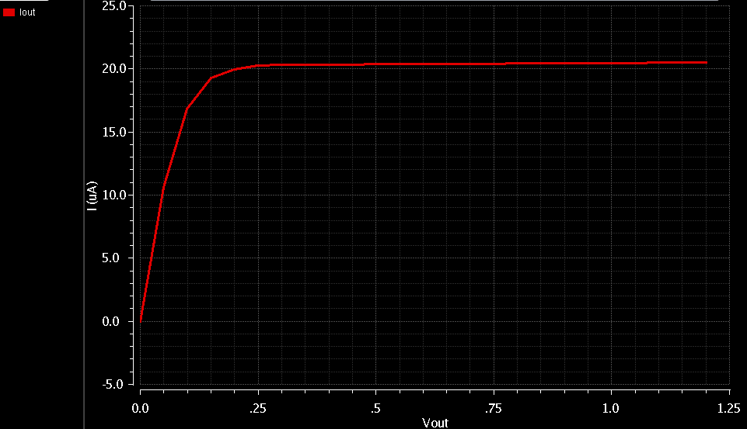
Minimum Vout
VOD3=0.163 V
VOD4=0.056 V
VOUT(min)=VOD3+VOD4=0.219 V

Slide 21
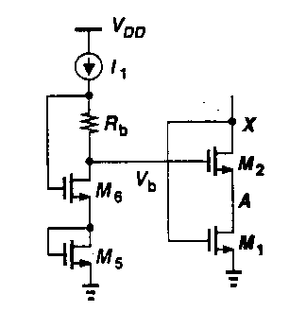
Vb Generation (Option 1)
Problem: M5 suffers from no body effect
M2 suffers from body effect
V_{GS5}=V_{GS2}
V_{OD1}=V_{GS6}-I₁R_{b}
Rb is not well controlled,
unless Rb is off-chip.
Requirement:
Vb=V_{OD2}+V_{TH2}+V_{OD1}

Slide 22
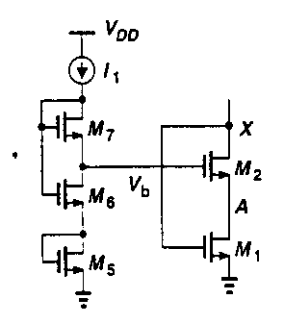
Vb Generation (Option 2)
Problem: M5 suffers from no body effect
M2 suffers from body effect
V_{GS5}=V_{GS2}
V_{OD1}=V_{GS6}-V_{TH7}
Design M7 (Large W₇/L₇) so
that VGS7 is approx. VTH7
Requirement:
Vb=V_{OD2}+V_{TH2}+V_{OD1}

Slide 23
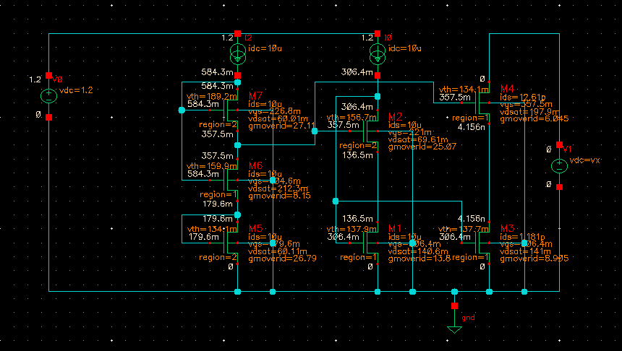
Vb Generation Circuit

Slide 24
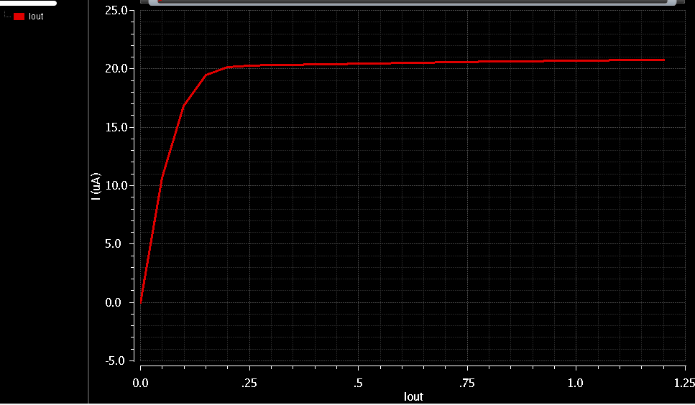
Iout versus Vout

Slide 25
Active Current Mirror

Slide 26
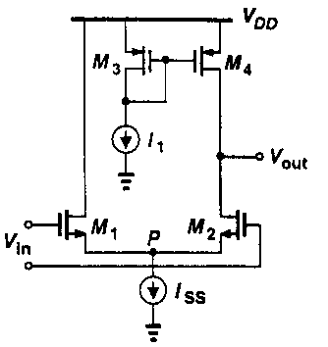
Differential Pair with Current-Source Load
Calculate the Av via Norten Equivalent Circuit
(The half-circuit concept is not applicable due to lack of symmetry)

Slide 27
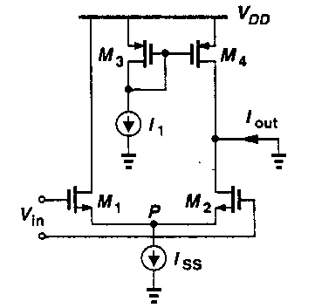
Transconductance
G_{m}=g_{m1}/2

Slide 28
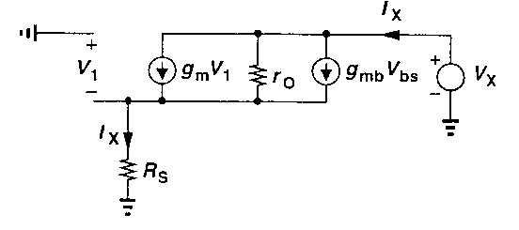
Output Resistance of a Source Degenerated Amplifier
(Output Resistance)

Slide 29
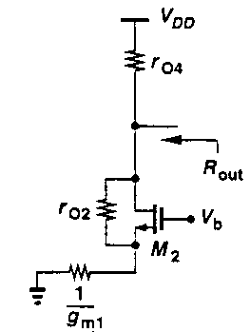
Output Resistance

Slide 30

Differential Pair with Current-Source Load

Slide 31
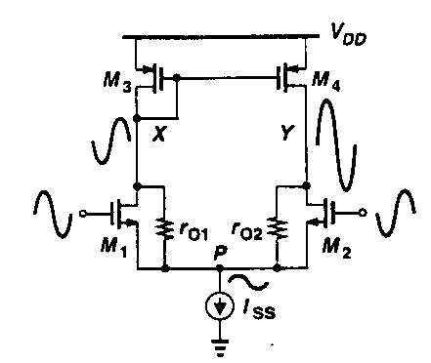
Combine Drain Currents to Increase Gain

Slide 32
Output DC Voltage
VX=VDD-|V_{GS3}|
If V_{Y} < V_{X}, then I_{M2}<I_{M1}.
Since I_{M3}=I_{M1} and I_{M4}=I_{M2},
I_{M3}>I_{M4}.
This is not possible because
V_{SD4}>V_{SD3}, so I_{M4}> I_{M3}.
With perfect symmetry V_{X,DC}=V_{Y,DC}.

Slide 33
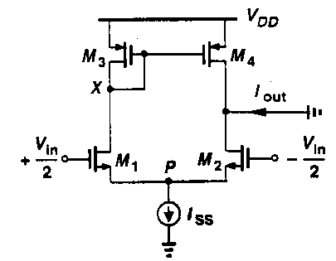
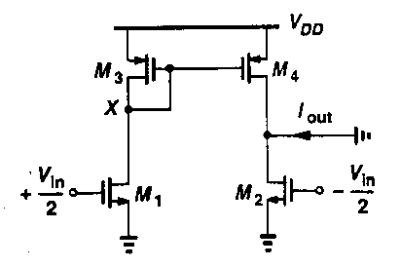
Small Signal Gain
The swing at X is low since the impedance at X is 1/gm3.
So the X can be approximated as an AC ground for the
purpose calculating Gm.

Slide 34
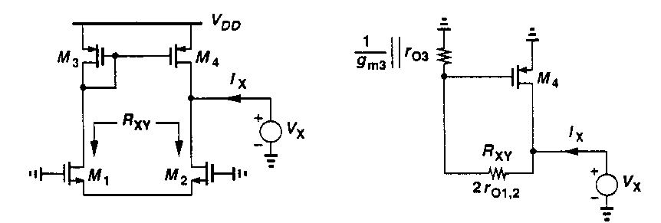
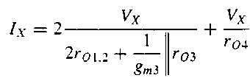

R_{out}
When a voltage is applied to the output to measured Rout,
the gate voltage of M4 does not remain constant.

Slide 35
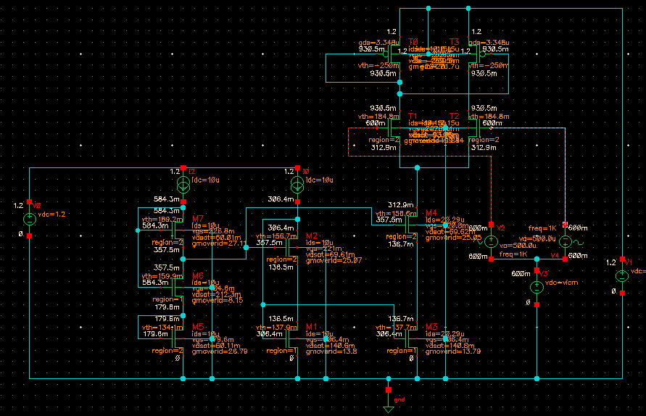
Active Current Mirror

Slide 36
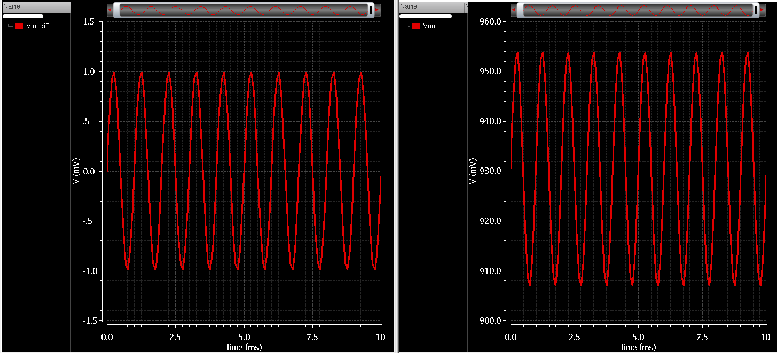
Voltage Gain of Active Current Mirror
Vin,pp=2 mV
Vout,pp=46.69 (Simulation)
Vout,pp=47.21 mV (Analytical calculation)

Slide 37
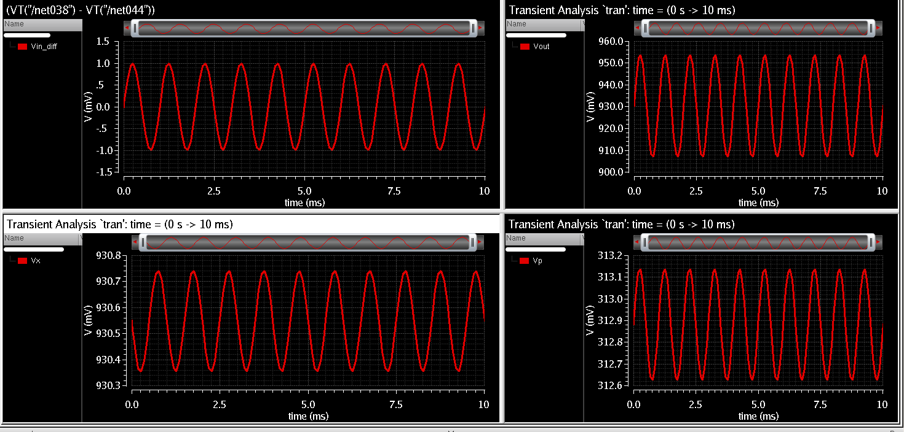

Slide 38
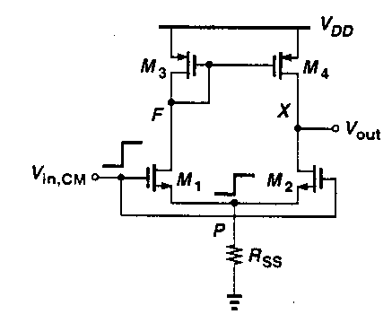

Common Mode Operation

Slide 39
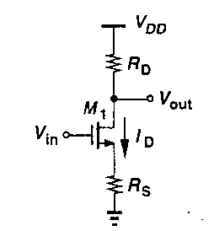
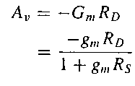
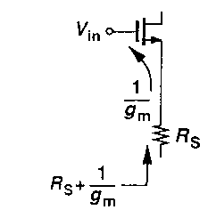
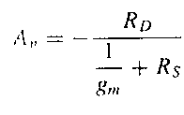
Gain By Inspection (Review)
Interpretation: The resistance at the drain
Divided by the resistance in the source path

Slide 40
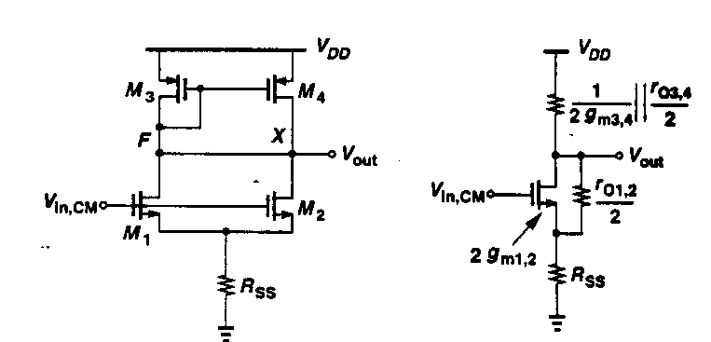
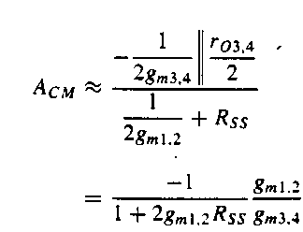

Equivalent Circuit
(neglected)

Slide 41
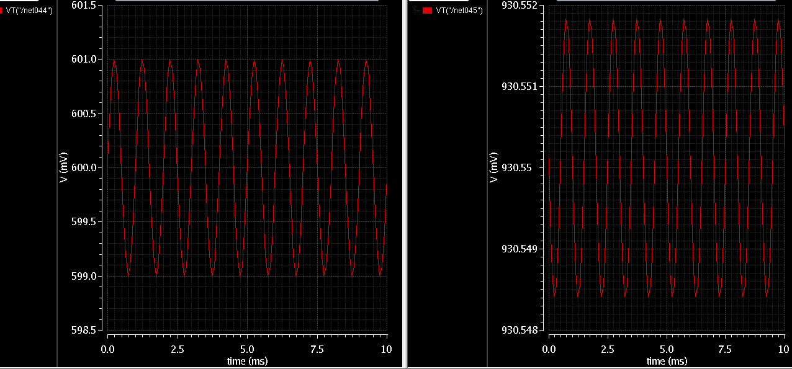
Vout,pp=0.003414m V
Vin,pp=2 mV
Av=0.001707

Slide 42
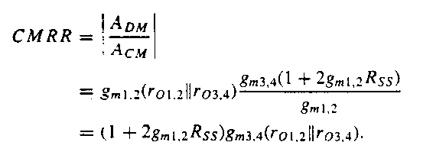
Common Mode Rejection Ratio

Slide 43
Active Current Mirror
CMRR=23.6/0.0017=13.88 x10³=82.84 dB

