Slide 1
Title goes here, move down a bit if no subtitle
Subtitle can go here

Slide 2
Choose the right Template Master for each file
Depending on the intended audience, be sure to choose
the right master template for each presentation:
  Public Information
  Confidential
  Internal Use Only
Download the “Tips for Template Users” file for information on this template and how to use it, including tips on pasting in slides from other templates, more layout samples, and examples of graphs, charts and tables you can copy, paste and modify as needed.
Tips for Users

Slide 3
Section Option 2 Slide
Subtitle goes here

Slide 4

Section Option 1 Slide
Subtitle goes here

Slide 5
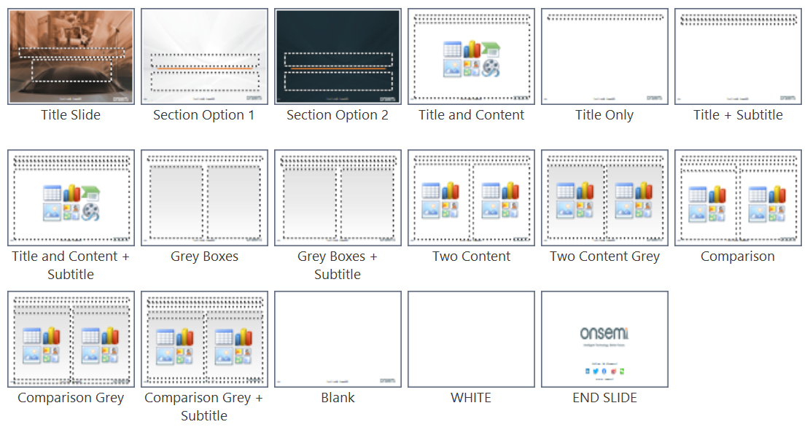
Layouts

Slide 6
Title and Content

Slide 7
Title and Content + Subtitle

Slide 8
Two Content

Slide 9
Two Content Grey

Slide 10
Comparison

Slide 11
Comparison Grey

Slide 12
Clustered column bar graph

Slide 13
Stacked bar chart

Slide 14
Pie chart

