Slide 1
Physical Design - IC Mask
Floorplan overview
Patrice Delpy – Toulouse Design Center

Slide 2
Why layout is so important ?
Area (cost)
Electrical performance
- Yield and robustness

Slide 3
Layout expertise :
Physical designer is expected to quickly, efficiently, and accurately translate a schematic into layout, make informed choices based on knowledge of increasingly complex tools, and understand how circuit function can affect layout decisions.
Layout Engineer has evolved into a highly value profession

Slide 4
Introduction
The first step in the Physical Design flow is Floorplanning.
This process identifying structures that should be placed close together, allocating space for them in such a manner as to meet the sometimes-conflicting goals of available space (cost of the chip), required performance, and the desire to have everything close to everything else.
Based on the area of the design and the hierarchy, a floorplan is decided upon. Floorplanning take in account all IP blocks, DigTop used in the design and their placement needs, the routing possibilities and the area of the entire design.
Floorplanning also decides the IO structure, aspect ratio of the design.
A bad floorplan will waste die area, create routing congestion low quality ,cost impact

Slide 5
Floorplanning vs Placement
Both determines block positions to optimize the circuit performance.
Floorplanning:
Details like shapes of blocks, I/O pin positions, etc. are not yet fixed (blocks with flexible shape are called soft blocks).
Placement:
Details like module shapes and I/O pin positions are fixed (blocks with no flexibility in shape are called hard blocks).

Slide 6
Floorplan challenges :
The effort for creating an analog layout of full custom circuit is higher.
Blocks are designed in parallel, specifcation is uncompleted : All technical informations are not available in same time !.
Schematic use multiple hiearchy level with missing parts of design : it’s laborious to build the chip organization.
The floorplanning task starts almost as soon as work on the project is begun.
Anticipate and estimate design change
Apply top/ down or bottom /up approch to create floorplan
Accurate estimations of blocks
Necessity for a new layout automation methodology : Flooplanning tool
IC physical floorplanner that enables you to develop effectively a layout floorplan from schematic in a hierarchical manner. Accept top-down approch, bottom-up or mix of both method to build topcell.
Cadence provide powerfull tool : Virtuoso Floorplanner
It contains interactive tools to assist designer.

Slide 7
Floorplanning
The goal of this document is to provide the essential steps required in the physical design of ASIC, in particular , the floorplanning stage,
Floorplanning is the art of any physical design. A well floorplan leads to an ASIC design with higher performance and optimum area.
Design a derivative product is easier

Slide 8
Floorplanning goals and objectives
Floorplanning is a mapping beetween schematic description and physical circuit. It’s an important stage to purpose a good implementation
Flooplanning
Arrange the macroblocks on a chip (placement)
Decide the location of the I/O pads
Build the type of power distribution ( power tree)
Define channel routing
Reduce wire length
Objectives :
Minimize the chip area
Minimize delay and reduce IR drop
Minimize routing congestion, making routing easy

Slide 9
Good floorplan : Teamwork and brainstorming
Good communication is key to acheive successful planning step.
Discussion to collect specifics requirements that will guide our choices
Knowing the needs expected by the application engineer, those coming from the schematic designer in order to translate his recommendations to the technological level
Floorplaning is an iterative process, in order to converge to the most optimal solution (tradoff)

Slide 10
It’s probably critical step to
Connectvity & constraints driven layout
Iterative procedure, in order to converge to the most optimal solution
Creating the right floorplan critical task that must evolve and be refined as the project progresses.
Rule of thumb
Layout planning is a time consuming task

Slide 11
Floorplanning : Inputs and outputs
Inputs
Schematic
Package data / pinout
Area requirements
Power requirements + isolation
Physical partitionning
Electrical / timing constraints
Die size vs performance vs schedule (trade-off)
Outputs
IO placed / ESD ring
Block area and placed
Pins interconnection
Routing channels
Power pre-routing
Domain : Noisy / sensitive blocks

Slide 12
Packaging
It’s really part of the floorplanning, should be addressed even before you begin your layout.
The package has a particularly large effect on placement of your I/O pads. You cannot just blindly put your input/output pads wherever you feel like it, because they interact with the package.
There are some rules and guidelines you will follow in order for these signal connections to be bonded properly in the packaging choice.
OnBds used to generate bonding diagram submitted to approbation (package expert validation)
Compute final die size

Slide 13
Types of Floorplan techniques
B1
B2
B1
B2
B1
B2
B3
B4
B5
B3
B4
B5
B3
B4
B5
Macro block: PLL
B6
B6
B6
Abutted
Non abutted
Mixed
Mixed topology is the most used

Slide 14
Floorplan illustration
LDO
VREF
VDD
VM
dead space
DIGTOP
GND
ADC
Rework required
Pad
Routing channel

Slide 15
Interconnect driven planning
The first part of your floorplan that you can be involved is the pin-out.
The quality of your pin-out directly affects how good your chip floorplan will be and how easy the chip will be to layout
k
f
h
e
h
a
j
i
d
c
e
c
l
f
l
i
b
j
b
a
g
d
k
g
Floorplan optimization
Define channel routing
Avoid congestion and bottleneck

Slide 16
Macro Block form factor
Aspect ratio : litterature suggest 1:1 and 2:1 (rectangular)
Avoid notches
The aspect ratio effects the routing resources available in the design
The aspect ratio effects the congestion

Slide 17
Guidelines for placing block-level pins
Determine the correct layer for the pins.
Spread out the pins to reduce congestion.
Avoid placing pins in corners where routing access is limited.
Use multiple pin layers for less congestion.
Never place cells within the perimeter of hard macros.
To keep from blocking access to signal pins, avoid placing cells under power straps unless the straps are on metal layers higher than metal2.
Use density constraints or placement-blockage arrays to reduce congestion.
Avoid creating any blockage that increases congestion.

Slide 18
ESD strategy ( ring ?)
Supply distribution (power tree, Start routing or trunck (large equipotential) )
Electromigration (current flow induces )
IR drop ( resistivity)
Isolation (power devices)
DFM rules
Reserve area to decoupling caps

Slide 19
Floorplan assistant
To reduce the time spent in the floorplanning phase and and be more efficient, necessity for a new layout automation methodology : Flooplanning tool
IC physical floorplanner that enables you to develop effectively a layout floorplan from schematic in a hierarchical manner. Accept top-down approch, bottom-up or mix of both method to build topcell.
Cadence provide powerfull tool : Virtuoso Floorplanner
It contains interactive tools to assist designer.

Slide 20

Virtuoso Floorplanner
Requires the following licenses :
Layout XL
Layout GXL
Select Floorplan workspace

Slide 21
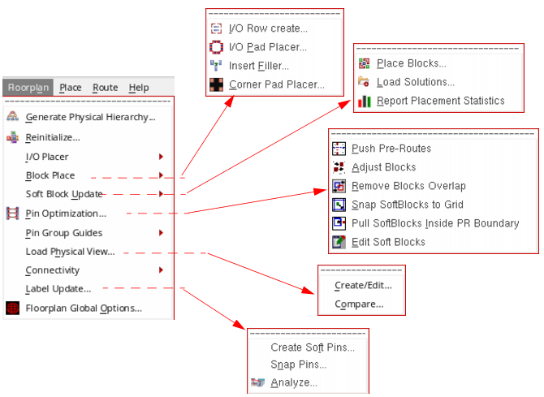
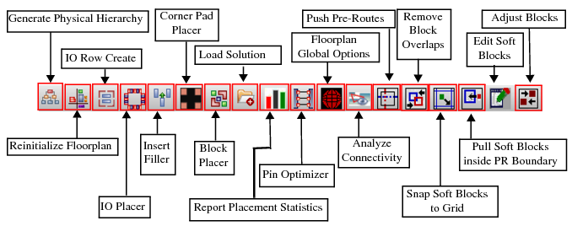
Flrorplan command : Layout -> Flooplan menu
Menu and toolbar contains commands that manipulate the hierarchy and define floor plans

Slide 23
Section Option 2 Slide
Subtitle goes here

Slide 24

Section Option 1 Slide
Subtitle goes here

Slide 25
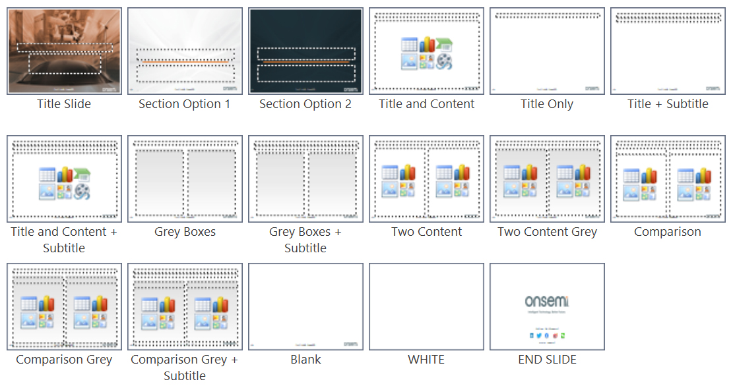
Layouts

Slide 26
Title and Content

Slide 27
Title and Content + Subtitle

Slide 28
Choose the right Template Master for each file
Depending on the intended audience, be sure to choose the right master template for each presentation:
Public Information
Confidential
Internal Use Only
Download the “Tips for Template Users” file for information on this template and how to use it, including tips on pasting in slides from other templates, more layout samples, and examples of graphs, charts and tables you can copy, paste and modify as needed.
Tips for Users

Slide 29
Two Content

Slide 30
Two Content Grey

Slide 31
Comparison

Slide 32
Comparison Grey

